Slide 1
Daily Routine
Sit in your appropriate seat quietly
Have all necessary materials out
All back packs on the floor
All cell phones on silent and away in backpacks
All music devices off and headphones out of your ears
No food or drink except for water

Slide 2
Bell Work
Compare and contrast warm fronts and cold fronts.
What type of weather is associated with a high pressure and low pressure systems?

Slide 3
Earth Science Announcements
District Common Assessment Dec 15
Course Final Dec 18th -19th

Slide 4
Climate
Is climate change real?

Slide 5
I will be able to…

Slide 6
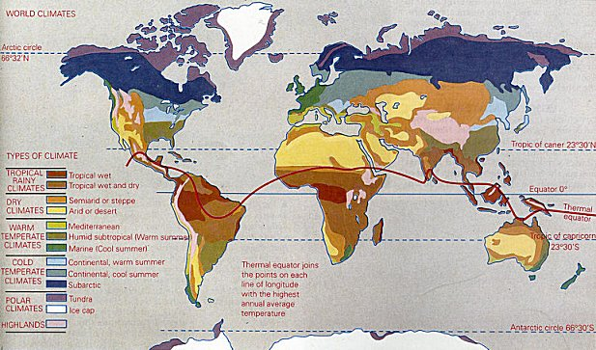
What is climate?
The study of atmospheric condition averages over a long period of time
Takes over 30 years to define a climate
Includes temperature, precipitation amounts, and humidity
Includes all spheres on Earth

Slide 7
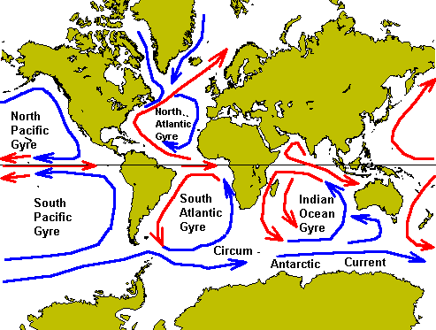
Factors Affecting Climate
1. Ocean Currents
Water temperatures can heat or cool land
Water temperatures can create humid or dry conditions on land
Currents transports heat or coldness to different areas of the world (poles)
Example: Gulf Stream and California Undercurrent

Slide 8
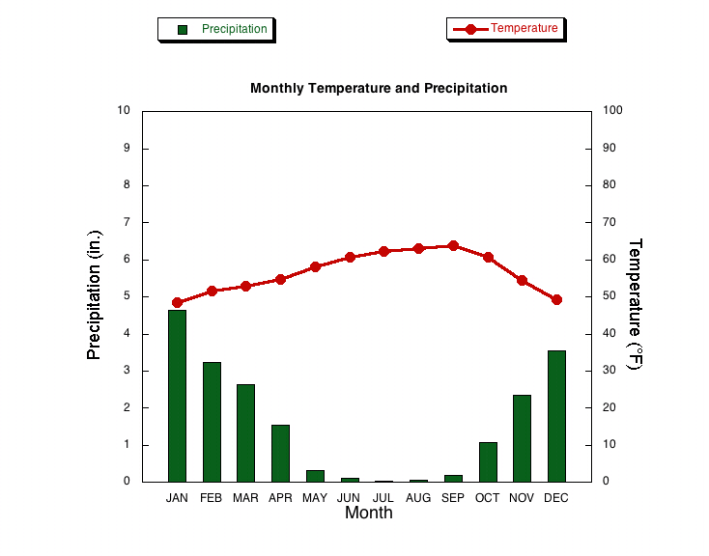
Large Bodies of Water Effect Climate
Coastal regions like that of the bay area experience a cooler, more humid climate
For example, San Francisco has a cool climate year round, never getting extremely hot or extremely cold
Why?
Because the Pacific Ocean keeps the temperatures moderate all year long, therefore, San Francisco even in the summer stays cool!

Slide 9
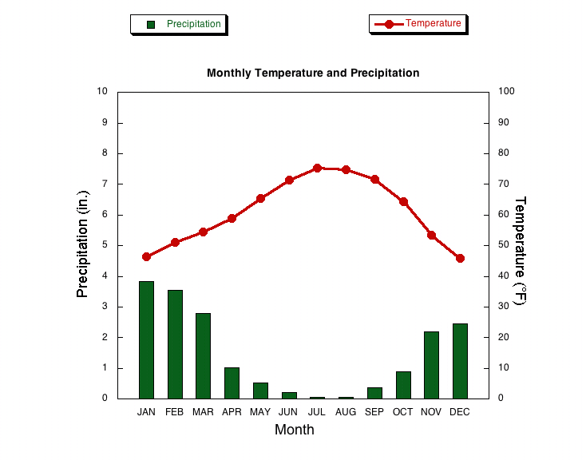
Climate Graphs
How does the ocean effect San Francisco's climate
Sacramento
San Francisco

Slide 10
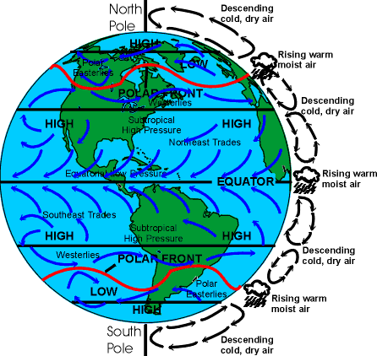
Factors Affecting Climate
2. Global Winds
Caused by uneven heating and convection
Brings in moisture to coastal areas
Transports dry air inland areas

Slide 11
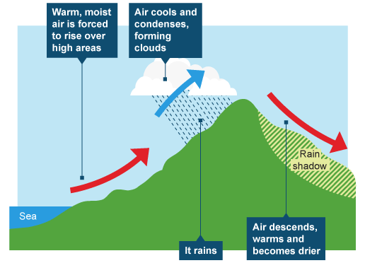
Factors Affecting Climate
3. Altitude/Relief
Higher elevations = colder temperatures
Higher elevations get more precipitation due to orographic lifting
Water moisture condenses because of colder temps

Slide 12



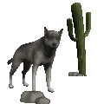


Rain Shadows
The Windward side
of Mountains have
wet moist climates
The Leeward side
of Mountains have
dry desert climates
As the air continues to
rise, it cools to the
Freezing point dropping
snowflakes
The air is now dry
Having lost it’s moisture
The mountain forces the air to
rise, as it rises, it cools below
The Dew point forming
Condensation, clouds and rain
The dry air flows over the
mountain, creating
a desert on the
Leeward side of
the mountain
Moist air from
over the ocean
Moves in over
the land (wind)
Dew Point
Lake
Tahoe
Sacramento
Reno
San Francisco
Pacific
Ocean
Windward
Leeward

Slide 13
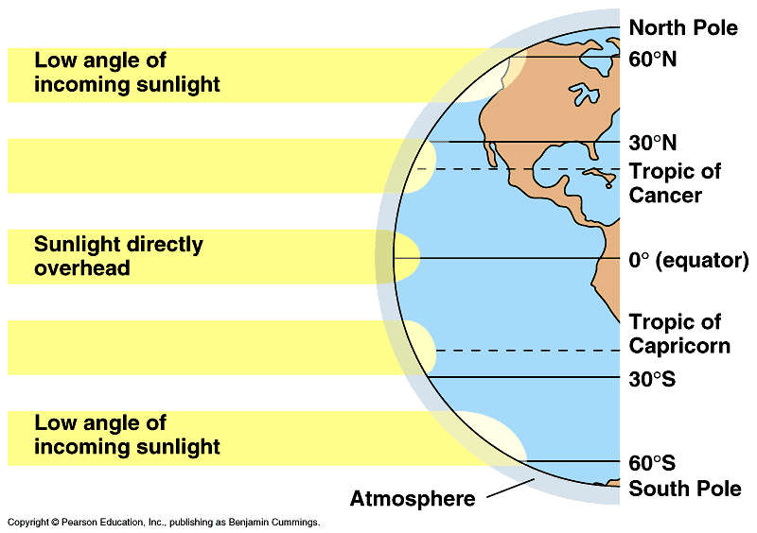
Factors Affecting Climate
4. Latitude
Affected by Earth’s axis tilt which creates seasons
Close to equator = more direct intense sunlight
Poles = less direct diffused sunlight
About 12 hour days around equator
Variable as you get away from the equator

Slide 14
Daily Routine
Sit in your appropriate seat quietly
Have all necessary materials out
All back packs on the floor
All cell phones on silent and away in backpacks
All music devices off and headphones out of your ears
No food or drink except for water

Slide 15
Bell Work
What are the four factors that affect climate for an area?
Choose one of the four factors and explain how it impacts climate?

Slide 16
Earth Science Announcements
District Common Assessment Dec 15
Course Final Dec 18th -19th

Slide 17
Climate
Is climate change real?

Slide 18
I will be able to…

Slide 19
Finish Yesterday’s Climate Graph Lab
Complete the graphs
Answer all questions
Make sure to answer the last question…question 9…in three thorough sentences on another sheet of pap

Slide 20
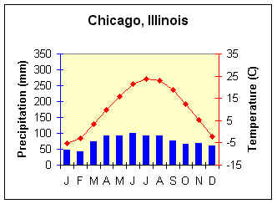
Continental Climates
Cities which are located in the middle of continents experience freezing winters and hot summers
Therefore, cities like Chicago experience dramatic temperature fluctuations over the coarse of a year:
Hot summers and Cold winters

Slide 21
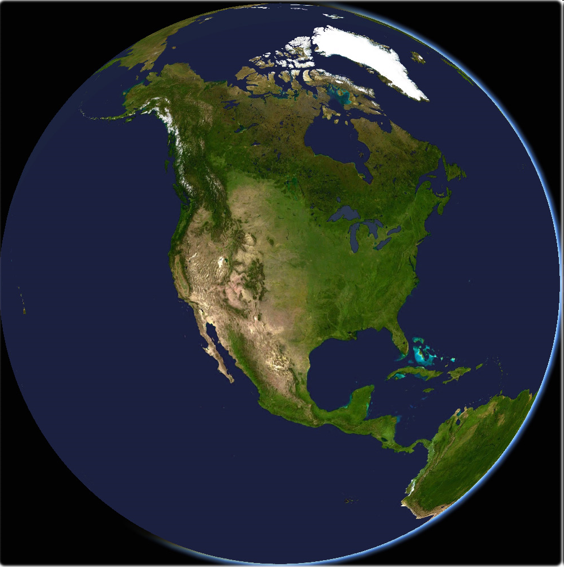
Continental Climates
-40º
-30º
Observe the behavior of temperatures as they cross over the North American Continent
-20º
-10º
0º
5º
10º
15º
How do
temperatures increase or decrease as they cross a continent???
20º
Winter
25º
30º

