Slide 2
Quickwrite
Answer the questions below in 1-2 sentences:
What do you think the deep ocean floor looks like??? Is it flat??? Does it have mountains???
What layer of the earth do we live on???

Slide 3
Plate Tectonics: Continental Drift

Slide 4
Objectives: I will be able to…
Identify Alfred Wegener and explain what his continental drift hypothesis was
Explain how Alfred Wegener used different lines of evidence to support his hypothesis
Plot latitude and longitude points of fossil evidence Wegener used to support his hypothesis
Map how the continents used to fit together

Slide 5
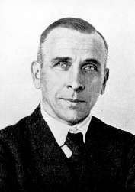
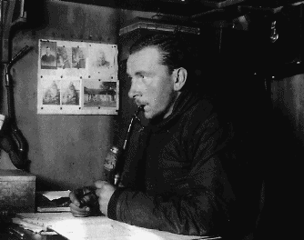
Who Was Alfred Wegener
German meteorologist (person who studies the weather)
Most research dealt with proving the existence of the jet stream
Became famous for his Continental Drift Hypothesis

Slide 6
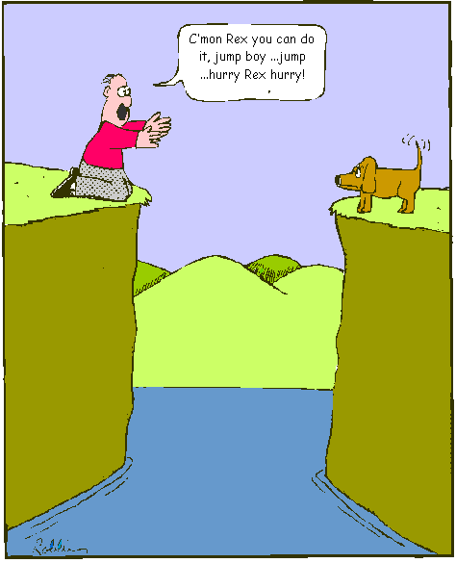
What is the Continental Drift Hypothesis
All continents were together in one landmass
Landmass was known as Pangaea
Some natural event happened and caused the continents to split
Continents drifted apart to their current day position

Slide 7
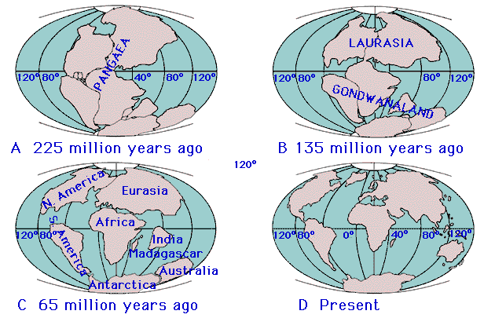
Continental Drift Hypothesis

Slide 8
Pangaea Animation
http://www.youtube.com/watch?v=hSdlQ8x7cuk

Slide 9
What type of evidence did he use to support his hypothesis?
The continents seems to fit together like a puzzle
Fossil Evidence
Geologic Evidence
Climate Evidence

Slide 10
What type of evidence did he use to support his hypothesis?
The continents seems to fit together like a puzzle
One large land mass known as Pangaea
Lauratania – North America, Europe, Asia
Gondwana – South America, Australia, Africa, Antarctica, India

Slide 11
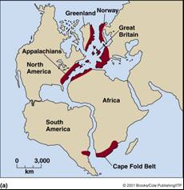
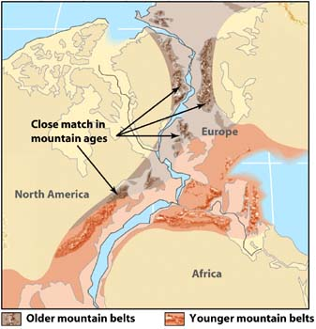
What type of evidence did he use to support his hypothesis?
Geologic Evidence:
Similar rock formations found on different continents
These formations were the same age
Different mountain ranges line up and have similarities

Slide 12
Mountains and Rocks match up!
Mountains
Match Up!

Slide 13
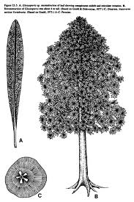
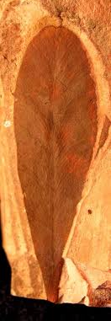
What type of evidence did he use to support his hypothesis?
Fossil Evidence:
Four index fossils were found throughout the five southern continents
Prime example: Glossopteris – type of tropical fern
Most animals were fresh water or land dwellers and couldn’t swim long distances

Slide 14
Fossils
Matched Up!

Slide 15
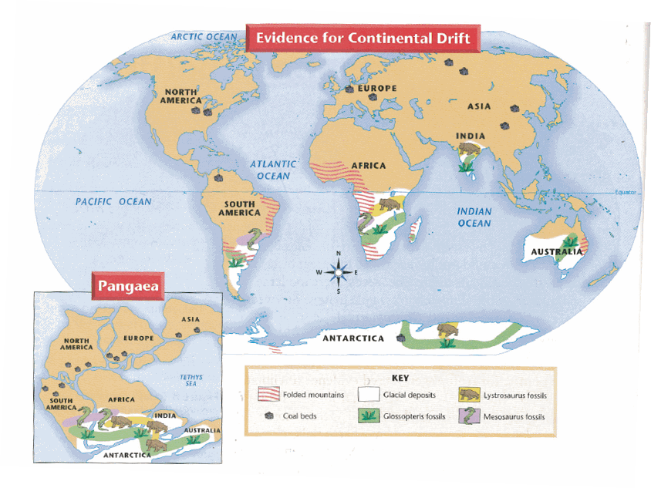
What type of evidence did he use to support his hypothesis?
Climatic Evidence
Coal Beds: indicate tropical climates and were found in Antarctica
Glacial deposits (moraines) on different continents are similar by positioning and material
Glacial striations or scratch marks follow same trends on different continents

Slide 16
Climate Evidence

Slide 17
Was Wegner’s Hypothesis accepted?
NO!!!!

Slide 18
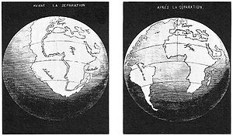
Why wasn’t Wegner’s Hypothesis accepted?
Wegner had an abundance of evidence to support his hypothesis
Didn’t have the mechanism to explain how the continents divided

