Slide 1
Daily Routine
Sit in your appropriate seat quietly
Make sure you are wearing your ID’s
Have all necessary materials out
All back packs on the floor
All cell phones on silent and away in backpacks
All IPods off and headphones out of your ears
Hats off
No food or drink except for water

Slide 2
Biology Announcements
Superhero vs. Supervillain Project Due 2/20

Slide 3
Complex Patterns of Inheritance

Slide 4
I will be able to…
Describe the different type of allele interactions
Describe polygenetic traits and the effect of environmental factors on phenotype

Slide 5
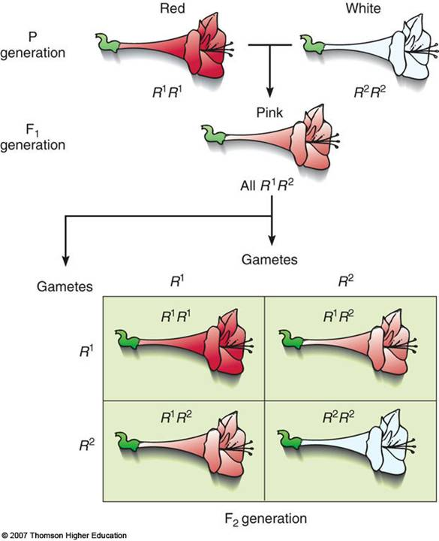
Incomplete Dominance
Heterozygous phenotype is somewhere between the two homozygous phenotypes
Alleles are neither dominant or recessive
Alleles represented by A₁ and A₂
Purple flower crossed with white flower = pink flower

Slide 6
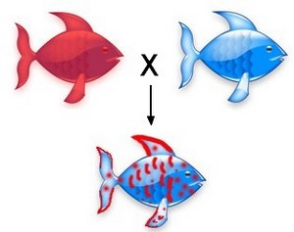
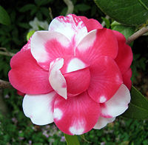
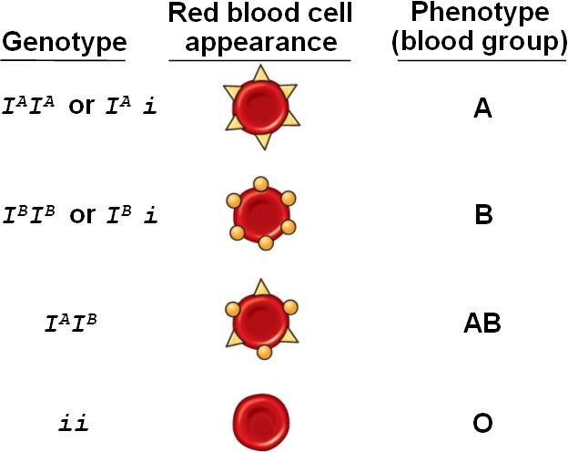
Codominance
No dominant or recessive allele for phenotype
Traits are fully and separately expressed
Red flower crossed with white one results in red and white spotted flower
Example Blood Type
Blood type A and blood B type are both dominant
When together, both phenotypes are expressed

Slide 7
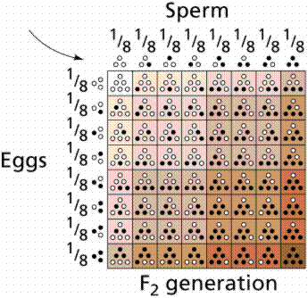
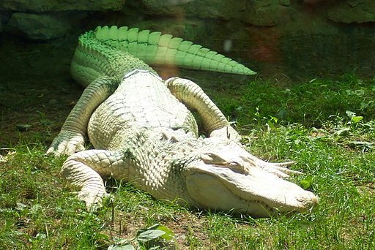
Polygenetic Traits
Traits produced by two or more gene
Need multiple sets of alleles (ex. AABBCC)
Has dominant and recessive alleles
Range of which is most dominant of dominant allele
EX. Eye color, skin color, etc.
Epistatic genes interfere with expression of other genes EX. Albinism

