Slide 1
Daily Routine
Sit in your appropriate seat quietly
Make sure you are wearing your ID’s
Have all necessary materials out
All back packs on the floor
All cell phones on silent and away in backpacks
All IPods off and headphones out of your ears
Hats off
No food or drink except for water

Slide 2
Earth Science Announcements
Volcano Project: Due 10/6
Volcano Quiz Tomorrow
Midterm 10/9 or 10/10

Slide 3
Introduction to Earthquakes
How does earthquakes affect our lives?

Slide 4
I will be able to…
Define what an earthquake is
Interpret a graph referring to elastic and plastic deformation
Diagram and explain what the three types of faults are and the anatomy of a fault

Slide 5
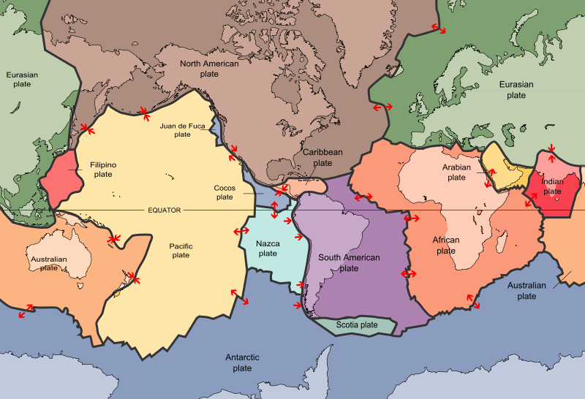
Earth’s Plates

Slide 6
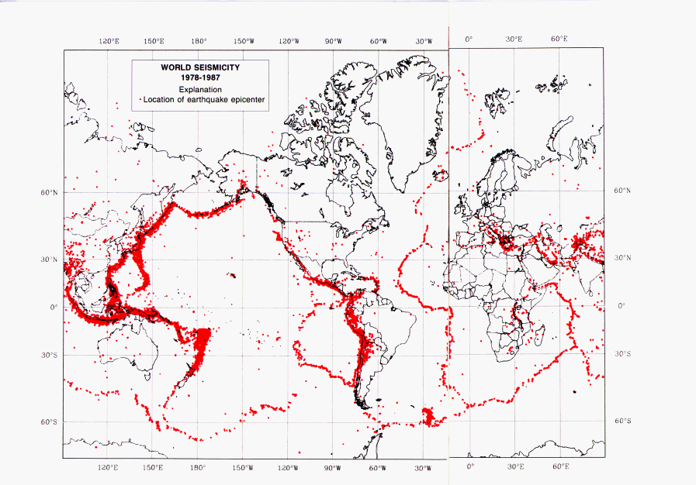
Earthquake Map

Slide 7
Are they similar?

Slide 8
Earth’s Plates

Slide 9
Are they similar?
OH YEAH!!!

Slide 10
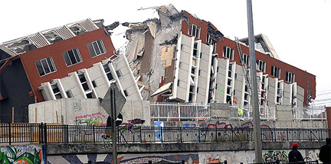
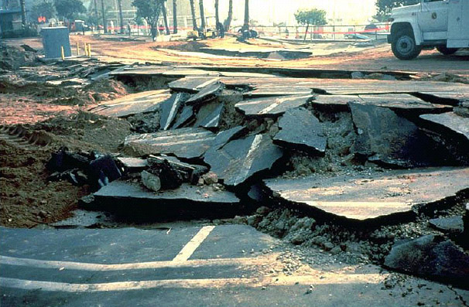
What are Earthquakes?
A sudden movement or offset from a release of energy and stress in Earth’s crust

Slide 11
What are Earthquakes?
A sudden movement or offset from a release of energy and stress in Earth’s crust
Most earthquakes occur around plate tectonic boundaries

Slide 12
Earth’s Plates

Slide 13
What are Earthquakes?
Most earthquakes occur around plate tectonic boundaries
Stress vs. Strain relationship

Slide 14
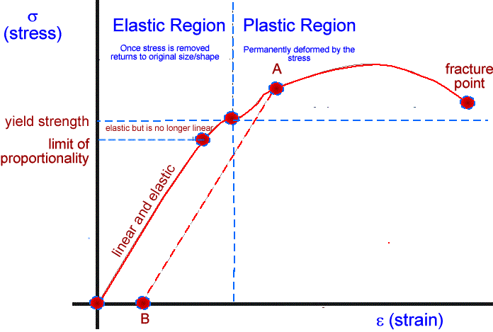
What are Earthquakes?
Most earthquakes occur around plate tectonic boundaries
Stress vs. Strain relationship
Elastic Deformation = bounces back
Plastic Deformation = deformed and breaks

Slide 15
What are Seismic Waves?
When an earthquake goes off it releases seismic waves
3 types of seismic waves exist: Primary, Secondary, and Surface
Primary waves are the fastest waves and cause rock to compress and stretch rock
Secondary waves are slower than primary waves and move rock up and down
Surface waves are the most destructive because they travel through rock at the surface causing rock to move up and down and side to side

Slide 16
How do we recording Seismic Waves?
After an earthquake seismic waves are released
Seismic stations record these earthquakes with a seismograph
These seismographs record P waves first since they are the fastest, the S-Waves second, and the destructive surface waves last
Surface-Waves
Surface-Waves
P-Waves
S-Waves
P-Waves
S-Waves

Slide 17
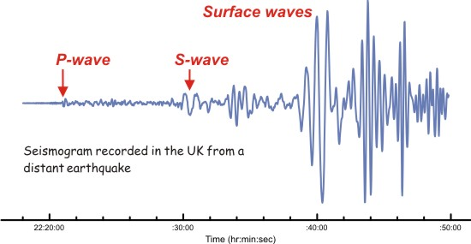
Earthquake Seismograph

Slide 18
Earthquake Seismograph

Slide 19
Earthquake Seismograph

Slide 20
Earthquake Seismograph

Slide 21
Slinky Lab

