Slide 1
Daily Routine
Sit in your appropriate seat quietly
All back packs on the floor
All cell phones away
ID’s on or out on the desk
All IPods off and headphones out of your ears
Have all necessary materials out
Hats off
No food or drink except for water

Slide 2
Anouncements
Quiz on Friday or next Monday about the atmosphere
Homework: Finish Atmosphere Graphing Due Thursday
Last week to make up work
Example: Geologic Time Scale Quiz and Test and Geologic Time Online Interactive

Slide 3
Weather: Introduction to the atmosphere

Slide 4
Today we will…
Describe Earth’s atmosphere gas make-up
Label the layers of the atmosphere
Graph atmosphere temperature information to determine the different layers of the atmosphere

Slide 5
Atmosphere Pre-Assessment
You need a pencil, the pre-assessment and the answer document
Do not write on the pre-assessment; only write on the answer document
After each question, check off whether you knew the answer or guessed

Slide 6
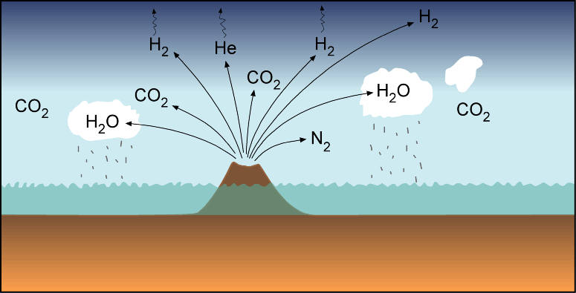
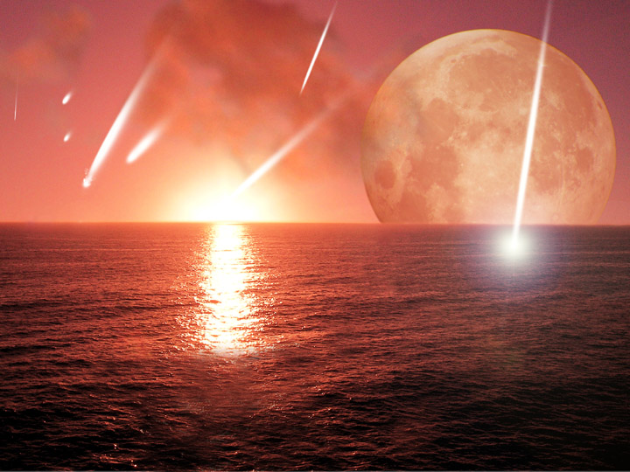
Earth’s Early Atmosphere
Early gases did not contain oxygen
Most gases came from outgassing of volcanoes
Mostly water vapor, carbon dioxide, nitrogen and methane
Oxygen became present 2.5 BYA due to cyanobacteria

Slide 7
Today’s Atmosphere
Gas | Chemical Abbreviation | Percentage
Nitrogen | N₂ | 78%
Oxygen | O₂ | 21%
Argon | Ar | 0.9%
Carbon Dioxide | CO₂ | 0.03%
Neon | Ne | Trace (ppm)
Helium | He | Trace (ppm)
Krypton | Kr | Trace (ppm)
Sulfur Dioxide | SO₂ | Trace (ppm)
Methane | CH₄ | Trace (ppm)
Hydrogen | H₂ | Trace (ppm)

Slide 8
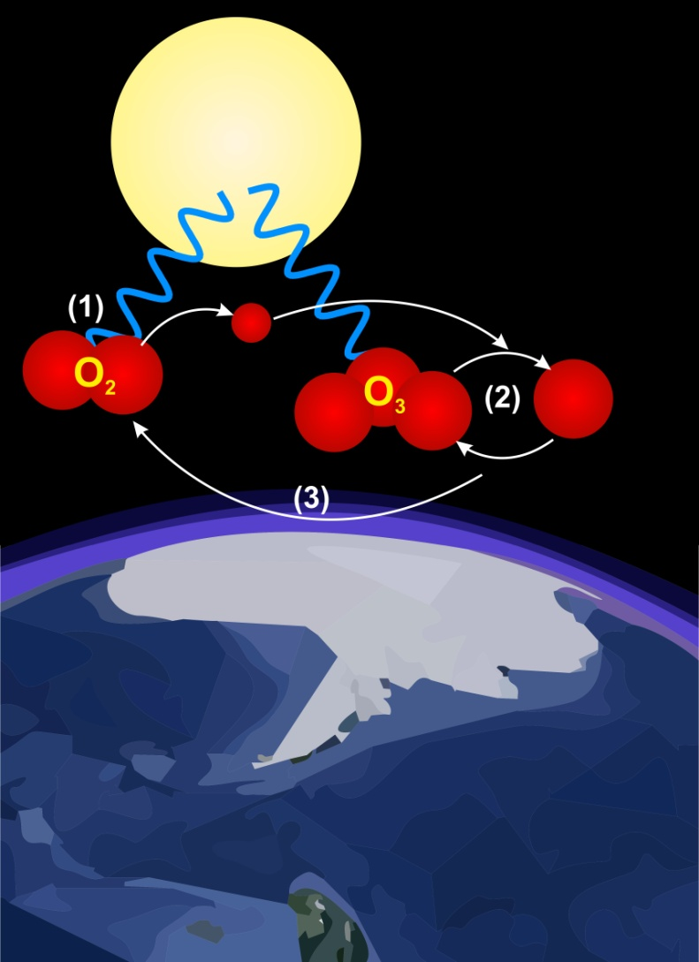
Variable Gases
Some gases in the atmosphere exist in different %
Based on location over land or location in the atmosphere
Examples:
Water Vapor (deserts)
Carbon Dioxide (seasons)
Ozone (seasons, location in atm, and CFC harm)

Slide 9
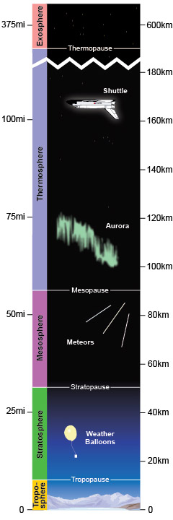
Layers of the atmosphere
Exosphere = lots of Helium and Hydrogen
Thermosphere = satellites orbit earth
Ionosphere = charge particles form Auroras and part of Thermosphere
Mesosphere = meteors burn up
Stratosphere = Ozone layer
Troposphere = where we live

Slide 10
Earth’s Layers Atmosphere Graphing

