Slide 1
Daily Routine
Sit in your appropriate seat quietly
Have all necessary materials out
All back packs on the floor
All cell phones on silent and away in backpacks
All music devices off and headphones out of your ears
No food or drink except for water

Slide 2
Bell Work
Students are trying to figure out the density of two objects their science teacher gave them. They found that object one had a mass of 5 grams and was shaped like a rectangular prism. Its measurements where 5 cm (L) x 2 cm (W) x 1 cm (H). Calculate objects one’s volume and density.
Object two had an irregular shape. The students had to use the displacement method. Their initial volume of water was 20 mL and their final volume was 30 mL. The object also had a mass of 20 grams. Calculate the objects volume and density.

Slide 3
Earth Science Announcements
Syllabus Signature Sheet
Lab Safety Contract
Quiz on Friday (Metric, Density, and Latitude and Longitude
Back to School Night – TONIGHT!!!

Slide 4
Mass, Volume, Density

Slide 5
The Metric System
A measurement system based on units or powers of 10
Meter measures length
Gram measures mass
Liter measures volume

Slide 6
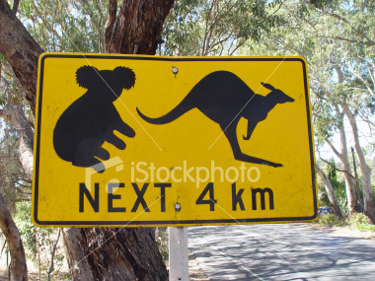
The Meter
The meter is used to measure length and distance
A Kilometer is a 1000 meters and is similar in length to the mile

Slide 7
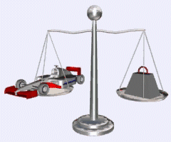
The Gram
A gram is used to measure Mass
Mass is a measure how much stuff (or matter) the object is made of
We find mass by weighing the object

Slide 8
The Liter
A liter is used to measure Volume
Volume is how much space an object uses up
50mL→

Slide 10
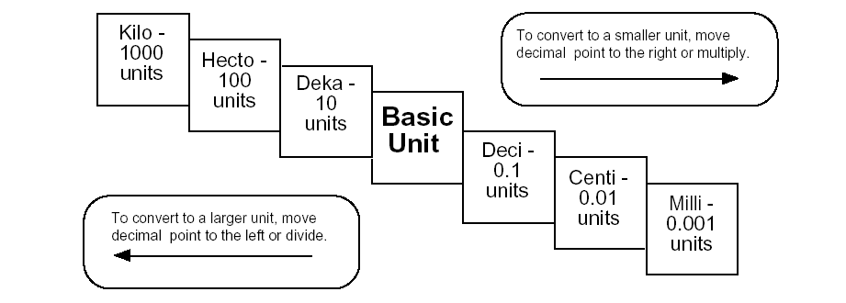
Metric Step Ladder
Basic Unit:
Meter,
Gram,
Liter

Slide 11
Daily Routine
Sit in your appropriate seat quietly
Have all necessary materials out
All back packs on the floor
All cell phones on silent and away in backpacks
All music devices off and headphones out of your ears
No food or drink except for water

Slide 12
Bell Work
Answer the questions of your choice in complete sentences:
What are latitude and longitude lines and what are they used for???
What are some things we use maps for???
Have you ever looked at a map, what sort of things did you notice on the map??????

Slide 13
Earth Science Announcements
Syllabus Signature Sheet
Lab Safety Contract
Quiz on Friday (Metric, Density, and Latitude and Longitude

Slide 14
Maps: Latitude and Longitude

Slide 15
Topic: Latitude and Longitude
Unit: Maps
Objectives: Day 1 of 3
To know the difference between latitude and longitude
To learn how to plot latitude and longitude coordinates

Slide 16
Pre Assignment
Find the correct cities for the corresponding lines of latitude and longitude.

Slide 17
Reading about Latitude and Longitude
Please do not write on these readings!!!!

Slide 18
Reading Questions
What are the seven major continents and the four major oceans?
How do we break up our Earth into different hemispheres?
What are lines of latitude and longitude?
What are the 0⁰ lines of latitude and longitude call?
What is the significance of Greenwich, England?
Compare and contrast a flat map and a Mercator map.

Slide 19
Latitude and Longitude
Longitude
Longitude
The earth is divided into lots of lines called latitude & longitude
Latitude
Latitude

Slide 20
Latitude Lines
Latitude lines run horizontally around the Earth.
The lines run parallel to each other and measure distances in degrees N or S.
The equator is at 0 degrees
Latitude
Equator
Latitude

Slide 21
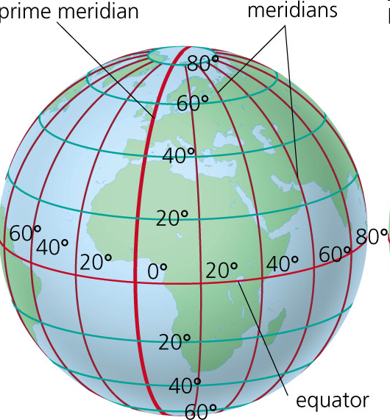
Equator
The Equator is at 0 degrees latitude
All latitude lines run parallel to the equator either measure north or south
Poles are the ending line at 90⁰

Slide 22
Longitude Lines
Longitude lines run north and south.
The lines also run parallel to each other and measure distances in degrees East or West.
The Prime Meridian is at 0 degrees
Prime Meridian
Longitude
Longitude

Slide 23
Prime Meridian
The prime meridian is 0 degrees longitude. This imaginary line runs through the United Kingdom, France, Spain, western Africa, and Antarctica.
All longitude lines run parallel to the prime meridian
Meridians measure to 180 degree East and West of the Prime Meridians

Slide 24
Hemispheres
By using the equator and prime meridian, we can divide the world into four hemispheres, north, south, east, and west.

Slide 25
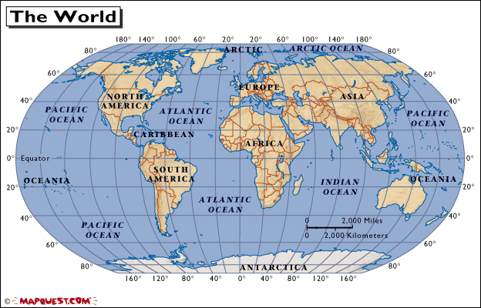

Slide 26
NW
NE
N
W
E
S
SE
SW

Slide 27
What is the latitude & longitude for:
-Sacramento California
-Darwin Australia
Lat= 40 degrees North
Long = 120 degrees West
Lat= 20 degrees South
Long = 140 degrees East

Slide 28
What is the latitude & longitude for:
-Mount Everest
-Lima Peru
Lat= 30 degrees North
Long = 80 degrees East
Lat= 10 degrees South
Long = 70 degrees West

