Slide 1
Daily Routine
Sit in your appropriate seat quietly
Have all necessary materials out
All back packs on the floor
All cell phones on silent and away in backpacks
All music devices off and headphones out of your ears
No food or drink except for water

Slide 2
Bell Work
What is Earth Science? Be specific….
What is one goal you have for this semester?

Slide 3
Earth Science Announcements
Syllabus Signature Sheet
Lab Safety Contract

Slide 4
Lab Safety

Slide 5
Mapping the Classroom
Take out your assumption sheet from yesterday
Take about five minutes to map out the classroom (don’t have to be artistic)
Mr. Hamilton will then go over where all the safety Equipment is in the classroom. He will also explain what the items are used for in the lab
Include these items in your map.

Slide 6
Lab Safety Video
https://www.youtube.com/watch?v=VRWRmIEHr3A

Slide 7
Lab Safety Quiz
Work on the quiz individual for 10-15 minutes
When instructed, talk to the person next you and compare answers (5-10 minutes)
When instructed, break up into groups of 4 (maybe a few groups of 3)

Slide 8
Daily Routine
Sit in your appropriate seat quietly
Have all necessary materials out
All back packs on the floor
All cell phones on silent and away in backpacks
All music devices off and headphones out of your ears
No food or drink except for water

Slide 9
Bell Work
What should you do if you accidently break a piece of glassware?
What do you think density is?

Slide 10
Earth Science Announcements
Syllabus Signature Sheet
Lab Safety Contract

Slide 11
Mass, Volume, and Density

Slide 12
Topic: Density
Unit: Metrics and Density
Objectives:
I will learn how to calculate volume by water displacement
I will understand the concept of density gi en mass and volume

Slide 13
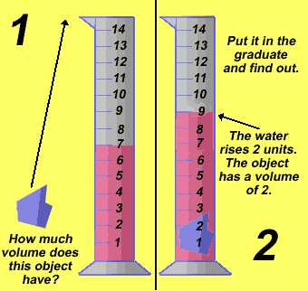
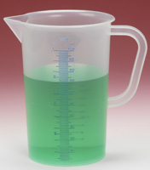
What is Volume?
We use Volume when we want to find the capacity or the space of something (how much liquid is inside)
Volume is measured is liters or milliliters

Slide 14
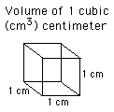
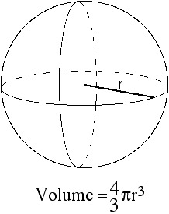
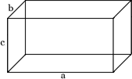
What are the 2 ways we find volume?
For simple shapes, like cubes and spheres, we can calculate them through basic math
For example, to find the volume of a cube we measure the (Length x Width x Height)

Slide 15
2 ways we find volume:
If something has an irregular shape, how do we find the volume of it?
The other way we find volume is by displacement

Slide 16
What is Volume by Displacement?
Let's say we want to find the volume of a rock
You can't exactly take out a ruler and measure it like you could a cube or triangle

Slide 17
What is Volume by Displacement?
Here's how you do it:
You drop the rock into water
Obviously, the water level will rise
But, by how much?
The amount it rises equals the volume of the rock

Slide 18
What is Volume by Displacement?
Submerging the object will cause the water level to rise
The amount it rises, equals the volume of the rock in milliliters
Volume of water and rock – volume of water = volume of rock

Slide 19
Practice measuring volume

Slide 20
What is Mass?
-
When we mass something, we measure how much stuff (or matter) the object is made of
We find mass by weighing the object
Mass is measured in grams and kilograms

Slide 21
What is Density
Density measures how much stuff (matter/mass) is compacted into a certain space (volume)
Density compares the mass of an object to its volume.
In the density expression, the mass of an object or substance is written in the numerator and its volume in the denominator.
D = mass = g or g = g/cm³ volume mL cm³
Note: 1 mL = 1 cm³

Slide 22
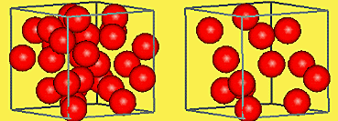
Density
Density measures how tightly matter is compacted
Lets imagine we have 2 cubes the same size
However, now let us imagine that one cube is made of lead, and the other is made of Foam
They both have the same size but which one is more dense?
Lead
Foam

Slide 23
Density
The lead Cube is!
But why?
Well, it all has to do with how much stuff is packed into the same amount of space!
Lead
Foam

Slide 24
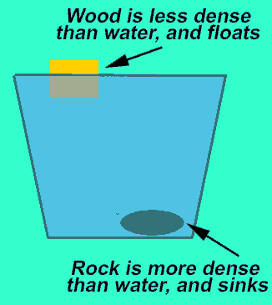
Water and Density
Water has a density of 1
If an object sinks, it has a density greater than 1
If an object floats, it has a density less than 1

Slide 25
Gummy Bear Lab

Slide 26
Daily Routine
Sit in your appropriate seat quietly
Have all necessary materials out
All back packs on the floor
All cell phones on silent and away in backpacks
All music devices off and headphones out of your ears
No food or drink except for water

Slide 27
Bell Work
Define density.
What is the equation to solve for density?
Explain how to figure out the volume of an irregular object.

Slide 28
Earth Science Announcements
Syllabus Signature Sheet
Lab Safety Contract
Back to School Night: Monday 1/12/15

Slide 29
Mass, Volume, and Density

