Slide 1
Daily Routine
Sit in your appropriate seat quietly
Have all necessary materials out
All back packs on the floor
All cell phones on silent and away in backpacks
All IPods off and headphones out of your ears
Hats off
No food or drink except for water

Slide 2
Bell Work
What is deposition?
What is lithofication and what two processes help form sedimentary rocks?

Slide 3
Metamorphic Rocks

Slide 4
Today, we will be able to:
Describe how metamorphic rocks form
Define how metamorphic rocks change with heat and/or pressure in large and small scaled settings
Identify metamorphic rocks by foliation or lack of foliation

Slide 5
Metamorphic Rocks
Big Idea
Supporting Detail
Heat and pressure change rocks
Heat and pressure change rocks
Metamorphism – process which rocks change

Slide 6
Metamorphic Rocks
Big Idea
Supporting Detail
Heat and pressure change rocks
Metamorphic rocks come from a parent rock
Recrystallization:
  Minerals crystals can grow larger
  New minerals can form and rearrange

Slide 7
Metamorphic Rocks
Big Idea
Supporting Detail
Metamorphic Changes occur over large and small areas
Large scale = mountain building
Rocks are buried
Deeper rocks change more; more heat and pressure

Slide 8
Metamorphic Rocks
Big Idea
Supporting Detail
Metamorphic Changes occur over large and small areas
Small scale = magma contact changes minerals
Earthquakes = pressure by grinding

Slide 9
Metamorphic Rocks
Big Idea
Supporting Detail
Most metamorphic rocks develop bands of minerals
Foliation = develop with pressure
Develop when minerals flatten out or line up
More pressure and heat = larger foliation

Slide 10
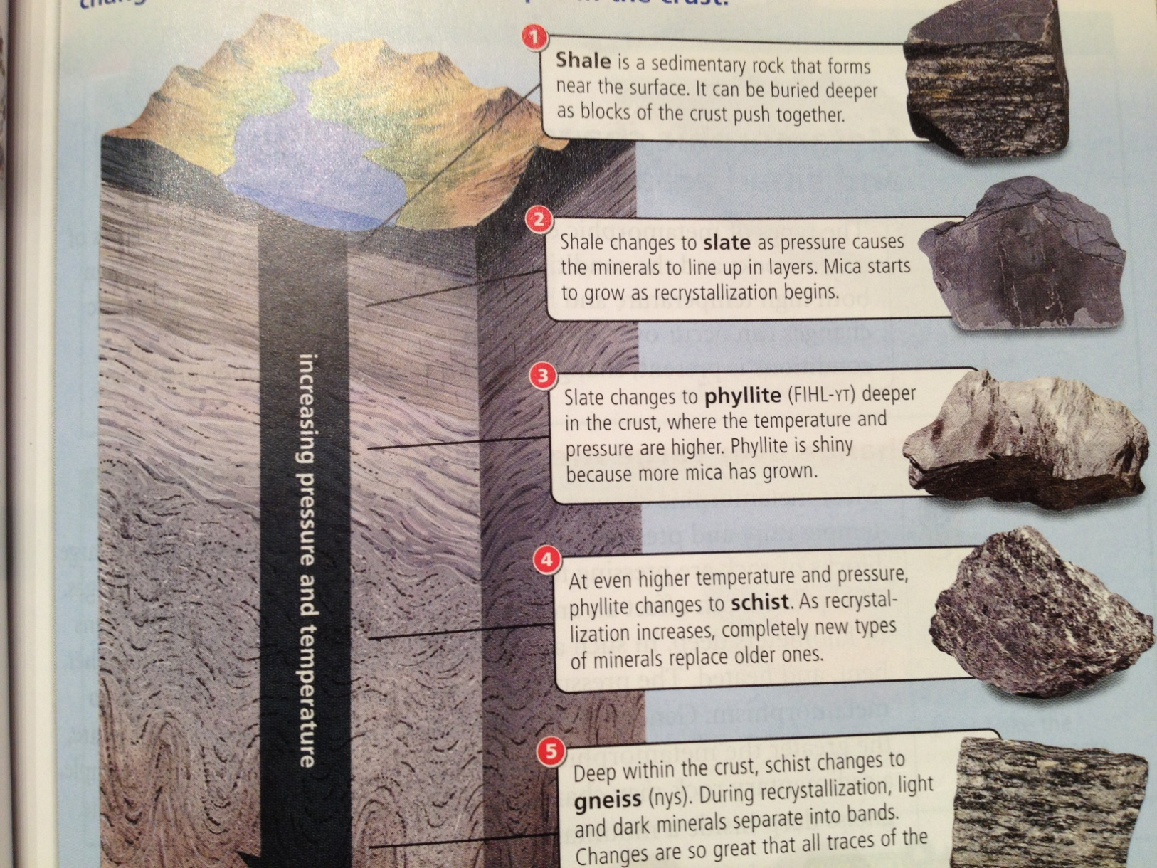
Foliated Metamorphic Rocks

Slide 11
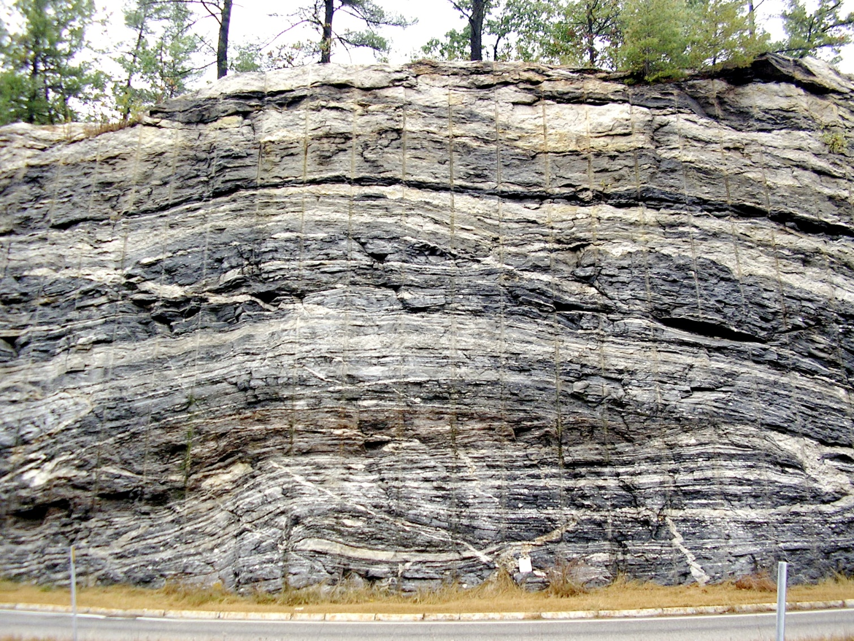
Foliation in Gneiss

Slide 12
Metamorphic Rocks
Big Idea
Supporting Detail
Most metamorphic rocks develop bands of minerals
Non-Foliation:
  Made of one mineral
  Minerals can’t separate or line up
Sometimes there isn’t enough pressure

Slide 13
Today’s activity
Today we will classify different metamorphic rocks by foliation
In the paper chart, write down your observations about foliation, parent rock and how deep below the surface the rock formed
Use the chart on the next page to help you identify
Metamorphic rocks are labeled with numbers 6-10

Slide 14
Types of Metamorphic Rocks
Rock Name | Foliation or None | How deep? | Parent Rock | Description
Slate | Foliated | Shallow | Shale | Very fine minerals; flat and black
Phyllite | Foliated | Medium | Shale | Wavy, flakey, more visible layers, greenish
Schist | Foliated | Medium | Shale | Very flakey, looks like mica, light brown, garbage rock
Gneiss | Foliated | Deep | Shale or Granite | Large white and black bands
Marble | None | Depends | Limestone | Usually white or gray and crystal like; reacts with acid
Quartzite | None | Depends | Sandstone | Hard, gray or reddish

