Slide 1
Daily Routine
Sit in your appropriate seat quietly
Make sure you are wearing your ID’s
Have all necessary materials out
All back packs on the floor
All cell phones on silent and away in backpacks
All IPods off and headphones out of your ears
Hats off
No food or drink except for water

Slide 2
Biology Announcements
No Homework

Slide 3
Cell’s Journey Through Life

Slide 4
I will be able to…
Describe the life cycle of a cell
Diagram and label the key parts of a chromosome
Explain the process of mitosis
Diagram the different phases of mitosis

Slide 5
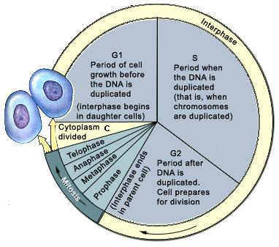
The Cell Cycle

Slide 6
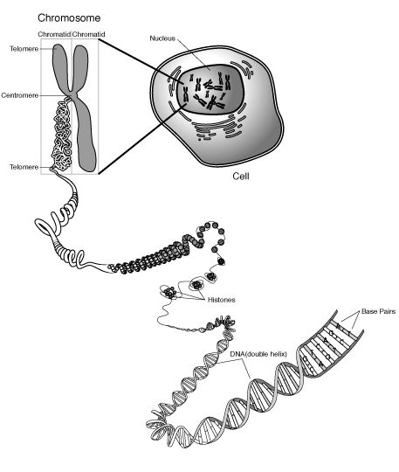
Cell living in Interphase
DNA Double Helix: Each continuous double stranded DNA molecule makes on chromosome

Slide 7
Cell living in Interphase
Histones: proteins that DNA wraps around to compact the DNA
Chromatin: structure of highly compacted histones and DNA

Slide 8
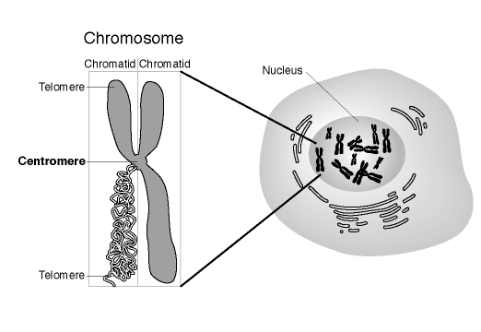
Cell living Interphase
Chromosome: long, continuous thread of DNA that consists of numerous genes and regulatory information

Slide 9
Cell living Interphase
Chromosome is made of two chromatid
Chromatid: one half of a duplicated chromosome
Chromatid are made of two telomeres

Slide 10
Cell living Interphase
Telomere: repeating nucleotides at the ends of DNA to cap the chromatid
Chromatid are pinched together in a condensed region known as the centromere

Slide 12
http://www.youtube.com/watch?v=ZEwddr9ho-4

Slide 13
Mitosis - Prophase
DNA and Protein condense to form chromosomes
Nuclear membrane dissolves
Centrioles move to opposite sides of cell
Spindle fibers start forming

Slide 14
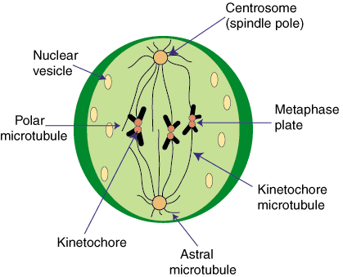
Mitosis - Metaphase
Nuclear membrane dissolved
Spindle fibers attach to chromosomes
Chromosomes line up in the middle of the cell

Slide 15
Daily Routine
Sit in your appropriate seat quietly
Make sure you are wearing your ID’s
Have all necessary materials out
All back packs on the floor
All cell phones on silent and away in backpacks
All IPods off and headphones out of your ears
Hats off
No food or drink except for water

Slide 16
Biology Announcements
No Homework

Slide 17
Cell’s Journey Through Life

Slide 18
I will be able to…
Describe the life cycle of a cell
Diagram and label the key parts of a chromosome
Explain the process of mitosis
Diagram the different phases of mitosis

Slide 19
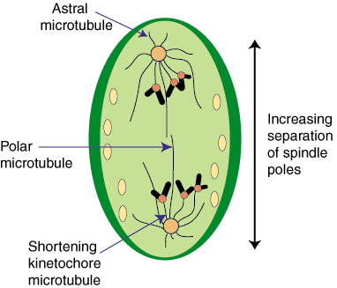
Mitosis – Anaphase
Chromosomes split into chromatid
Spindle fibers start pulling chromatid to opposite sides of the cell

Slide 20
Mitosis - Telophase
Spindle fibers start dissolving
Nuclear membrane starts forming
Chromatid start unraveling into DNA

Slide 21
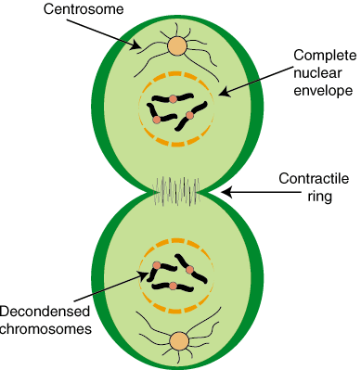
Mitosis – Cytokinesis
Nuclear membrane forms
Chromosomes start to unravel to DNA
Cell membrane pinches off to form two daughter cells

Slide 22
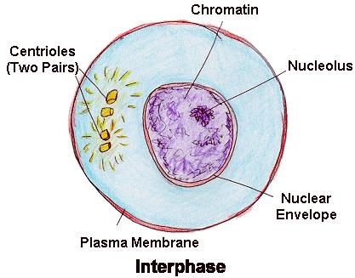
Cell Cycle - Interphase
Most time spent in this phase
Growth, synthesize DNA, and prepare for mitosis

