Slide 1
Daily Routine
Sit in your appropriate seat quietly
All back packs on the floor
All cell phones away
All IPods off and headphones out of your ears
Have all necessary materials out
No food or drink except for water

Slide 2
Bell Work
Why are solar eclipses so rare?
What are scale models?

Slide 3
Announcements
No Homework

Slide 4
Modeling the Solar System
The Solar System:
Is Pluto a planet or a dwarf planet?

Slide 5
Today we will
Create a scale model of the solar system

Slide 6
Spend 10 minutes finishing yesterday’s scale calculations

Slide 7
Scale Model of the Solar System Lab

Slide 8
Daily Routine
Sit in your appropriate seat quietly
All back packs on the floor
All cell phones away
All IPods off and headphones out of your ears
Have all necessary materials out
No food or drink except for water

Slide 9
Bell Work
What are neap and spring tides?
What does the scale 1 cm = 100 km actually mean?

Slide 10
Announcements
No Homework

Slide 11
Modeling the Solar System
The Solar System:
Is Pluto a planet or a dwarf planet?

Slide 12
Today we will
Create a scale model of the solar system

Slide 13
Get into your groups from yesterday and finish yesterday’s scale model.

Slide 14
Daily Routine
Sit in your appropriate seat quietly
All back packs on the floor
All cell phones away
All IPods off and headphones out of your ears
Have all necessary materials out
No food or drink except for water

Slide 15
Bell Work
Why does the moon go through different phases?
Why don’t we see the far side of the moon?

Slide 16
Announcements
No Homework

Slide 17
Modeling the Solar System
The Solar System:
Is Pluto a planet or a dwarf planet?

Slide 18
Today we will
Create a scale model of the solar system

Slide 19
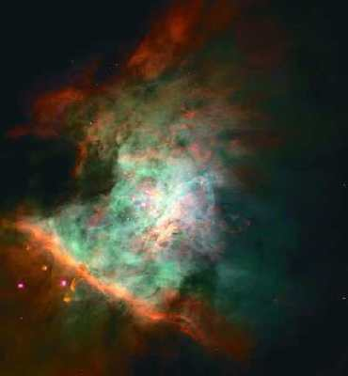
Formation of the Solar System Nebular Model
A nebula is molecular cloud made up of gas, ice and dust particles
These nebular clouds are the birthplace of stars and planets
Scientists believe that the sun and solar system formed out of a nebula about 4.6 billion years ago

Slide 20
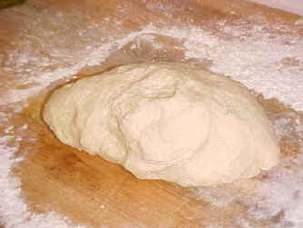
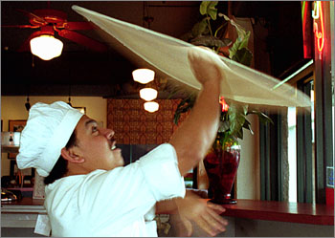
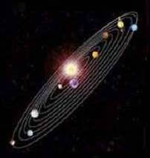
Making the Solar System: It’s Like Making Pizza!

Slide 21
Solar System Formation Step 1: Gravitational Collapse
Shock waves from a nearby exploding star cause the Nebula slowly shrink or collapse
As more material collapses, the stronger the gravitational pull inward is

Slide 22
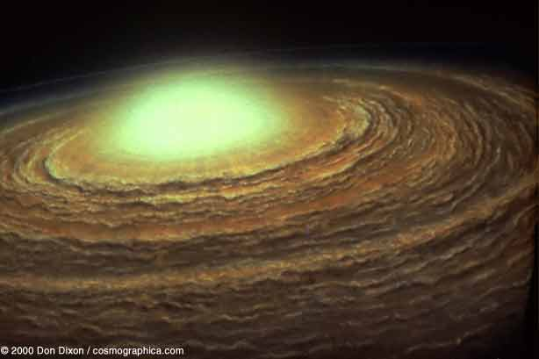
Solar System Formation Step 2: Angular Momentum
As it collapses, or shrinks it spins faster into a disk shape due to angular momentum
A center bulge develops at the center of the spinning disk
This explain why the planets orbit in the same direction

Slide 23
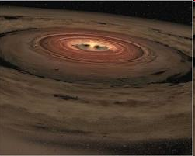
Solar System Formation Step 3: Condensation
Condensation causes gas particle to become solid dust particles
These particles start to stick together like dust bunny’s on the top of your TV

Slide 24
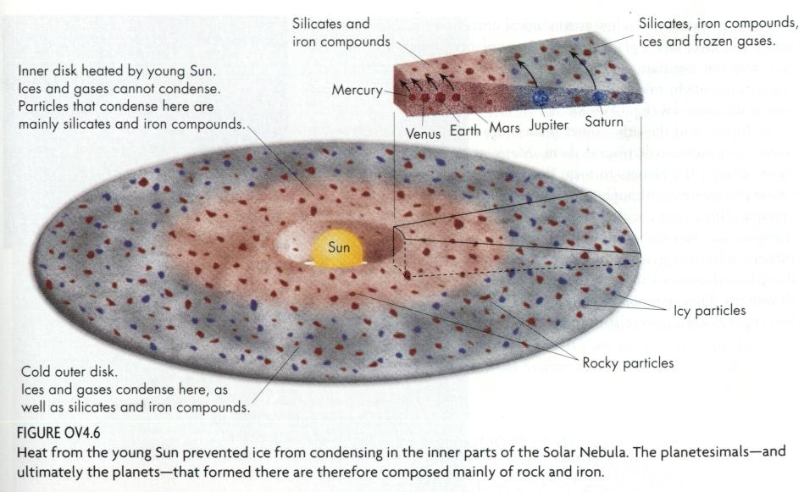
Rocky Planets vs. Gassy Planets
Hot Inner Disk: Rocky planets formed
in the inner solar nebula disk because
only rocky material (iron, silica)
could condense and solidify
Icy
Particles
Rocky
particles
Cold Outer Disk: Gassy planets formed
in the outer solar nebula disk where it
was cooler and gases (hydrogen, helium)
could condense

Slide 25
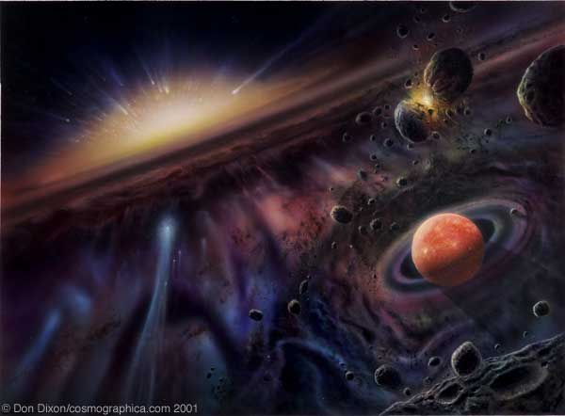
Solar System Formation Step 4: Accretion
Accretion occurs as solid particles stick together becoming larger in size
The inner planets form as rocky material begins to clump together
Rocks collide to make boulders, boulders collide to make small planets (planetesimals)
The outer planets from as icy material clumps together

Slide 26
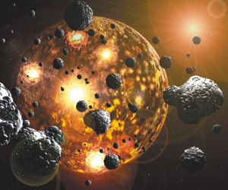
Solar System Formation Step 5: Bombardment
The newly formed planets now have enough gravity to pull in the remaining debris in the solar system
As a result, planets are being bombarded by asteroids and small planets

