Slide 1
Daily Routine
Sit in your appropriate seat quietly
All back packs on the floor
All cell phones away
ID’s on or out on the desk
All IPods off and headphones out of your ears
Have all necessary materials out
Hats off
No food or drink except for water

Slide 2
Bell Work
Describe the process of how clouds are made and what they are made of?

Slide 3
Can we predict the weather
Orographic Lifting and Acid Rain

Slide 4
Today we will
Diagram how orographic lifting occurs with precipitations and geographic feature
Describe how acid rain forms in clouds

Slide 5
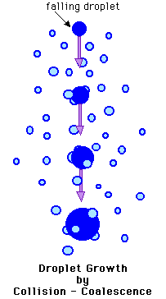
How does the water in clouds build up to get large enough to where it falls as precipitation?
Coalescences
Droplets collide and join together
Bigger collides with smaller droplets
When they become too heavy, it precipitates
Sizes of 0.5-5.0mm

Slide 6
Orographic lifting

Slide 7
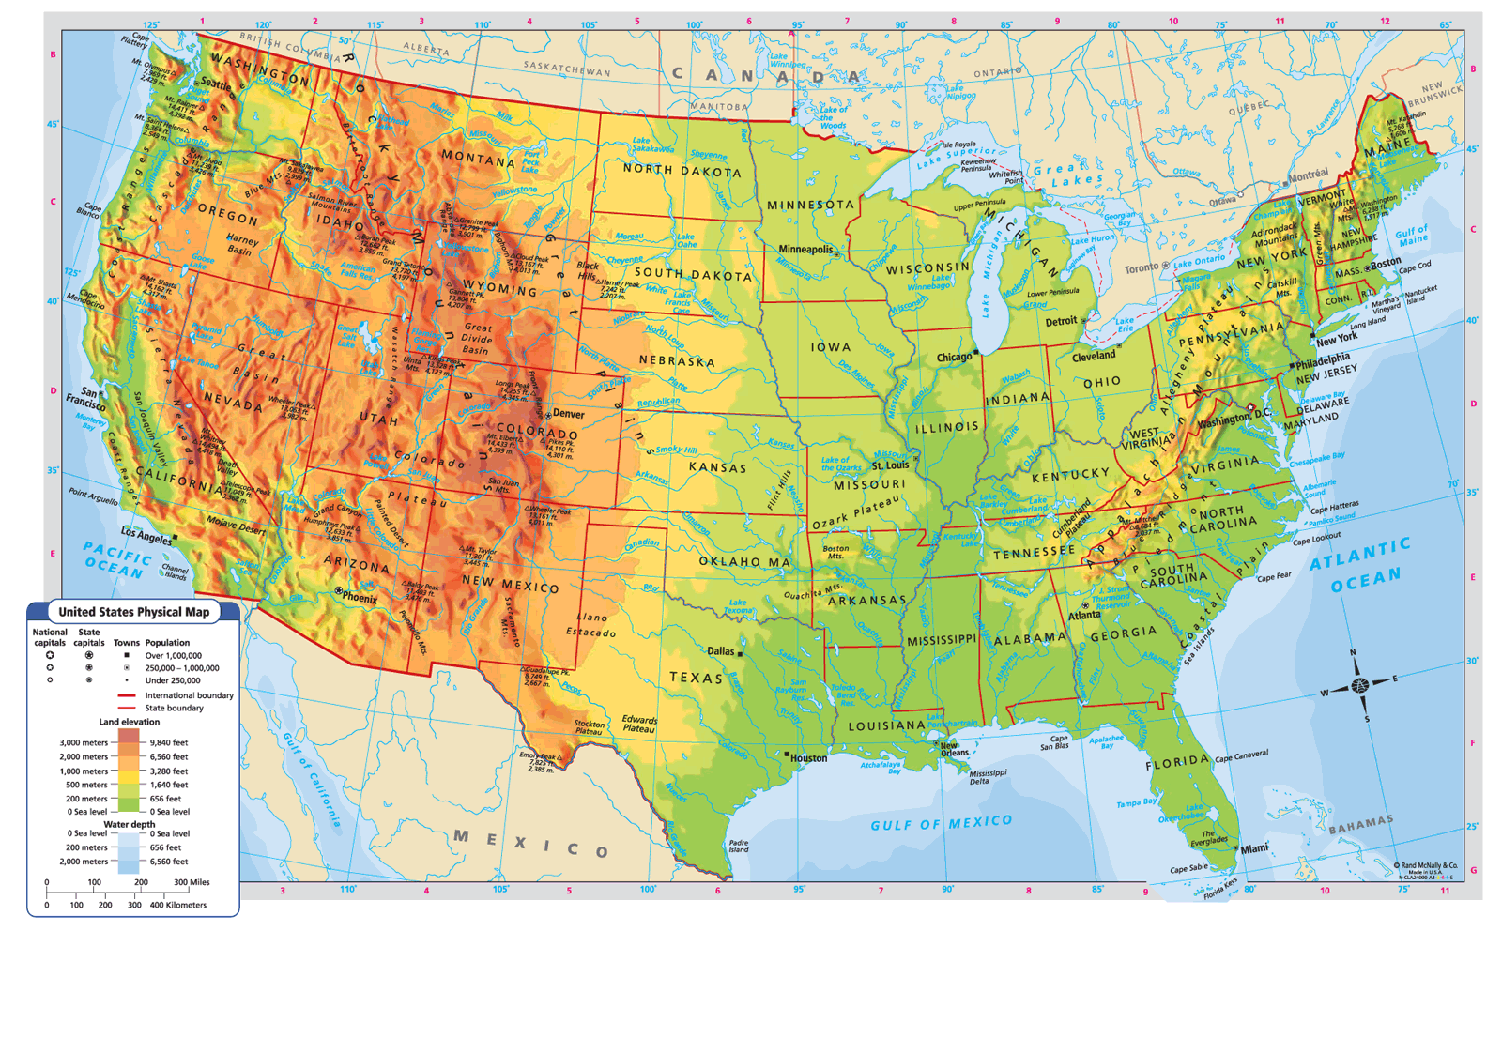
Orographic lifting in the US

Slide 8
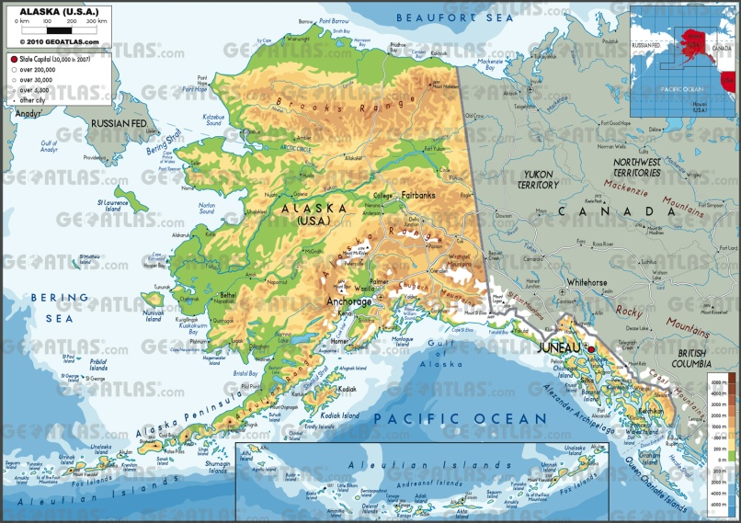
Orographic lifting in the US

