Slide 1
Daily Routine
Sit in your appropriate seat quietly
Make sure you are wearing your ID’s
Have all necessary materials out
All back packs on the floor
All cell phones on silent and away in backpacks
All IPods off and headphones out of your ears
Hats off
No food or drink except for water

Slide 2
Bellwork/Quick-write
When comparing the ages of rocks at and away from the mid-ocean ridge, describe the age patterns modeled in yesterday’s activity.
Why was Wegener’s hypothesis not accepted?

Slide 3
Rock Ages through radiometric dating
Older rocks are found away from the ridge.
Younger rocks are found near the ridge

Slide 4
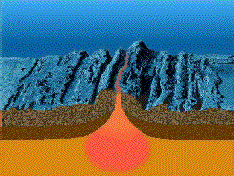
How do magnetic clues help show sea floor spreading?
As Harry Hess mapped the ocean bottom, he dragged a magnetometer behind his boat
He discovered stripes or anomalies on the seafloor bottom
Paleomagnetism: the arrangement of magnetic metals in minerals pointing toward magnetic North after formation

Slide 5
How do magnetic clues help show sea floor spreading?
What Harry Hess realized was that each stripe was a reversal in the magnetic field
Each stripe was a record of earth’s magnetic history
Pattern remain consistent on both sides of the ridge
This discovery provided strong evidence for Seafloor Spreading

Slide 6
Mineral Alignment
Iron minerals (magnetite) in basaltic lava rock Align themselves with the earth’s magnetic field like a miniature compass needle
As lava cools, these magnetic minerals Record the direction of the earth’s magnetic field like a compass needle
Normal
N
S

Slide 7
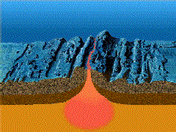
1,400,000 million years ago
Normal
N
S

Slide 8
700,000 thousand years ago
Reversed
N
S

Slide 9
Present Day
Normal
N
S

Slide 10
Why doesn’t the Earth continue to get bigger with sea floor spreading?
If sea floor spreading was the only mechanism happening, then Earth’s surface would continue to expand
This doesn’t happen, so Hess had to add to his explanation
New crust created and old crust recycled back into the earth
Earth’s crust gets recycled into the Mantle through the process of subduction

Slide 11
How else do we know the plates are moving?
Geography of Earth’s Crust
Mountain ranges
Trenches
Valleys
Seamounts
Volcanoes
Earthquake data

