Slide 1
Daily Routine
Sit in your appropriate seat quietly
Make sure you are wearing your ID’s
Have all necessary materials out
All back packs on the floor
All cell phones on silent and away in backpacks
All IPods off and headphones out of your ears
Hats off
No food or drink except for water

Slide 2
Bell Work
Write down one personal goal you have this year
Write down one personal goal you have this semester
Write down one personal goal you have for this class this semester.

Slide 3
Bell Work
Write the matching base pair sequence in this segment of a DNA molecule.
ACCGTAATGCCGCGAAATTGCTAT

Slide 4
Bell Work
Write the matching base pair sequence in this segment of a DNA molecule.
ACCGTAATGCCGCGAAATTGCTAT
TCCCATTACGGCGCTTTAACGATA

Slide 5
Biology Announcements
DNA replication model project Due Wednesday Jan 15th

Slide 6
DNA Replication

Slide 7
I will be able to…
Summarize the process of DNA replication
Describe the role of enzymes in DNA replication

Slide 8
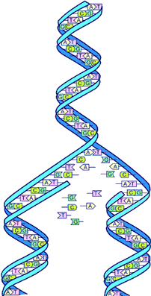
What is replication?
Replication: the process which DNA is copied
Takes place during the synthesis phase of interphase
Takes place the nucleus
Watson and Crick realized a single strand of DNA can be used as a pattern for a new strand

Slide 9
How does replication ensure that cells have complete sets of DNA?

Slide 10
How does DNA replication work?
Enzymes unzip the DNA molecule
Breaks hydrogen bonds holding nucleotides together
Bases on separate strands are exposed
Analogy: unzipping your jacket

Slide 11
How does DNA replication work?
Free-floating nucleotides pair with match on pattern strand
DNA polymerase (enzyme/protein) binds nucleotides
Forms a complimentary (matching up) strand
Complex; DNA polymerase works on segments of DNA until ready to form finished copy

Slide 12
How does DNA replication work?
Special enzymes proof-read the strands and fix base pair matching mistakes
Two new strands formed (one template and other partner match)
Semiconservative replication

Slide 13
DNA Replication Project
Work individual or groups up to 3 people.
This will be due by Wednesday, Jan 15th
Project is to create a DNA model that is undergoing replication
Model can be 2D or 3D which must be neat, clear, and orderly out materials from home
Every student must answer the question that go along with the assignment
Question must be answered in the student’s own words; no copying your partners’ answers

Slide 14
Daily Routine
Sit in your appropriate seat quietly
Make sure you are wearing your ID’s
Have all necessary materials out
All back packs on the floor
All cell phones on silent and away in backpacks
All IPods off and headphones out of your ears
Hats off
No food or drink except for water

Slide 15
Biology Announcements
DNA replication project due Wed. Jan 15th

