Slide 1
Daily Routine
Sit in your appropriate seat quietly
Make sure you are wearing your ID’s
Have all necessary materials out
All back packs on the floor
All cell phones on silent and away in backpacks
All IPods off and headphones out of your ears
Hats off
No food or drink except for water

Slide 2
Bell Work
Describe how Mendel’s experiment made a major impact in the study of genetics.

Slide 3
Biology Announcements
No Homework

Slide 4
Traits, Genes, and Alleles

Slide 5
I will be able to…
Explain how there can be many versions of one gene
Describe how genes influence the development of traits

Slide 6
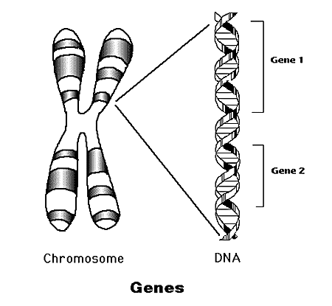
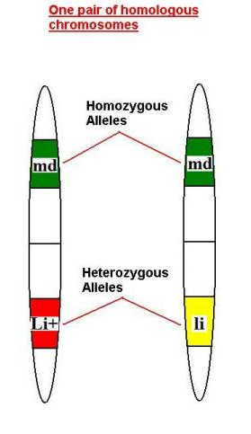
Different Gene Pairs
A gene is a piece of DNA that provides a set of instructions to a cell to make protein
Most genes exist in many forms known as an allele
An allele is any of the alternate forms of a gene that may occur in a specific locus on a chromosome

Slide 7
Different Gene Pairs
All organisms have two alleles for each gene
Alleles come from parents; one from each
Alleles that are homozygous are the same occur at the same specific locus on a chromosome
Alleles that are heterozygous are different and occur at different locus on a chromosome

Slide 8
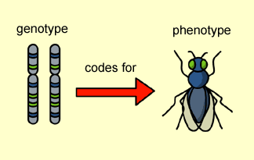
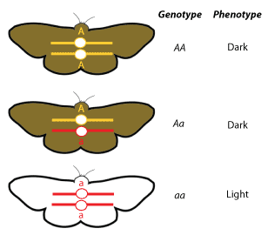
Genotype vs. Phenotype
Genotype = genetic make-up
Phenotype = physical characteristics

Slide 9
Dominant vs. Recessive
Dominant
Allele expressed when two different alleles or two dominant alleles are present
Does not mean stronger or better
Expressed when heterozygous
Recessive
Allele only expressed when two copies are present
Alleles are expressed as letters when talking about traits

Slide 10
How can I describe an individual’s genotype?
Use capital letter for ____________ allele
Use small case letter for _________ allele
Homozygous dominant____________
Homozygous recessive_____________
Heterozygote_________________
If a disease, then is a CARRIER

Slide 11
Punnet Square

