Slide 1
Daily Routine
Sit in your appropriate seat quietly
Have all necessary materials out
All back packs on the floor
All cell phones on silent and away in backpacks
All IPods off and headphones out of your ears
Hats off
No food or drink except for water

Slide 2
Bellwork
What are seismic waves? Describe the three types of seismic waves.
What are the three types of faults?

Slide 3
Earth Science Announcements
Volcano Project: Due Today
Midterm 10/9 or 10/10

Slide 4
How to find the epicenter
How does earthquakes affect our lives?

Slide 5
Richter Moment of Magnitude Scale
Developed by Charles Richter in 1935
Mathematical calculation for the intensity of an earthquake
Calculated using the amplitude of the waves on a seismogram
Measures surface waves energy from the epicenter
Increases by a factor of 10 (log)
Represented by whole numbers and decimals

Slide 6
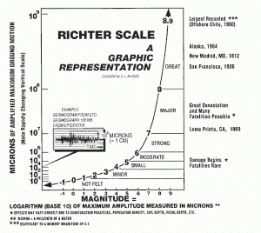
Richter Moment of Magnitude Scale

Slide 7
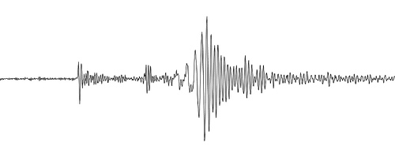
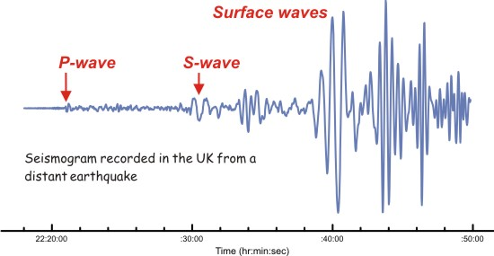
What is the usefulness of a seismogram?
Determine amplitude of waves from an earthquake
Calculate magnitude of an earthquake
Calculate where the epicenter of an earthquake is

Slide 8
Distance To Earthquake Epicenter
S-P Time Delay =
Distance to Epicenter
Scientists use the seismograph to locate the epicenter of an earthquake
Remember, the P-wave is faster and arrives first at a seismic station
Every Seismograph records a time delay between the P and S and waves
The farther from the earthquake epicenter, the greater the time delay
This time delay between the P and S wave is used to find the distance to the earthquake epicenter
P-Wave
Arrival Time
S-Wave
Arrival Time
Surface-Waves
Surface-Waves
P-Waves
S-Waves
P-Waves
S-Waves

Slide 9
Distance To Epicenter
Distance to Epicenter
---------- = S - waves
--------- = P - waves
P-Waves
S-Waves
Seismic
Station
Epicenter

Slide 10
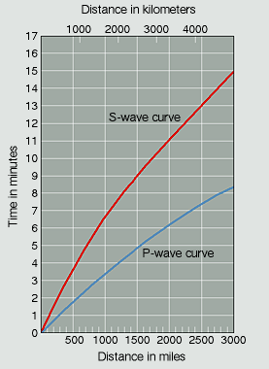
S-Wave Time
- P-Wave Time
Distance

Slide 11
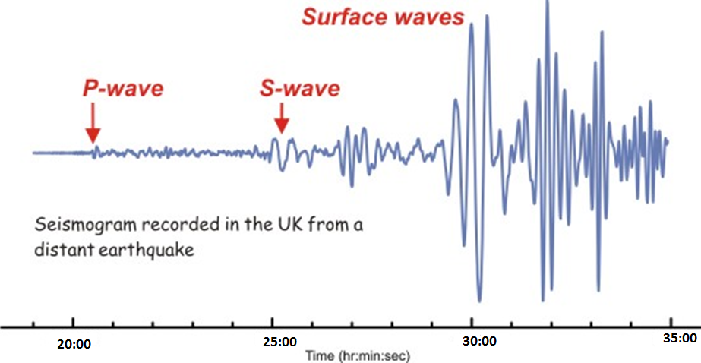
Let’s practice

Slide 12
Math work
S Wave comes in at:
25:00 minutes

Slide 13
Let’s practice

Slide 14
Math work
S Wave comes in at:
P wave comes in at:
25:00 minutes
20:00 minutes

Slide 15
Let’s practice

Slide 16
Math work
S Wave comes in at:
P wave comes in at:
Do the math:
25:00 minutes
20:00 minutes
25-20:00 = 5:00 minutes

Slide 18
Distance to Epicenter
S-P Time Delay =
Distance to Epicenter
P-Wave
S-Wave
Seismic
Station A
Epicenter
The time delay between the
S and P wave gives us the
Distance to the epicenter
In other words,
S-P Time Delay = Distance to Epicenter

Slide 19
Triangulation
P-Wave
S-Wave
Seismic
Station A
Epicenter
P-Wave
Epicenter
S-Wave
S-Wave
Seismic
Station B
P-Wave
Seismic
Station C

Slide 20
Daily Routine
Sit in your appropriate seat quietly
Have all necessary materials out
All back packs on the floor
All cell phones on silent and away in backpacks
All IPods off and headphones out of your ears
Hats off
No food or drink except for water

Slide 21
Bellwork
What do you use to determine how far the epicenter is located from a seismic station?
Why can’t one seismic station determine where the epicenter of an earthquake is located? How many stations do you need to make a better locate the epicenter?

Slide 22
Earth Science Announcements
Volcano Project: Due Today
Midterm 10/9 or 10/10

Slide 23
How to find the epicenter
How does earthquakes affect our lives?

