Slide 1
Daily Routine
Sit in your appropriate seat quietly
Make sure you are wearing your ID’s
Have all necessary materials out
All back packs on the floor
All cell phones on silent and away in backpacks
All IPods off and headphones out of your ears
Hats off
No food or drink except for water

Slide 2
Biology Announcements
No Homework

Slide 3
Water: It’s Important to Life
Chemistry in Biology
What are we made out of?

Slide 4
I will be able to…
Describe a hydrogen bond
Discuss the similarities and difference of polar and nonpolar covalent bonds
Model and perform experiment pertaining to water properties
Describe the difference between a solute and solvent in solution
Describe the difference between acids and bases
Measure the pH of different household produce

Slide 5
Water vs. Metals
Open your lab notebooks to the table of contents
Write the title Water vs. Metals on the next available line in the table of contents list
Turn to the next available page and title the page Water vs. Metals along with today’s date
Skip a couple a couple of lines and write Demonstration 1: Water vs. Aluminum

Slide 6
Water vs. Metals
Write the question, Will aluminum sink or float in water?, right below the demonstration title
Write a hypothesis using the following format: If the aluminum foil is placed in water, then is will sink ____% of the time because _____.
Fill in the blanks with your thoughts from previous experiences.
Write the following materials down: water, Dixie cup, aluminum foil, paper clip, and paper towel

Slide 7
Water vs. Metal
Under your hypothesis, create a table with three columns and three rows
Collect the necessary materials
Try the two different tests and fill out both the hypothesis observations
 | Hypothesis | Observations
Aluminum Foil flat
Aluminum Foil Crumpled

Slide 8
Water vs. Metal
Skip a couple a couple of lines and write Demonstration 2: Water vs. Aluminum Paper Clip
Under your hypothesis, create a table with three columns and three rows
 | Hypothesis | Observations
Dropping the paper clip
Flat paper clip

Slide 9
Water vs. Metal
Try the two different tests and fill out both the hypothesis observations
To perform the flat paper clip test, carefully place a small piece of paper towel flat on the water
Carefully lay the paper clip flat on the paper towel a wait a minute or two
After the demonstrations are done, write a two to four sentence analysis of your observations from both demonstrations

Slide 10
Water vs. Metal Conclusion
Write a paragraph or two answering the following questions:
Was your hypothesis supported or not supported? Why or why not? Explain using your observations.
Why do you think certain test had the aluminum sink while other tests had the aluminum float?
What special property gives water the ability to sustain floating metals? Why is this important to real life situations?

Slide 11
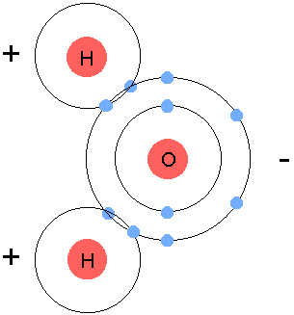
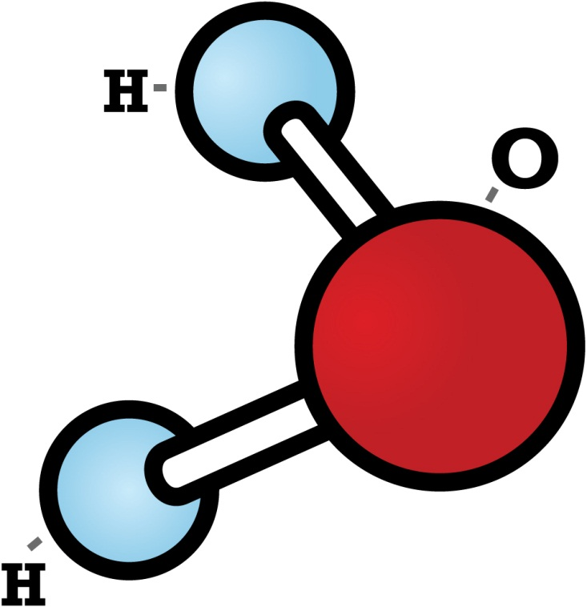
How do water molecules connect to one another?
Water is made up of two elements:
Oxygen and Hydrogen (2)
Water molecule holds atoms together with a covalent bond (sharing)
Atoms don’t share evenly
Hydrogen side is more positive
Oxygen side is more negative
Forms a polar molecule because of slight charge

Slide 12
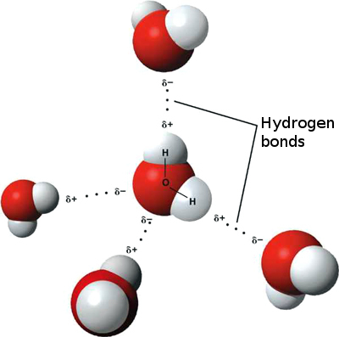
How do water molecules connect to one another
Think of water molecule like a magnet
The positive side has an attraction to the negative side of another molecule
Attraction between water molecule forms a linked chain
The attraction between the different slight atom charges forms a hydrogen bond

Slide 13
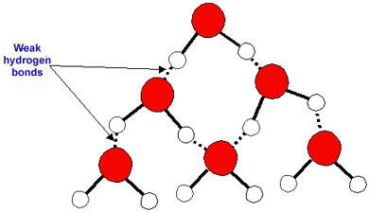
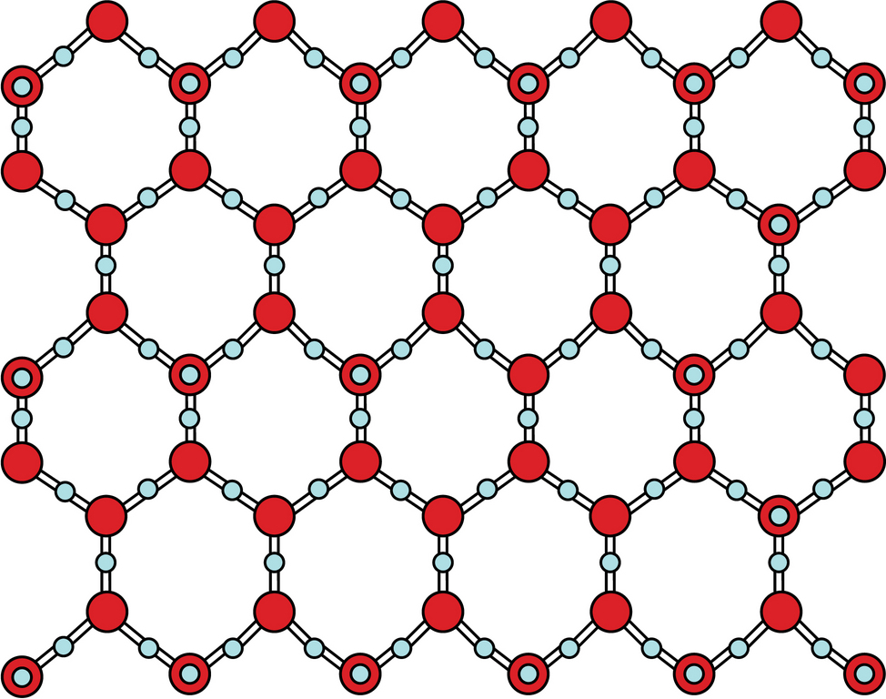
How do water molecules connect to one another

Slide 14
Daily Routine
Sit in your appropriate seat quietly
Make sure you are wearing your ID’s
Have all necessary materials out
All back packs on the floor
All cell phones on silent and away in backpacks
All IPods off and headphones out of your ears
Hats off
No food or drink except for water

Slide 15
Biology Announcements
No Homework

Slide 16
Water: It’s Important to Life
Chemistry in Biology
What are we made out of?

Slide 17
I will be able to…
Describe a hydrogen bond
Discuss the similarities and difference of polar and nonpolar covalent bonds
Model and perform experiment pertaining to water properties
Describe the difference between a solute and solvent in solution
Describe the difference between acids and bases
Measure the pH of different household produce

Slide 18
How do water molecules connect to one another?
Water is made up of two elements:
Oxygen and Hydrogen (2)
Water molecule holds atoms together with a covalent bond (sharing)
Atoms don’t share evenly
Hydrogen side is more positive
Oxygen side is more negative
Forms a polar molecule because of slight charge

Slide 19
How do water molecules connect to one another
Think of water molecule like a magnet
The positive side has an attraction to the negative side of another molecule
Attraction between water molecule forms a linked chain
The attraction between the different slight atom charges forms a hydrogen bond

Slide 20
How do water molecules connect to one another

Slide 21
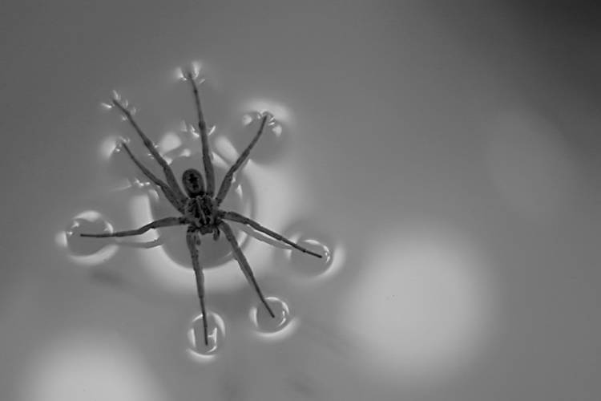
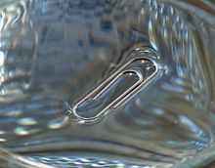
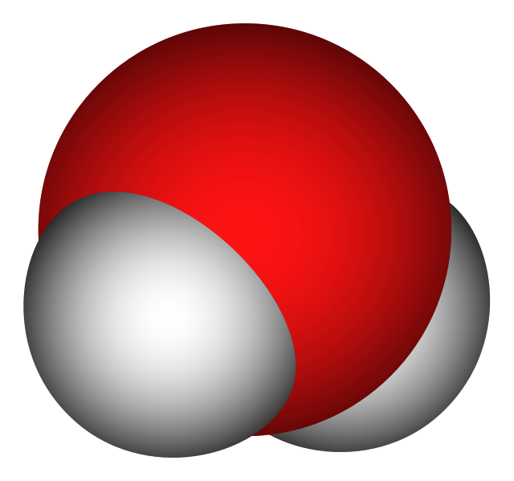
What cause water keep the metal floating in the demonstrations?
Water has a high surface tension
Surface tension is how molecules contract to resist external forces
Best with thing with greater surface area
Water’s surface tension occurs due hydrogen bonding

Slide 22
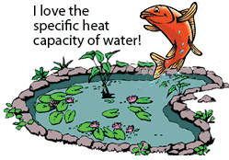
Special Properties of Water Due to Hydrogen Bonding
Specific Heat – ability to resist change in temperature
High boiling point
Takes a long time to cool down or heat up
Helps regulate cell temperature

Slide 23
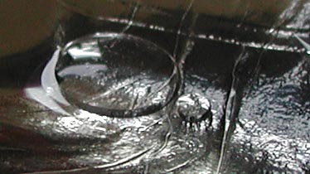
Special Properties of Water Due to Hydrogen Bonding
Specific Heat – ability to resist change in temperature
Cohesion – attraction between different water molecules: Convex shape
Examples – Dew in the morning
Beads of rain water on cars

Slide 24
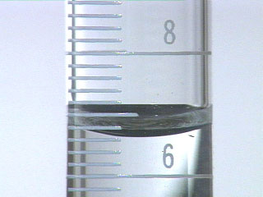
Special Properties of Water Due to Hydrogen Bonding
Specific Heat – ability to resist change in temperature
Cohesion – attraction between different water molecules
Adhesion – attraction of molecule to other substances: Concave shape
Example: meniscus in a graduated cylinder

Slide 25
Daily Routine
Sit in your appropriate seat quietly
Make sure you are wearing your ID’s
Have all necessary materials out
All back packs on the floor
All cell phones on silent and away in backpacks
All IPods off and headphones out of your ears
Hats off
No food or drink except for water

Slide 26
Biology Announcements
No Homework

Slide 27
Water: Forming Solutions
Chemistry in Biology
What are we made out of?

Slide 28
I will be able to…
Describe a hydrogen bond
Discuss the similarities and difference of polar and nonpolar covalent bonds
Model and perform experiment pertaining to water properties
Describe the difference between a solute and solvent in solution
Describe the difference between acids and bases
Measure the pH of different household produce

Slide 29
Water vs. Metals
Open your lab notebooks yesterday’s exercise
Continue with today’s water’s exercise at the end of yesterday’s conclusion.
Write down demonstration 3: Water covering Penny
Write down the following materials: penny, water, cup, eye dropper, paper towel

Slide 30
Water vs. Metals
Under your materials list, create a table three columns and two rows
Collect the necessary materials
Fill out both the hypothesis, actual and observation areas when and after performing the demonstration
Hypothesized amount of drops | Actual amount of drops to cover | Observations

Slide 31
Water vs. Metal Conclusion
Answer the following question(s):
What water property(ies) did you observe in this demonstration?
Explain how these properties work with water at a molecule level in this demonstration. Use your observations to help support your answer.
After you complete these questions, work on chapter vocabulary words starting on page 36.
Complete words for sections 2.1-2.3.
After you complete these words, work on vocabulary from sections 2.4 through 2.5

Slide 32
Daily Routine
Sit in your appropriate seat quietly
Make sure you are wearing your ID’s
Have all necessary materials out
All back packs on the floor
All cell phones on silent and away in backpacks
All IPods off and headphones out of your ears
Hats off
No food or drink except for water

Slide 33
Biology Announcements
No Homework

Slide 34
Bell Work
Describe how water forms a hydrogen bond

Slide 35
Water: Forming Solutions
Chemistry in Biology
What are we made out of?

Slide 36
I will be able to…
Describe a hydrogen bond
Discuss the similarities and difference of polar and nonpolar covalent bonds
Model and perform experiment pertaining to water properties
Describe the difference between a solute and solvent in solution
Describe the difference between acids and bases
Measure the pH of different household produce

Slide 37
Bell Work
What is a hydrogen bond?

Slide 38
Water vs. Metal Conclusion
Answer the following question(s):
What water property(ies) did you observe in yesterday’s demonstration?
Explain how these properties work with water at a molecule level in this demonstration. Use your observations to help support your answer.

Slide 39
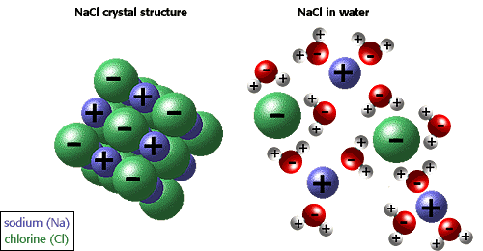
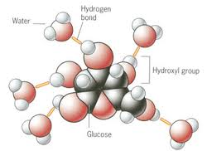
Why do things dissolve in water?
Water molecule is a polar molecule with weak charges
Ions break up and fill in the voids between hydrogen bonds
Other nonpolar molecules can take up the space between water molecules
This important in cells and blood so important ions and molecules can be transported

Slide 40
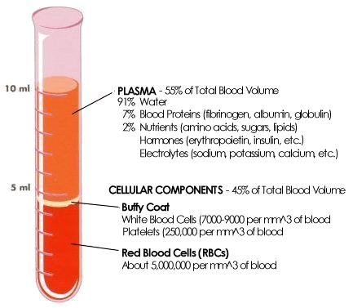
What does dissolve different materials make?
Solutions – a mixture of substances that is the same throughout
Has two parts:
Solvent is the substance that is present in greatest amount
Solute is the substance that dissolves in a solvent
Blood is a solution
Solvent: water
Solute: proteins, sugars, lipids

Slide 41
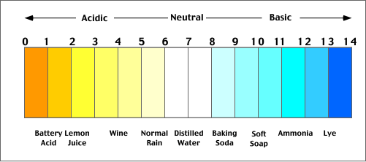
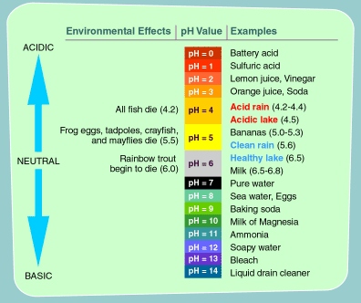
Why do some solutions burn and others don’t?
Solutions have different pH values.
pH – the concentration of H⁺ ions in a solution
Acids – a solution that contains a high concentration of H⁺ ions
Bases – a solution low in concentration of H⁺ ions
Dependent on how items release or absorbs H⁺ ions in solution

Slide 42
pH scale

Slide 43
Daily Routine
Sit in your appropriate seat quietly
Make sure you are wearing your ID’s
Have all necessary materials out
All back packs on the floor
All cell phones on silent and away in backpacks
All IPods off and headphones out of your ears
Hats off
No food or drink except for water

Slide 44
Biology Announcements
No Homework

Slide 45
Measuring pH
Chemistry in Biology
What are we made out of?

Slide 46
I will be able to…
Describe a hydrogen bond
Discuss the similarities and difference of polar and nonpolar covalent bonds
Model and perform experiment pertaining to water properties
Describe the difference between a solute and solvent in solution
Describe the difference between acids and bases
Measure the pH of different household produce

Slide 47
Things to do today…
Finish vocabulary in sections 2.1-2.3
Leave vocabulary out so I can check it off
Get lab notebook and textbook
Open to page 58 and copy down the problem, materials, and procedure, and analyze and conclude section in your lab notebooks
Work on vocabulary from section 2.4-2.5

