Slide 1
Daily Routine
Sit in your appropriate seat quietly
All back packs on the floor
All cell phones away
ID’s on or out on the desk
All IPods off and headphones out of your ears
Have all necessary materials out
Hats off
No food or drink except for water

Slide 2
Announcements
Quiz on Friday about the material we cover this week
Bring in empty 2L bottles for extra credit by Friday

Slide 3
Can we predict the weather
Pre-Assessment and Temperature

Slide 4
Today we will
Assess our knowledge about the temperature, air pressure, and humidity

Slide 5
Pre-Assessment
Answer the questions on the answer document
Do not write on the question sheet
Make sure to mark off whether you knew the answer or guessed on it

Slide 6
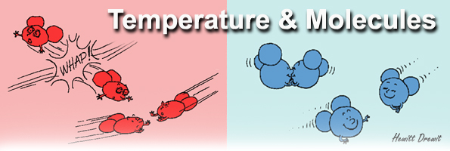
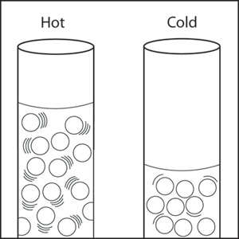
What is temperature?
The speed of movement between particles
Cold temperatures = slow movement
Hot temperatures = chaotic (fast) movement

Slide 7
The three temperature scales
Fahrenheit – based on math calculations for body temperature and solution stability
Water freezes at 32⁰ and boils at 212⁰
Celsius – based on water properties
Water freezes at 0⁰ and boils at 100⁰
Kelvin – based on atomic particle movement
Water freezes at 273 K
Absolute zero – 0K – all particle motion stops

Slide 8
Weather Record Keeping Project
In class, we will be recording different atmospheric and weather conditions
Recording: time of recording, temperature, humidity, wind speed, cloud cover, weather type, etc.
Information will be useful when we discuss climate

Slide 9
Daily Routine
Sit in your appropriate seat quietly
All back packs on the floor
All cell phones away
ID’s on or out on the desk
All IPods off and headphones out of your ears
Have all necessary materials out
Hats off
No food or drink except for water

Slide 10
Bell Work
Explain how the three terms of heat transfers operate in our atmosphere to transfer heat from one location to another.
What is temperature?

Slide 11
Announcements
Quiz on Friday about the material we cover this week
Bring in empty 2L bottles for extra credit by Friday

Slide 12
Can we predict the weather
Pre-Assessment and Temperature

Slide 13
Today we will
Watch demonstrations on Youtube.com about how air has pressure
Explain how air exerts a pressure on everything and how it changes due to density and temperature

Slide 14
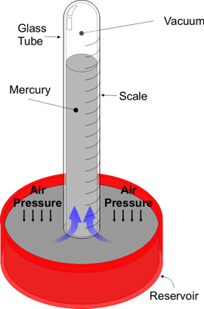
What is Air Pressure?
is the pressure of the atmospheric weight exerted on a surface
Use a barometer to measure air pressure
Barometer shows how the air pressure pushes down on us

Slide 15
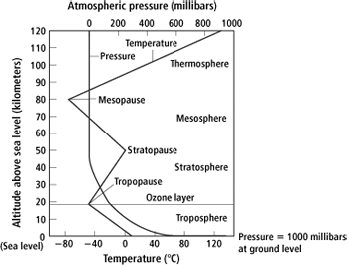
Does air pressure change? How?
Yes air pressure changes!
One way is through increasing altitude in the atmosphere
Troposphere has highest air pressure
Decreases dramatically with increasing altitude

Slide 16
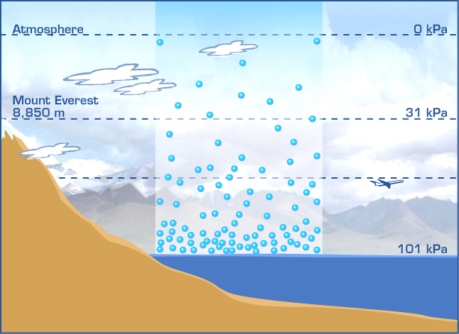
Air pressure decreases the higher up in the troposphere!

Slide 17
Does temperature have an affect on air pressure?
YES!!!!

Slide 18
Temperatures affect on air pressure
http://www.youtube.com/watch?v=JsoE4F2Pb20

Slide 19
How does temperature affect air pressure?
Constant Contolled Volume
In the Atmosphere
Temperature affects the particles movement
Higher temperature yield higher pressure
Colder temperatures yield lower pressure
Temperature affects the particle movement
Volume is huge which affects air pressure
Higher Temp = lower pressure
Lower temp = higher pressure

Slide 20
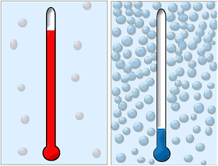
Atmospheric Temperature and Air pressure

Slide 21
Another temperature and air pressure demonstration
http://www.youtube.com/watch?v=ctJyu5ete6Y

Slide 22
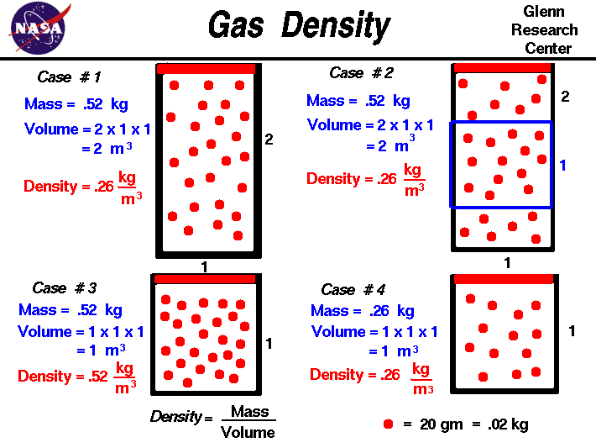
How does density affect air pressure?
At a fixated temperature and volume
More air molecules in a volume = higher density
Less air molecules in a volume = lower density
With more gas matter in a volume it applies more pressure

Slide 23
Daily Routine
Sit in your appropriate seat quietly
All back packs on the floor
All cell phones away
ID’s on or out on the desk
All IPods off and headphones out of your ears
Have all necessary materials out
Hats off
No food or drink except for water

Slide 24
Bell Work
Diagram and label how heat is transferred in the atmosphere?
How does altitude affect air pressure?
How does temperature affect air pressure?
Explain how one the activities in the YouTube clips worked in accordance to air pressure.

Slide 25
Announcements
Quiz on Friday about the material we cover this week
Bring in empty 2L bottles for extra credit by Friday

Slide 26
Can we predict the weather
Air Pressure

Slide 27
Today we will
Watch demonstrations on Youtube.com about how air has pressure
Explain how air exerts a pressure on everything and how it changes due to density and temperature

Slide 28
Recording today’s weather!

Slide 29
Temperature and Density Affecting Air Pressure

Slide 30
Air Pressure in a Nut Shell
http://www.youtube.com/watch?v=jmQ8FWnM0fA

Slide 31
Exit Slip
Explain how temperature and density affect air pressure.

