Slide 1
Daily Routine
Sit in your appropriate seat quietly
Have all necessary materials out
All back packs on the floor
All cell phones on silent and away in backpacks
All IPods off and headphones out of your ears
Hats off
No food or drink except for water
All electronic devices away!!!

Slide 2
Bell Work
How do you think our universe and galaxy were formed?
What is the name of our galaxy?

Slide 3
Earth Science Announcements
Project Final Draft 11/12/2014
Extra Credit Opportunity

Slide 4
Galaxies & The Big Bang
Looking beyond our realm of understanding in space

Slide 5
Topic: Galaxies & The Big Bang
Unit: Stars & Galaxies
Objectives: Day 4 of 4
I will be able to define a galaxy and classify the 3 different types of galaxies
I will understand the Big Bang theory and the evidence supporting it

Slide 6
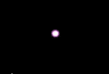
Big Bang Theory
It is believed our universe formed 10–20 billion years ago
All matter existed in an incredibly hot dense state of hydrogen and helium
After it exploded, it expanded & cooled into stars & galaxies

Slide 7
Big Bang Theory
The big bang theory or model states that all matter in the universe was released in a massive expansion of time and space about 10-20 billion years ago

Slide 8
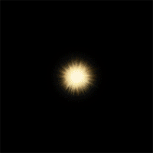
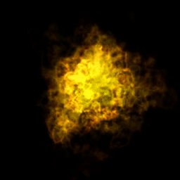
The Big Bang Theory
13.7 billion years ago
Time started when all Matter
began to expand outward
and fill an empty universe
with stars and galaxies
Over Time
Galaxies and stars continue
to expand, moving farther apart
and cooling in the process

Slide 9
Evidence for the Big Bang Theory
Evidence for the big bang theory came through two huge pieces of evidence:
Red Shift and cosmic background radiation in the form of radio waves and microwaves

Slide 10
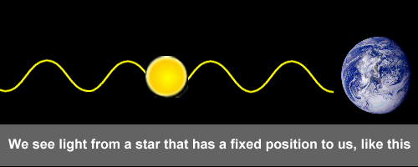
Red Shift
Red shift showed that all galaxies and stars are moving away from each other and in fact expanding
If objects are expanding then at one point they must have been closer together
Here’s how it works:

Slide 11
Background Radiation
When Scientists look out into space, they detect cosmic background radiation left over from the Big Bang
This radiation is just “drifting” in the background of space and is one of the reasons we get static on out TV’s and Radio’s

Slide 12
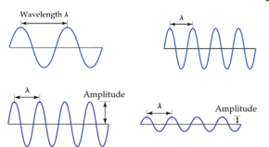
Background Radio Waves & Microwaves
The Big Bang released
high energy gamma waves
As the universe expanded,
high energy gamma waves
became stretched out
After 10 billion years, these
waves stretched out even
more, eventually becoming
microwaves and radio waves
These microwaves and radio waves
makeup the background radiation scientists
have detected drifting through space

Slide 13
Daily Routine
Sit in your appropriate seat quietly
Have all necessary materials out
All back packs on the floor
All cell phones on silent and away in backpacks
All IPods off and headphones out of your ears
Hats off
No food or drink except for water
All electronic devices away!!!

Slide 14
Bell Work
Explain how red shift works to help provide evidence for the Big Bang Theory
What is the Big Bang Theory?

Slide 15
Earth Science Announcements
Project Final Draft 11/12/2014
Extra Credit Opportunity

Slide 16
Galaxies & The Big Bang
Looking beyond our realm of understanding in space

Slide 17
Topic: Galaxies & The Big Bang
Unit: Stars & Galaxies
Objectives: Day 4 of 4
I will be able to define a galaxy and classify the 3 different types of galaxies
I will understand the Big Bang theory and the evidence supporting it

Slide 18
Background Radio Waves & Microwaves
The Big Bang released
high energy gamma waves
As the universe expanded,
high energy gamma waves
became stretched out
After 10 billion years, these
waves stretched out even
more, eventually becoming
microwaves and radio waves
These microwaves and radio waves
makeup the background radiation scientists
have detected drifting through space

Slide 19
Galaxies
We are on earth, all going around the sun
However, does the sun orbit anything?
The sun is one star among many in our Galaxy
A galaxy is a group of billions of stars, gas and dust held together by gravity

Slide 20
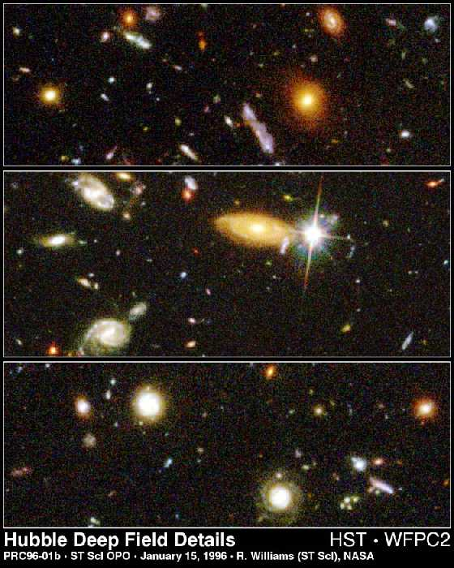
Billions and Billions
When we look out into deep space we see billions of galaxies
Each galaxy contains billions of stars
So space is made mostly up of star and galaxies

Slide 21
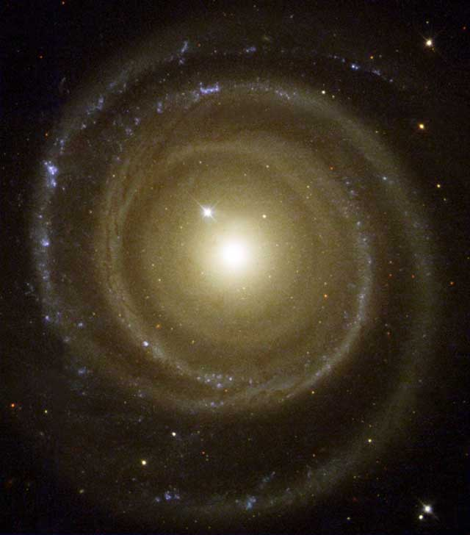
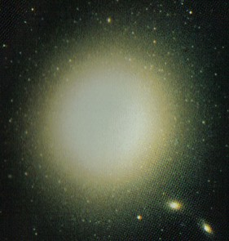
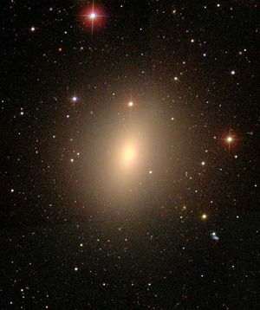
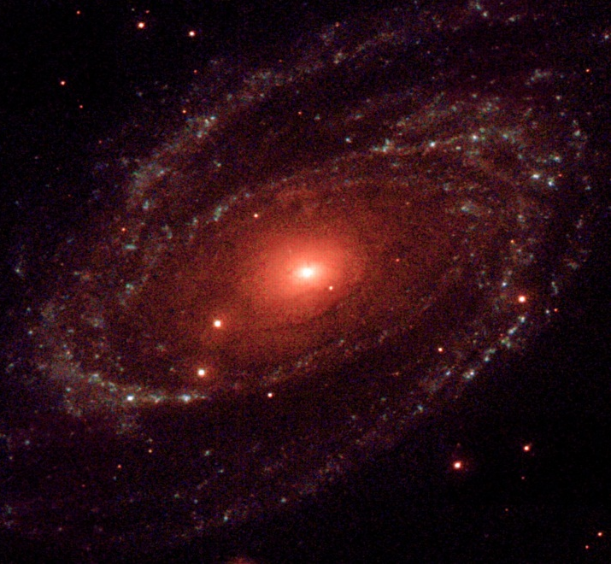
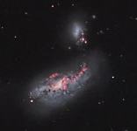
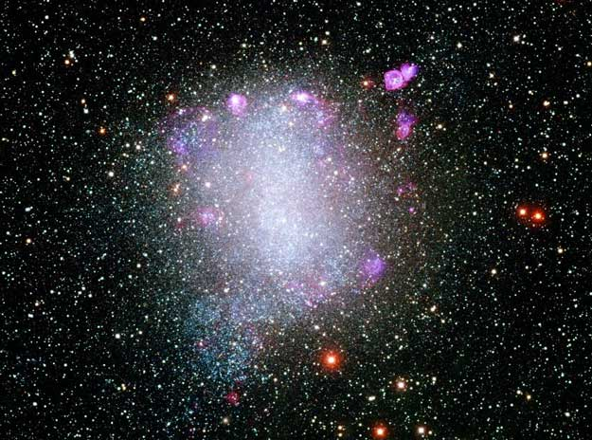
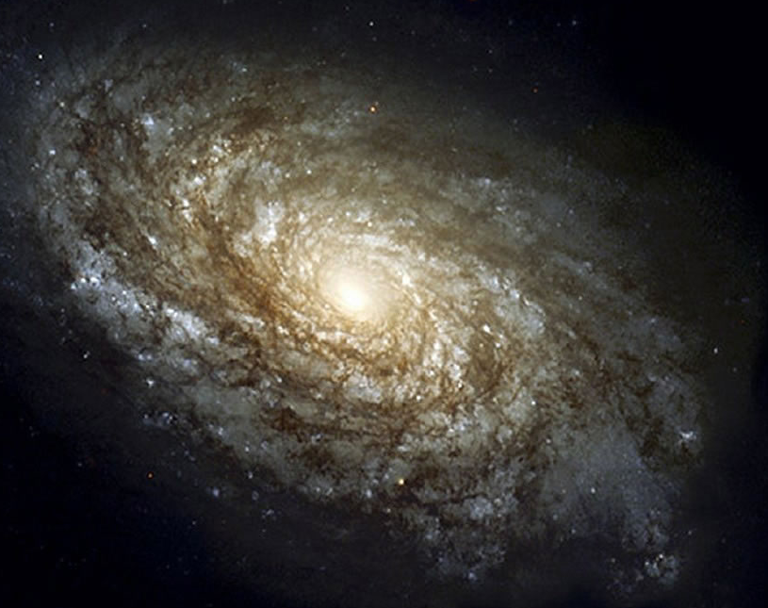
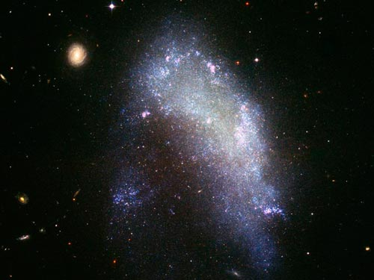
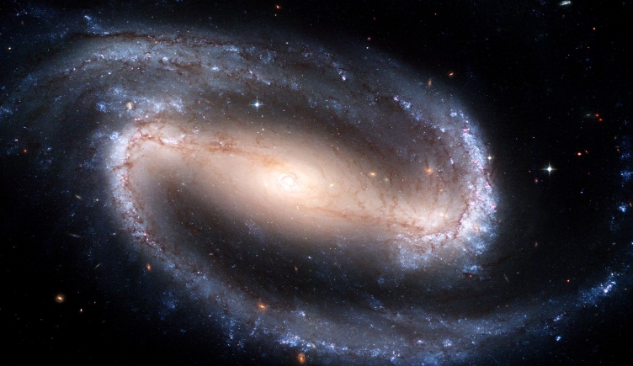
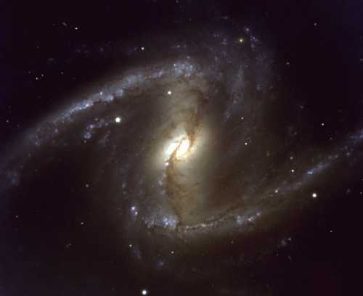
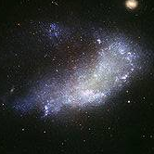
Galaxies: 4 Types
A galaxy is a group of billions of stars, gas and dust held together by gravity
We classify galaxies into 4 types:
Elliptical: sphererical or oval shaped more common
Irregular: small irregular shaped less
common
Barred spiral: same as spiral but has
bar going through the middle of it
Spiral: disc shaped, have long spiral arms

Slide 22
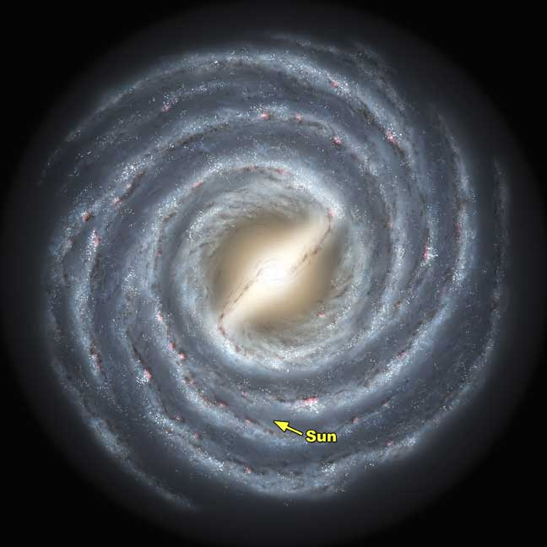
Milky Way Galaxy
Contains around 500 billion stars
The visible disk of stars is about 100,000 light years across
The sun is located 30,000 light years out from its center
All stars orbit around the central region
Based on a distance of 30,000 light-years and a speed of 235 kilometers a second, the sun orbits around the center of the galaxy once every 240 million years

Slide 23
Milky Way Continued…..
The Milky Way is usually classified as a spiral galaxy
It is difficult to know for sure because it is impossible to see our galaxy from the outside
You can see the Milky Way stretching across the night sky as a faint band of light
All of the stars you can see in the night sky belong to the Milky Way

Slide 24
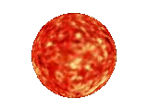
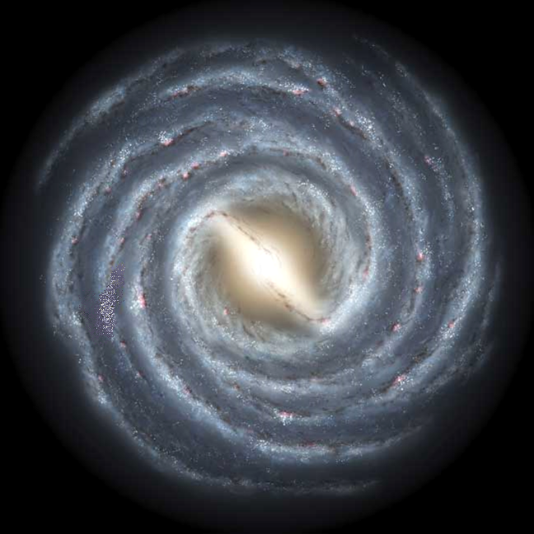
Our Sun and
Solar System
Is located 26,000
Light years form
Our galactic center
Our Milky Way
galaxy is 100,000
light years across
Our Sun
is 1 star
among
500 billion

