Slide 1
Daily Routine
Sit in your appropriate seat quietly
All back packs on the floor
All cell phones away
ID’s on or out on the desk
All IPods off and headphones out of your ears
Have all necessary materials out
Hats off
No food or drink except for water

Slide 2
Bell Work
A teacher asks her students, what causes seasons on Earth. These are her student’s answers. Choose one you support and explain your answer.
Student A: Seasons are caused by Earth’s distance away from the Sun
Student B: Seasons are caused by Earth’s axis tilt
Student C: Seasons are caused by the Moon’s gravitational pull on Earth

Slide 3
Earth Science Announcements
No homework

Slide 4
Can we predict the weather
Causes of weather

Slide 5
Today we will
Define the similarities and differences between weather and climate
Explain and model how Earth’s axis tilt affect heating for weather event
Describe the different types of air masses

Slide 6
Similarities and Differences of Weather and Climate
Weather | Both | Climate

Slide 7
Similarities and Differences of Weather and Climate
Weather | Both | Climate
 | Study atmospheric conditions

Slide 8
Similarities and Differences of Weather and Climate
Weather | Both | Climate
 | Study atmospheric conditions Study how they change over a period of time

Slide 9
Similarities and Differences of Weather and Climate
Weather | Both | Climate
 | Study atmospheric conditions Study how they change over a period of time Measure: Temperature Precipitation Humidity Wind Speeds Air Pressure

Slide 10
Similarities and Differences of Weather and Climate
Weather | Both | Climate
Study events that occur over a short period of time | Study atmospheric conditions Study how they change over a period of time Measure: Temperature Precipitation Humidity Wind Speeds Air Pressure

Slide 11
Similarities and Differences of Weather and Climate
Weather | Both | Climate
Study events that occur over a short period of time I.E. minutes – weeks | Study atmospheric conditions Study how they change over a period of time Measure: Temperature Precipitation Humidity Wind Speeds Air Pressure

Slide 12
Similarities and Differences of Weather and Climate
Weather | Both | Climate
Study events that occur over a short period of time I.E. minutes –weeks Forecasting/Predicting | Study atmospheric conditions Study how they change over a period of time Measure: Temperature Precipitation Humidity Wind Speeds Air Pressure

Slide 13
Similarities and Differences of Weather and Climate
Weather | Both | Climate
Study events that occur over a short period of time I.E. minutes – weeks Forecasting/Predic-ting | Study atmospheric conditions Study how they change over a period of time Measure: Temperature Precipitation Humidity Wind Speeds Air Pressure | Study events that occur over long periods of time

Slide 14
Similarities and Differences of Weather and Climate
Weather | Both | Climate
Study events that occur over a short period of time I.E. minutes –weeks Forecasting/Predicting | Study atmospheric conditions Study how they change over a period of time Measure: Temperature Precipitation Humidity Wind Speeds Air Pressure | Study events that occur over long periods of time I.E. years – decades – centuries – millennia

Slide 15
Similarities and Differences of Weather and Climate
Weather | Both | Climate
Study events that occur over a short period of time I.E. minutes –weeks Forecasting/ Predicting | Study atmospheric conditions Study how they change over a period of time Measure: Temperature Precipitation Humidity Wind Speeds Air Pressure | Study events that occur over long periods of time I.E. years – decades – centuries – millennia Historical

Slide 16
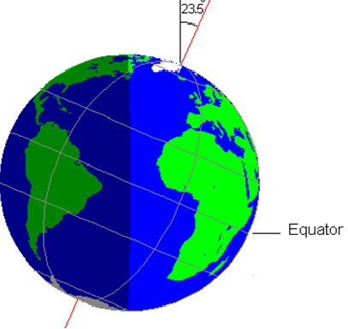
How does Earth’s tilt and latitude location affect weather
1. Sunlight radiates to heat Earth’s surface
2. Earth’s axis is 23.5⁰
3. Because of the tilt, different latitudes receive different intensities of sun light
4. Some latitudes experience more direct/intensity light and others experience diffused/spread-out light
5. Earth’s atmosphere experiences imbalanced heating

Slide 17
Cell Phone Flashlight Modeling
http://astro.unl.edu/naap/motion1/animations/seasons_ecliptic.html

Slide 18
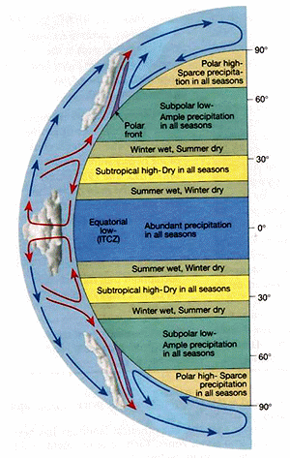
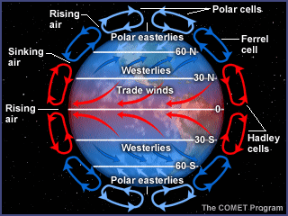
How does the heat from the Sun’s radiation gets redistributed around the planet?
Atmospheric Convection and
water circulation currents

Slide 19
Exit Slip
How does Earth’s axis tilt affect weather and form different seasons?

Slide 20
Daily Routine
Sit in your appropriate seat quietly
All back packs on the floor
All cell phones away
ID’s on or out on the desk
All IPods off and headphones out of your ears
Have all necessary materials out
Hats off
No food or drink except for water

Slide 21
Bell Work
How does Earth’s axis tilt affect weather and form different seasons?

Slide 22
How does Earth’s tilt and latitude location affect weather
1. Sunlight radiates to heat Earth’s surface
2. Earth’s axis is 23.5⁰
3. Because of the tilt, different latitudes receive different intensities of sun light
4. Some latitudes experience more direct/intensity light and others experience diffused/spread-out light
5. Earth’s atmosphere experiences imbalanced heating

Slide 23
Can we predict the weather
Causes of weather

Slide 24
Today we will
Describe the different types of air masses
Locate the source regions of different air masses in North American
Explain how air masses can change

Slide 25
How does the heat from the Sun’s radiation gets redistributed around the planet?
Atmospheric Convection and
water circulation currents

Slide 26
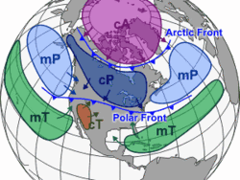
What is an air mass and where do they form?
Large volume of air that has the same characteristics, such as temperature and humidity
Form over a source region
Location of formation that has prime conditions needed for a specific air mass

Slide 27
Types of Air Masses
Arctic = A
Continental Polar = cP
Continental Tropical = cT
Maritime Polar = mP
Maritime Tropical = mT
*Continental = over land
*Maritime = over water

Slide 28
In the textbook on page 316, look up the source regions for the air masses and the seasonal characteristics of the different air masses

Slide 29
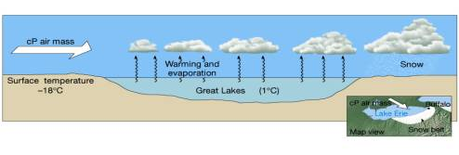
Why and how do air masses change?
Air masses are constantly moving around since the atmosphere is dynamically moving
They change into other air masses because water characteristics – water cycle properties

Slide 30
Lake Effect Snow
http://www.youtube.com/watch?v=6YjuEI0RplA

Slide 31
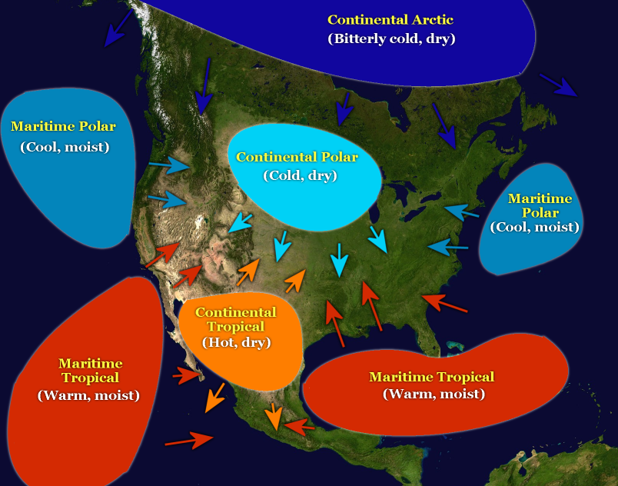
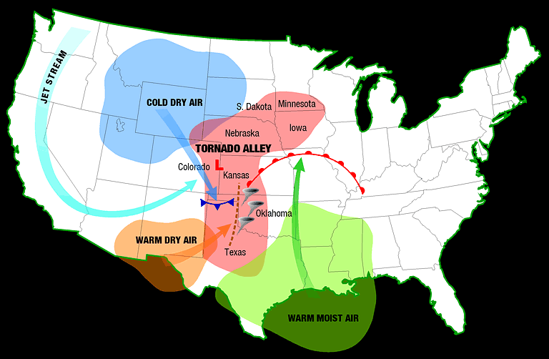
Air Masses and Severe Weather
http://www.youtube.com/watch?v=TyZx-fk1kXA

Slide 32
Exit Slip
How does Earth’s axis tilt and the source region/latitude and location affect the different characteristics of air masses

Slide 33
Daily Routine
Sit in your appropriate seat quietly
All back packs on the floor
All cell phones away
ID’s on or out on the desk
All IPods off and headphones out of your ears
Have all necessary materials out
Hats off
No food or drink except for water

Slide 34
Bell Work
Explain how air mass change in this picture to form Lake Effect Snow.

Slide 35
Announcements
There will be a quiz on Friday, March 1st about cloud formation, types of clouds, the water cycle, heating earth’s atmosphere, and air masses

Slide 36
Can we predict the weather
Causes of weather

Slide 37
Today we will
Read and analyze a weather article about cloud type, air masses, and fronts and how we can use different aspects to predict weather

Slide 38
Eye in the Sky
Read the article Eye in the Sky thoroughly
After reading the article, I will pass out a worksheet
Answer the questions from the reading in complete sentences
If you finish this assignment before the end of the class, get a textbook and answer question 1-6 on page 317

Slide 39
Exit Slip
What are three things you learned about in this article
What is a question you have after reading this article?

