Slide 1
Daily Routine
Sit in your appropriate seat quietly
Make sure you are wearing your ID’s
Have all necessary materials out
All back packs on the floor
All cell phones on silent and away in backpacks
All IPods off and headphones out of your ears
Hats off
No food or drink except for water

Slide 2
Monohybrid Punnett Square Quiz

Slide 3
Biology Announcements
Quiz Today
Chapter 6 Dihybrid Cross Worksheet
Superhero vs. Supervillain Project Due 2/20

Slide 4
Extending Mendelian Genetics

Slide 5
I will be able to…
Relate dominant-recessive patterns of inheritance in autosomal chromosomes to genetic disorders
Describe patterns of inheritance in sex-linked traits

Slide 6
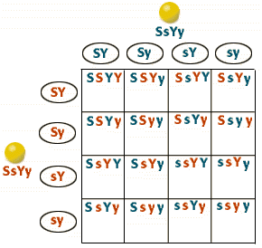
Dihybrid crosses
When comparing two or more traits, the different alleles separate in different matches in gamete formation
Law of independent assortment: allele pairs separate independently of each other during gamete formation
Inherit separately

Slide 7
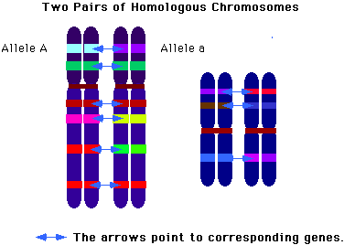
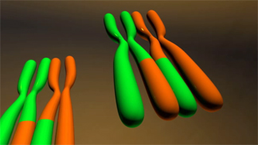
Autosome Chromosomes and Phenotype
Pertains to genes and traits in homologous paired chromosomes
Pairs have genes, but each chromosome has different allele
Many genetic diseases are passed on to offspring from crossing parental genotypes

Slide 8
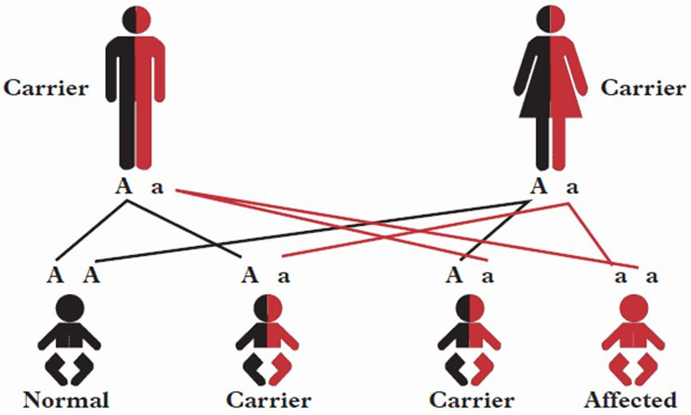
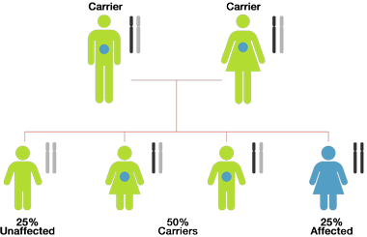
Autosome Chromosomes and Phenotype
Most genetic disorders are passed on by recessive alleles
Both alleles must be recessive to show disease
Heterozygous genotypes are carriers do no show symptoms but pass on genetic information to offspring

Slide 9
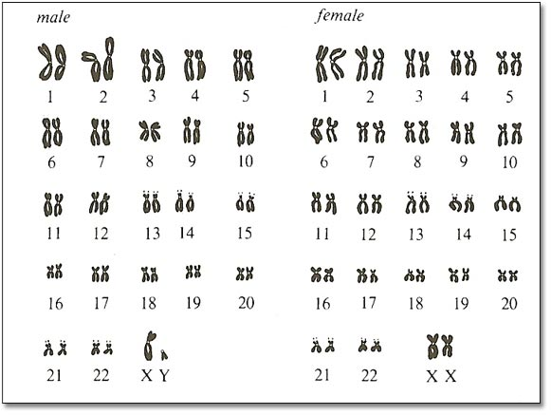
Sex Chromosome and Phenotype
Genes located on sex chromosomes
XX = female; XY = male
X chromosome has phenotype genetic info
Y chromosome only used for sex determination in males
In males, since X carries phenotype info, phenotype determined by one allele

Slide 10
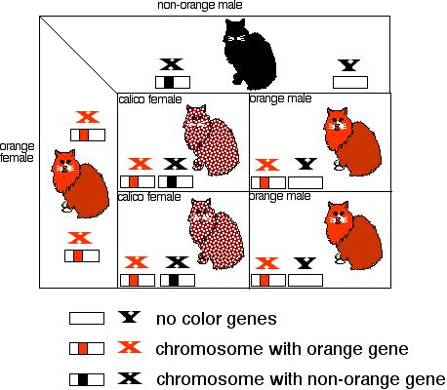
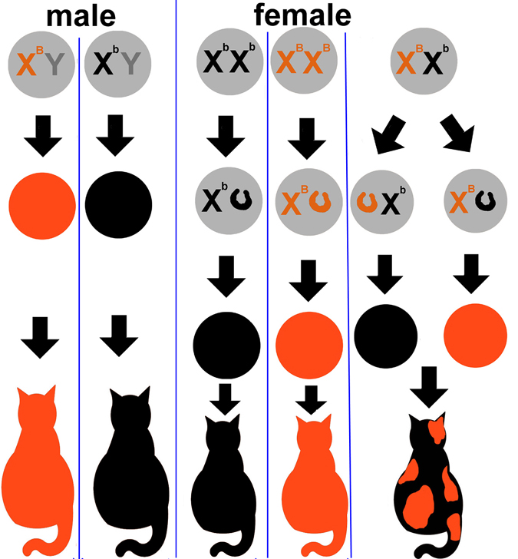
Sex Chromosomes and Phenotype
In females, sex linked traits can work differently
X-chromosome inactivation: one of two X-chromosome is randomly turned off
Creates two types of cells expressed; one from mom and one from dad
Example: calico cats

Slide 11
Finish Answering Pipe Cleaner Baby Questions

