Slide 1
Daily Routine
Sit in your appropriate seat quietly
Have all necessary materials out
All back packs on the floor
All cell phones on silent and away in backpacks
All IPods off and headphones out of your ears
No food or drink except for water

Slide 2
Bellwork
What evidence do we have to help explain the theory of plate tectonics?
Choose one of those lines of evidence and explain how it helps show the theory of plate tectonics.

Slide 3
Plate Tectonics: Convection Currents
Mr. Hamilton
CP Earth Science
Roseville High School
RJUHSD

Slide 4
I will be able to…
Locate where passive and active areas on plates
Describe the differences between passive and active margins
Explain how convection currents work
Explain how convection currents move tectonic plates

Slide 5
What is the difference between Passive vs. Active Margins
Ocean Crust
(basalt)
Ocean Crust
(basalt)
Continental Crust
(granite)
Active
Passive
Active continental margins are located at convergent plate boundaries
They are active because they experience frequent earthquakes and volcanic eruptions
Ex: West of united States
Passive continental margins have no plate boundaries
They are passive because they experience no earthquake activity
Example: East Coast united states

Slide 6
Passive vs. Active Margins
West coast is Active, check out he earthquake over the last two weeks
Now check out the east coast…..Not much happening

Slide 7
How do our plates move?
If you recall, Alfred could not explain what caused the plates or continents to move
Since he could not explain how the continents drifted apart, his hypothesis was rejected
Today, we know our plates move through spreading, sliding, and subduction
The main driving force for plate tectonics happens in the Mantle or Asthenosphere

Slide 8
Modeling Plate Tectonic Mechanism
http://www.youtube.com/watch?v=7xWWowXtuvA

Slide 9
How do our plates move?
If you recall, Alfred could not explain what caused the plates or continents to move
Since he could not explain how the continents drifted apart, his hypothesis was rejected
Today, we know our plates move through spreading, sliding, and subduction
The main driving force for plate tectonics happens in the Mantle or Asthenosphere
Convections currents move tectonic plates/lithosphere through heat changes in the Mantle

Slide 10
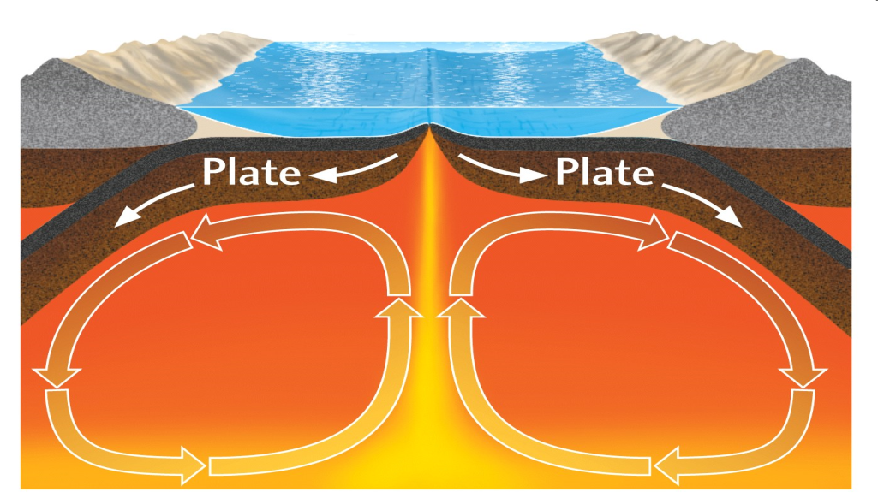
Hot Magma rises at Divergent Plate Boundaries creating new ocean crust
As the magma cools, it drags the plate back into the Mantle
Where it is destroyed (melts)

Slide 11
Diagram and Label
Ridge Push
Slab Pull
3. Magma cools and it drags the plate back into the Mantle
2. Hot Magma rises at Divergent Plate Boundaries creating new ocean crust
4. Crust is destroyed or melted in the Mantle
1. Heat comes from Core

