Slide 1
Daily Routine
Sit in your appropriate seat quietly
All back packs on the floor
All cell phones away
ID’s on or out on the desk
All IPods off and headphones out of your ears
Have all necessary materials out
Hats off
No food or drink except for water

Slide 2
Bell Work

Slide 3
Announcements
No Homework

Slide 4
Can we predict the weather
Causes of weather

Slide 5
Today we will

Slide 6
Coriolis Effect
http://www.youtube.com/watch?v=mcPs_OdQOYU
http://www.youtube.com/watch?v=7TjOy56-x8Q
http://www.youtube.com/watch?v=Pb69HENUZs8

Slide 7
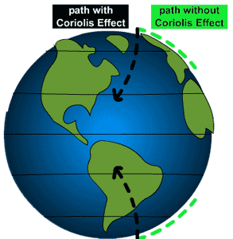
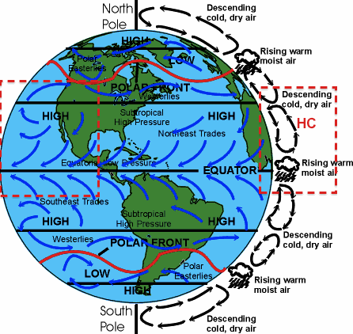
Coriolis Effect
Results of how objects (air or liquids) move in an apparent curved or deflected path rather than a straight path
Affected by Earth’s rotation, latitude location, and positioning on land
N. Hemisphere – to the right
S. Hemisphere – to the left

Slide 8
