Slide 1
Daily Routine
Sit in your appropriate seat quietly
Make sure you are wearing your ID’s
Have all necessary materials out
All back packs on the floor
All cell phones on silent and away in backpacks
All IPods off and headphones out of your ears
Hats off
No food or drink except for water

Slide 2
Biology Announcements
Mitosis Quiz – Wednesday
Written Final – December 13th
Multiple Choice Final – December 19th

Slide 3
Biology Announcements
EXTRA CREDIT:
BRING IN COLORED MARSHMELLOWS AND TWIZLERS BY WEDNESDAY

Slide 4
Meow Meiosis

Slide 5
I will be able to…
Describe the stages of Meiosis
Compare and contrast the similarities and difference between meiosis and mitosis

Slide 6
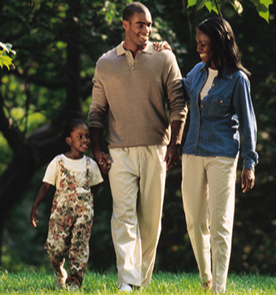
Meiosis: An Introduction
An organism must inherit a single copy of every gene from its parents.
Meiosis is a process in which the number of chromosomes per cell is cut in half through the separation of homologous chromosomes in a diploid cell.

Slide 7
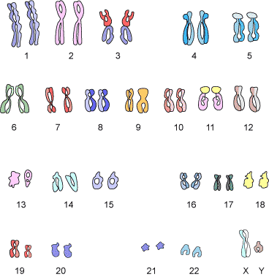
Chromosome Number
Different organisms have different numbers of chromosomes.
Humans have 46 chromosomes, 22 pairs of autosomes and one pair of sex chromosomes.
A pair (or set) of chromosomes (one from each parent) are called “homologous”

Slide 8
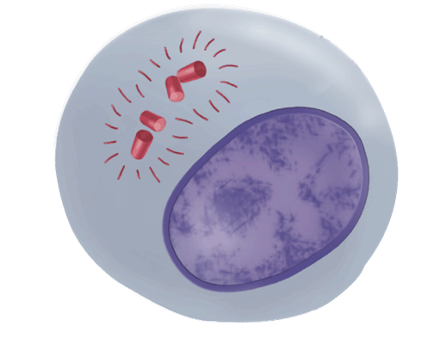
Meiosis I
Interphase I
Interphase I is essentially identical to the process previously outlined in the somatic cell cycle in mitosis.
Cells undergo a round of DNA replication, forming duplicate chromosomes.

Slide 9
Daily Routine
Sit in your appropriate seat quietly
Make sure you are wearing your ID’s
Have all necessary materials out
All back packs on the floor
All cell phones on silent and away in backpacks
All IPods off and headphones out of your ears
Hats off
No food or drink except for water

Slide 10
Biology Announcements
Mitosis Quiz – Thursday
Written Final – December 13th
Multiple Choice Final – December 19th

Slide 11
Biology Announcements
EXTRA CREDIT:
BRING IN COLORED MARSHMELLOWS AND TWIZLERS BY THURSDAY

Slide 12
Meow Meiosis PART DEUX

Slide 13
I will be able to…
Describe the stages of Meiosis
Compare and contrast the similarities and difference between meiosis and mitosis

Slide 14
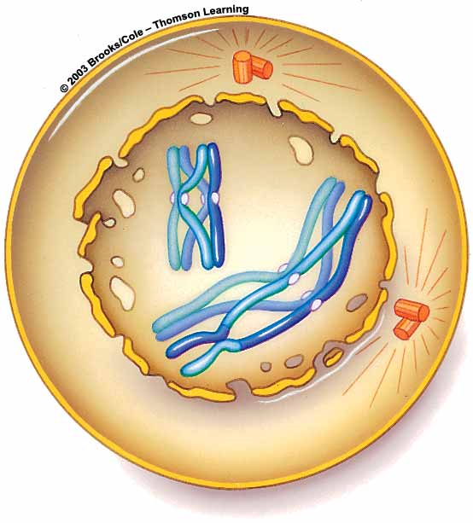
Meiosis I: Prophase I
During Prophase I each chromosome pairs with its corresponding homologous chromosome to form a tetrad.
There are 4 chromatids in a tetrad.
Prophase I
Tetrad

Slide 15
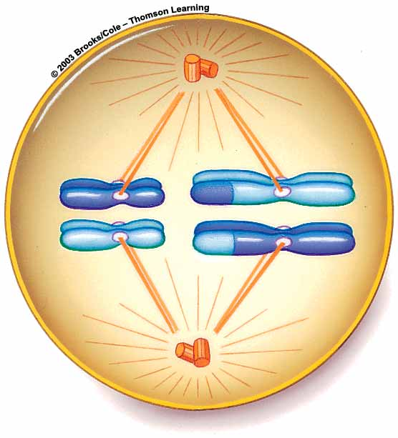
Meiosis I: Metaphase I
How is this different from Mitosis?
During Metaphase I, the 23 homologous pairs (tetrads) line up along the equator of the cell.
Spindle fibers from the centrioles attach to the centromere of the chromosome
Metaphase I

Slide 16
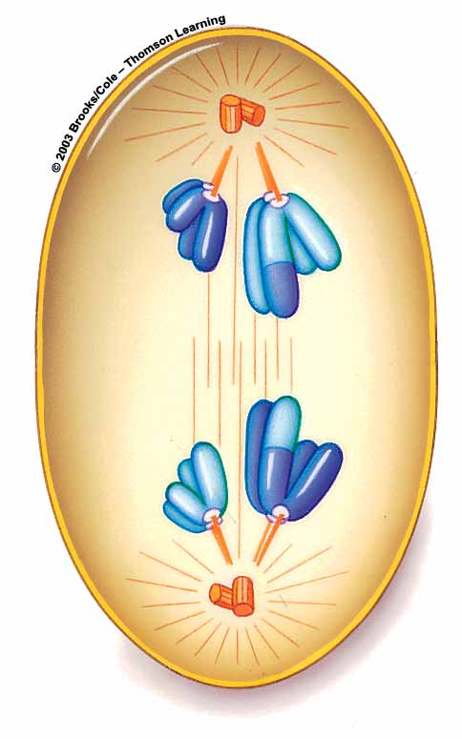
Meiosis I: Anaphase I
During Anaphase I the homologous pairs separate (via shortening spindle fibers) and move toward the poles of the cell.
Note the difference from mitosis; while the homologous pairs have left one another, the chromatids are still in tact at the centromere.
Anaphase I

Slide 17
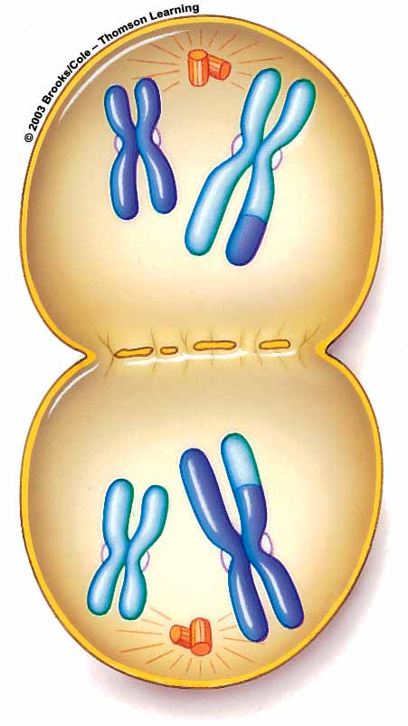
Meiosis: Telophase I
Nuclear membranes form and the spindle breaks down.
Cytokinesis results in two cells.
The two haploid (N) cells produced by meiosis I have chromosomes from each homologous pair.
The cells are different from each other (remember independent assortment) and from the diploid cell that entered meiosis I.
Telophase I and Cytokinesis

Slide 18
Meiosis II
The 2 haploid cells produced by meiosis I now enter a second meiotic division which results in the production of 4 genetically different haploid cells.
No replication takes place. Remember, the chromosomes already replicated during Interphase I.

Slide 19
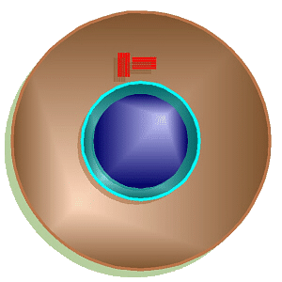
Meiosis II
Telophase II and Cytokinesis II
Telophase I and Cytokinesis I
Prophase II
Metaphase II
Anaphase II

Slide 20
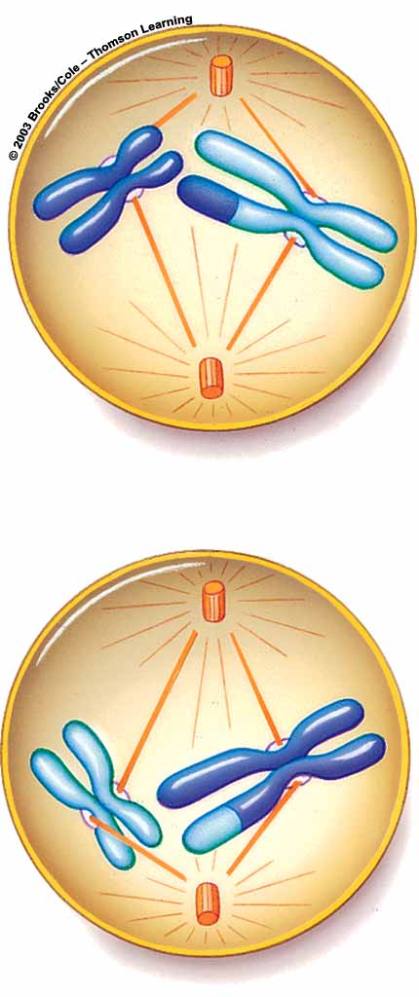
Meiosis II
During Prophase II, each of the cell’s 23 chromosomes has 2 chromatids.
Spindle fibers reform and move chromosomes toward cell equator.
Notes:
20

Slide 21
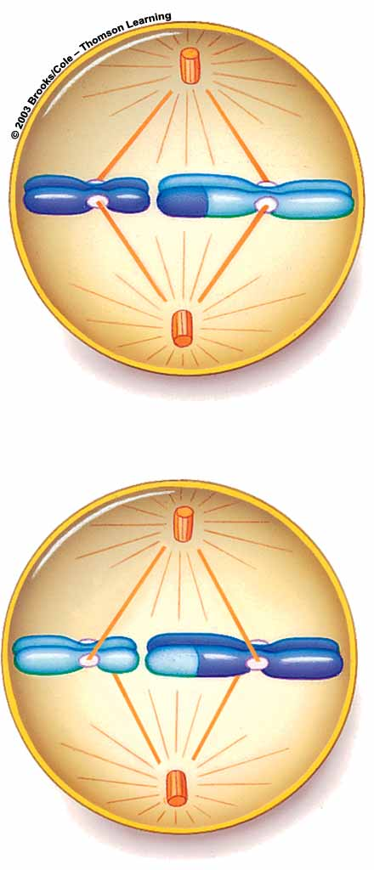
Meiosis II
During Metaphase II
Chromosomes move to
midline of dividing
cell, facing opposite
poles.
Notes:
21

Slide 22
Meiosis II
During Anaphase II, chromatids separate and move toward opposite poles of the cell.
Notes:
22

Slide 23
Meiosis II
During Telophase II, the nuclear membrane reforms around chromosomes in each of the four new cells, and a second round of cytokinesis produces four new haploid cells

Slide 24
Telophase II

Slide 25
Daily Routine
Sit in your appropriate seat quietly
Make sure you are wearing your ID’s
Have all necessary materials out
All back packs on the floor
All cell phones on silent and away in backpacks
All IPods off and headphones out of your ears
Hats off
No food or drink except for water

Slide 26
Biology Announcements
Mitosis Quiz – Wednesday
Written Final – December 13th
Multiple Choice Final – December 19th

Slide 27
What are the blue prints of us?

Slide 28
I will be able to…
Model the structure of DNA
Describe the different parts of DNA

Slide 29
What makes us different from other organism?
Organisms differ in their genetic information
Genetic information is a code that take the shape of a double helix
Structure is known as deoxyribonucleic acid (DNA)

Slide 30
DNA Structure
The DNA molecule looks like a spiral staircase
Spiral back bone is made of
Phosphate group
Pentagon Deoxyribose sugar
Stair are made of bonded nitrogen bases known as nucleic acids

Slide 31
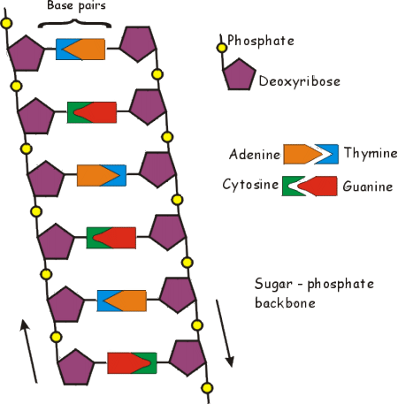
Nucleic Acids
Pyrimidines
Thymine (matches with Adenine)
Cytosine (matches with Guanine)
Uracil (matches with Adenine)
Purines
Adenine (matches with thymine and uracil)
Guanine (matches with

Slide 32
Modeling the Structure of DNA

Slide 33
Daily Routine
Sit in your appropriate seat quietly
Make sure you are wearing your ID’s
Have all necessary materials out
All back packs on the floor
All cell phones on silent and away in backpacks
All IPods off and headphones out of your ears
Hats off
No food or drink except for water

Slide 34
Bell Work
What are the three main parts of DNA
What are the base pairings used as a code for our genetic information?
Which nucleotide is not used in DNA?

Slide 35
Biology Announcements
Written Final – December 13th
Multiple Choice Final – December 19th

Slide 36
What are the blue prints of us?

Slide 37
I will be able to…
Model the structure of DNA
Describe the different parts of DNA
Compare and contrast DNA structures to RNA Structure

Slide 38
DNA vs. RNA
DNA
RNA
Double Stranded
Codes for genetic information
Contains phosphate group
Has deoxyribose sugar
Nitrogen bases: adenine, thymine, cytosine, and guanine
Single Stranded
Coded from DNA to make proteins
Contains phosphate group
Has ribose sugar
Nitrogen bases: adenine, uracil, cytosine, and guanine

Slide 39
DNA vs. RNA
DNA
RNA

Slide 40
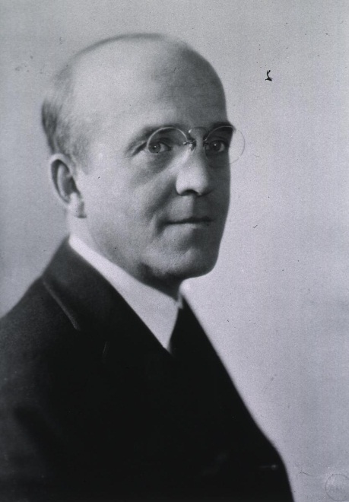
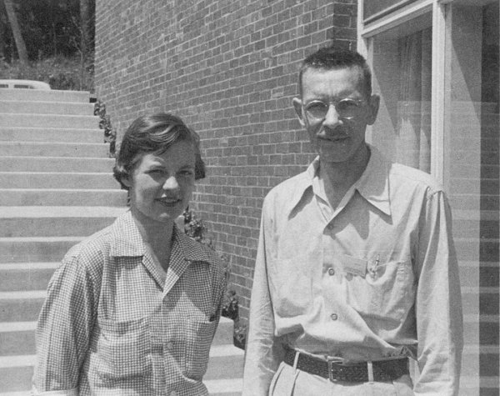
Developing Understanding about DNA
Frederick Griffith – 1928 – transforming principle of “material” in bacteria
Oswald Avery – 1944 – genetic information is DNA or proteins
Hershey and Chase – 1952 – bacterial DNA carried genetic information; DNA is genetic information for organisms

Slide 41
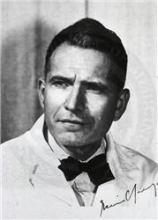
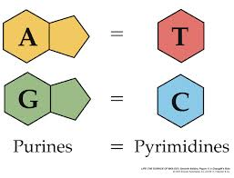
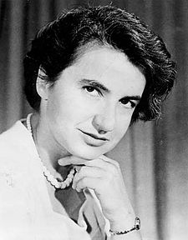
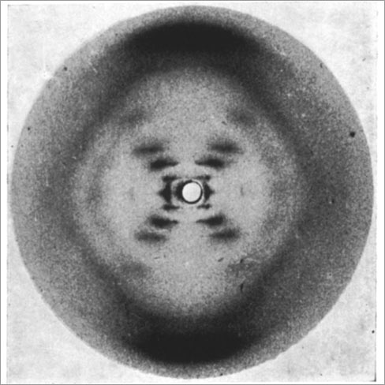
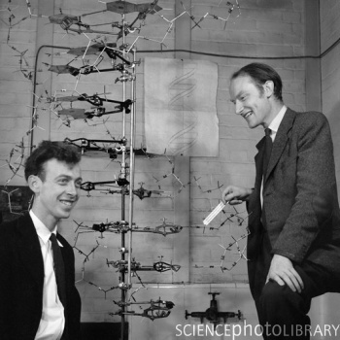
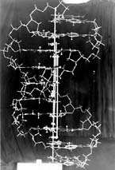
Developing Understanding about DNA
Erwin Chargaff – 1950 – DNA contained four main nitrogen bases in specific pairings
Rosalind Franklin – 1951 – X-rayed DNA
Watson and Crick – 1953 – Double helix structure with coded base pairings

Slide 42
Class Work Assignment

