Slide 1
Daily Routine
Sit in your appropriate seat quietly
Make sure you are wearing your ID’s
Have all necessary materials out
All back packs on the floor
All cell phones on silent and away in backpacks
All IPods off and headphones out of your ears
Hats off
No food or drink except for water

Slide 2
Bell Work
Write down one personal goal you have this year
Write down one personal goal you have this semester
Write down one personal goal you have for this class this semester.

Slide 3
Earth Science Announcements
Geologic Time Scale News Article Due: Friday, Jan 10th

Slide 4
Introduction to Geologic Time

Slide 5
Today we will
Discuss how old Earth is and how we have broken Earth’s history into different parts
Research how Earth has evolved over the course of it’s history
Create a time scale representation of significant events during

Slide 6
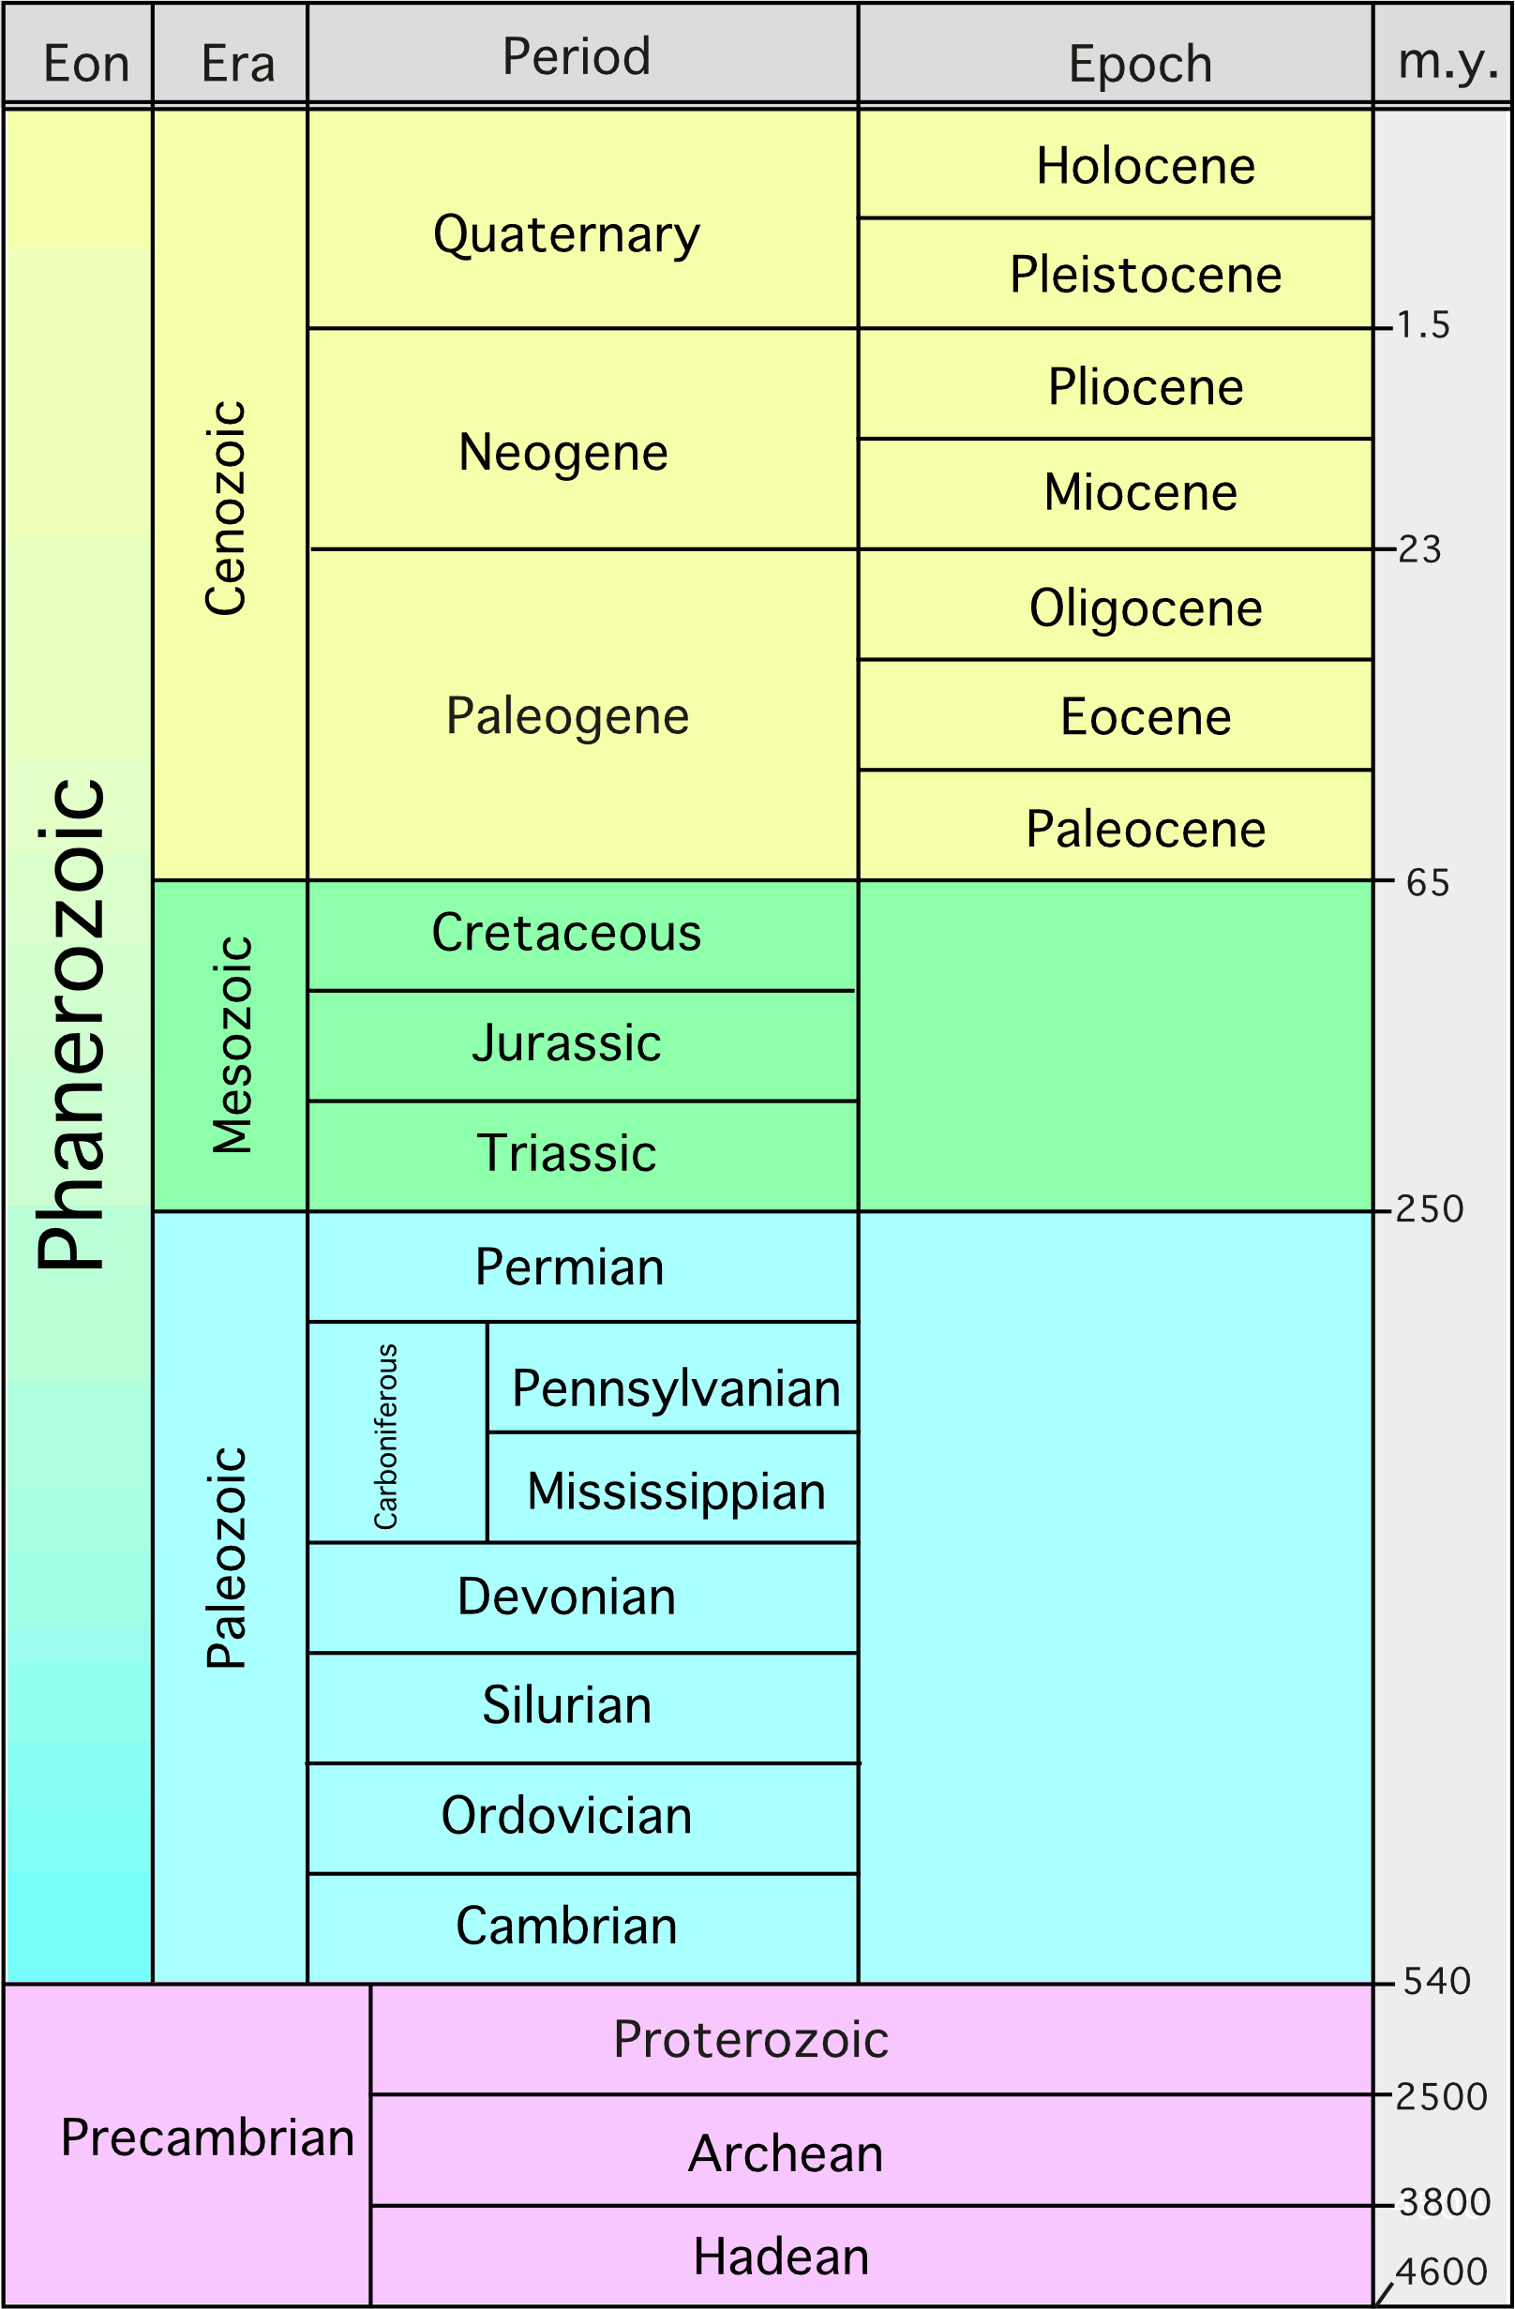
Geologic Time
Geologic Time is Broken into four distinct amounts of time
Eons, Eras, Periods and Epochs

Slide 7
What is an eon?
An eon is the longest subdivision of time
Last from 500 million years – several billion years
Two eons – Precambrian and Phanerozoic

Slide 8
What is an era?
An era is the second longest subdivision of time
Last from tens of million years – few hundred million years
Three eras –
Paleozoic – time of invertebrates
Mesozoic – time of reptiles/dinosaurs
Cenozoic – time of mammals

Slide 9
What is an Period?
A period is the second shortest subdivision of time
Last a million to 10’s of millions of years
Main ones occur in the Paleozoic and Mesozoic
We are in the Quaternary period

Slide 10
What is an epoch?
An epoch is the shortest subdivision of time
Last from hundreds of thousand of years
Most useful epochs occur during the Cenozoic
Used to describe younger Earth

Slide 11
Today we are going research about Earth’s History
I will assign which period of time you get
Each student will research one different geologic or paleontological event that occurred during Earth’s history time
Each student must write a one to two page (double spaced) news article about their event in Earth’s physical history (typed or neatly hand written)
Think about these type questions: what, when, how, and why is it important
Due: Friday, January 10th

Slide 12
Daily Routine
Sit in your appropriate seat quietly
Make sure you are wearing your ID’s
Have all necessary materials out
All back packs on the floor
All cell phones on silent and away in backpacks
All IPods off and headphones out of your ears
Hats off
No food or drink except for water

Slide 13
Bell Work
What are the four subdivisions of time to describe geologic time?
What are the three eras that make up the geologic timescale
What is the longest period time (specific name) on the geologic timescale?

Slide 14
Earth Science Announcements
Geologic Time Scale News Article Due Jan. 10th

Slide 15
Relative Dating

Slide 16
Today we will

Slide 17
Daily Routine
Sit in your appropriate seat quietly
Make sure you are wearing your ID’s
Have all necessary materials out
All back packs on the floor
All cell phones on silent and away in backpacks
All IPods off and headphones out of your ears
Hats off
No food or drink except for water

Slide 18
Bell Work
The last couple of days, you have been observing and reading about different organisms during Earth’s history and correlating them to geologic time. We know about these organisms because they make up our fossil record.
Describe how life changed during the course of Earth’s geologic history.

Slide 19
Earth Science Announcements
Geologic Time Scale News Article Due Jan. 10th

Slide 20
Relative Dating

Slide 21
Today we will
Discuss about the development of geology and the importance of uniformitarianism
Describe the principle of relative dating
Relative date different rock strata drawings by applying the different principles of relative dating

Slide 22
Early History of Geologic Time

Slide 23
James Hutton
Father of geology (one of the first geologists)
Noticed that patterns occurring during the present are seen in old rocks
Openly stated that the Earth is old

Slide 24
Uniformitarianism
James Hutton was a uniformitarian
Geologic processes happening today have been occurring since Earth formed
Supports old Earth because Earth is experiencing same forces throughout history to shape and change land

Slide 25
Relative Dating
Method which scientists study geologic events and how they occurred
Does not give an exact age of rock layers or strata
Based on observations and understanding different theories and principles

Slide 26
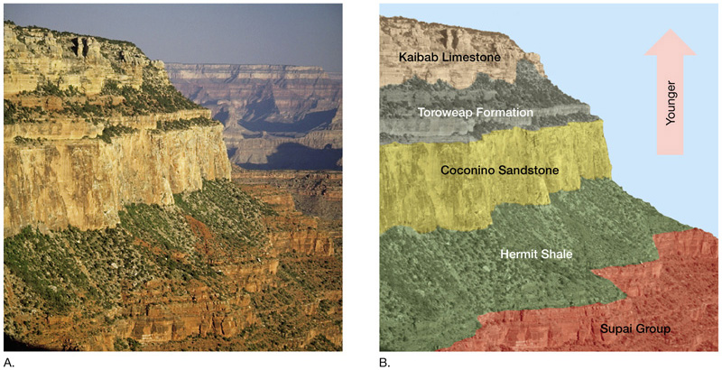
Original Horizontality
Sedimentary rocks are deposited horizontal (flat) or nearly flat
Are formed horizontality due to three things:
Gravity
Water
Wind

Slide 27
Superposition
Geologist cannot determine the exact age of rocks by observation
They infer that:
The oldest rocks are at the bottom
The youngest are at the top

Slide 28
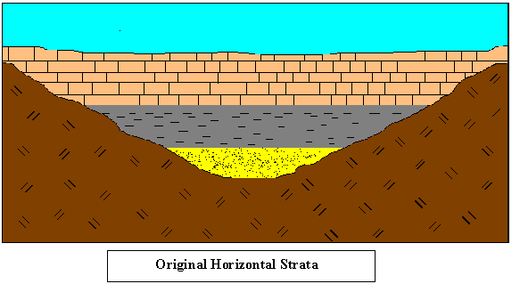
Superposition
Determine the age of this strata cross section where 1 is the oldest and 4 is the youngest

Slide 29
Superposition
Determine the age of this strata cross section where 1 is the oldest and 4 is the youngest
4
3
2
1

Slide 30
Principle of Inclusions
One rock layer contains fragments of another rock layer
Usually caused by erosion of igneous intrusions
Rock fragments known as inclusions
Inclusions are usually older than surrounding rock

Slide 31
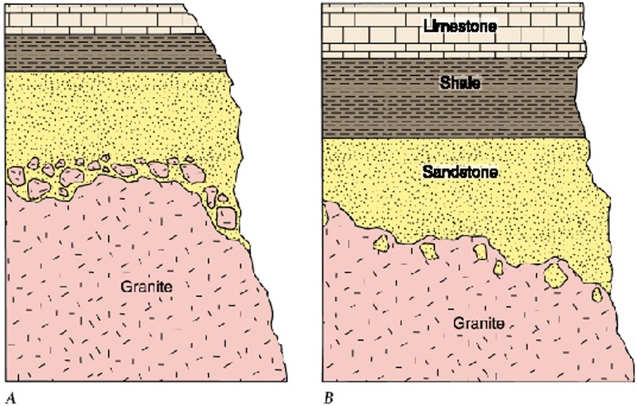
Principle of Inclusions
In picture A, Is the sandstone or granite older? Is it the same in picture B? Why?

Slide 32
Principle of Inclusions
In picture A, Is the sandstone or granite older? Is it the same in picture B? Why?
The granite in picture A is older.
The granite was weathered and eroded
and the sandstone formed around
the granite fragments. The fragments
or inclusions are older than the
surrounding rock.

Slide 33
Principle of Inclusions
In picture ! Is the sandstone or granite older? Is it the same in picture B? Why?
In picture B, the sandstone is older.
Smaller sandstone fragments are found in the granite. This means the granitic magma intruded on the sandstone and broke some pieces off. As the magma cooled to form the granite, the sandstone inclusions were infused into the rock. Again, the inclusions are older than the surrounding rock.

Slide 34
Cross-Cutting Relationships
Igneous intrusions can cut surrounding rock
Intrusions are younger than the rock they cut
Intrusions can “cut” through other intrusions
Superposition is key for determining relative age!

Slide 35
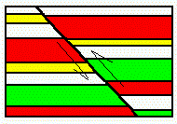
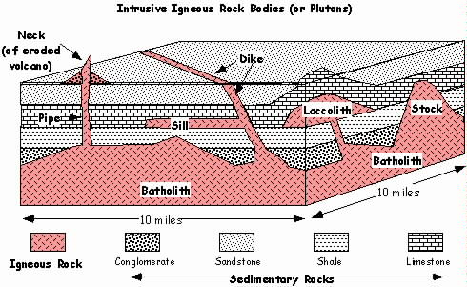
Cross Cutting Relationships
Faults
Igneous Intrusions (plutons)

Slide 36
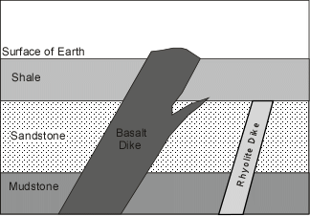
Cross Cutting Practice

Slide 37
Cross Cutting Practice
5
4
3
2
1

Slide 38
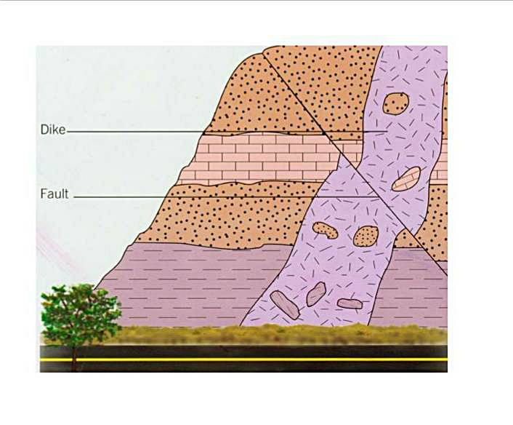
Cross Cutting Practice

Slide 39
Cross Cutting Practice
4
5
3
6
2
1

Slide 40
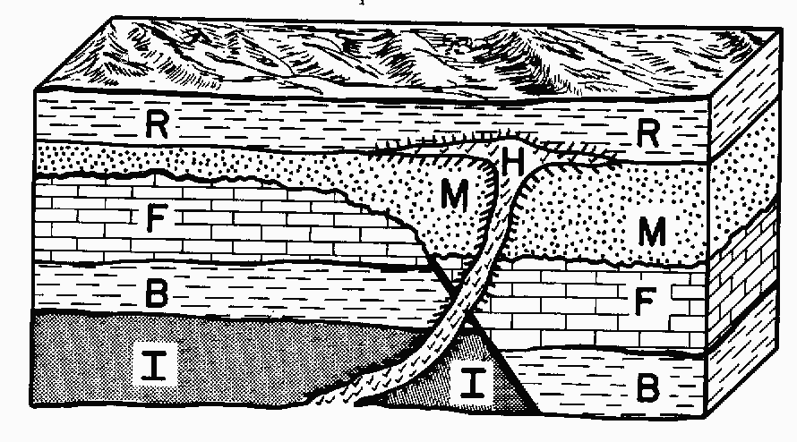
Exit Slip
Relatively date this cross-section from oldest to youngest. For each step, write down the principle you used to create your series of events. Are there any more principles shown in this cross section that we have not discussed? Why or why not?

Slide 41
Daily Routine
Sit in your appropriate seat quietly
Make sure you are wearing your ID’s
Have all necessary materials out
All back packs on the floor
All cell phones on silent and away in backpacks
All IPods off and headphones out of your ears
Hats off
No food or drink except for water

Slide 42
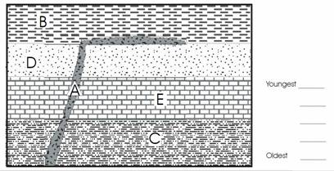
Bell Work
Relatively date this cross-section from oldest to youngest. For each step, write down the principle you used to create your series of events.

Slide 43
Earth Science Announcements

Slide 44
Relative Dating

Slide 45
Today we will
Describe the principles of relative dating
Relative date different rock strata drawings by applying the different principles of relative dating

Slide 46
Yesterday, we discussed about four principles of relative dating…
Original Horizontality
Superposition
Inclusion
Cross-Cutting Relationships

Slide 47
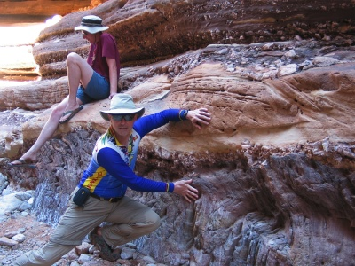
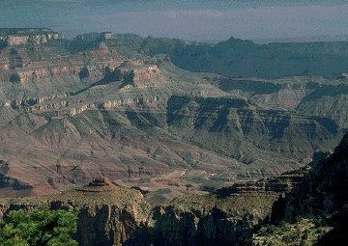
Unconformities
Unconformities are gaps of missing time in the rock record
Missing due to the ever changing Earth
Weathering and Erosion
The missing rock layer(s) are eventually covered with new rock layers
Rocks above an unconformity are considerably younger

Slide 48
Types of Unconformities
Disconformity:
Major erosion surface exists between two sedimentary rock layers
Often hard to tell because the erosion surface is often smooth; look for ripples in cross sections

Slide 49
Types of Unconformities
Nonconformity:
When sedimentary rocks are on top deep and old igneous and metamorphic rocks
Show gap of time where there was uplift and erosion

Slide 50
Types of Unconformities
Angular unconformity:
When flat sedimentary rocks are on top of folded or tilted sedimentary rocks
Shows a history where forces changed the form of strata, experienced erosion, and new sedimentary rocks formed

Slide 51
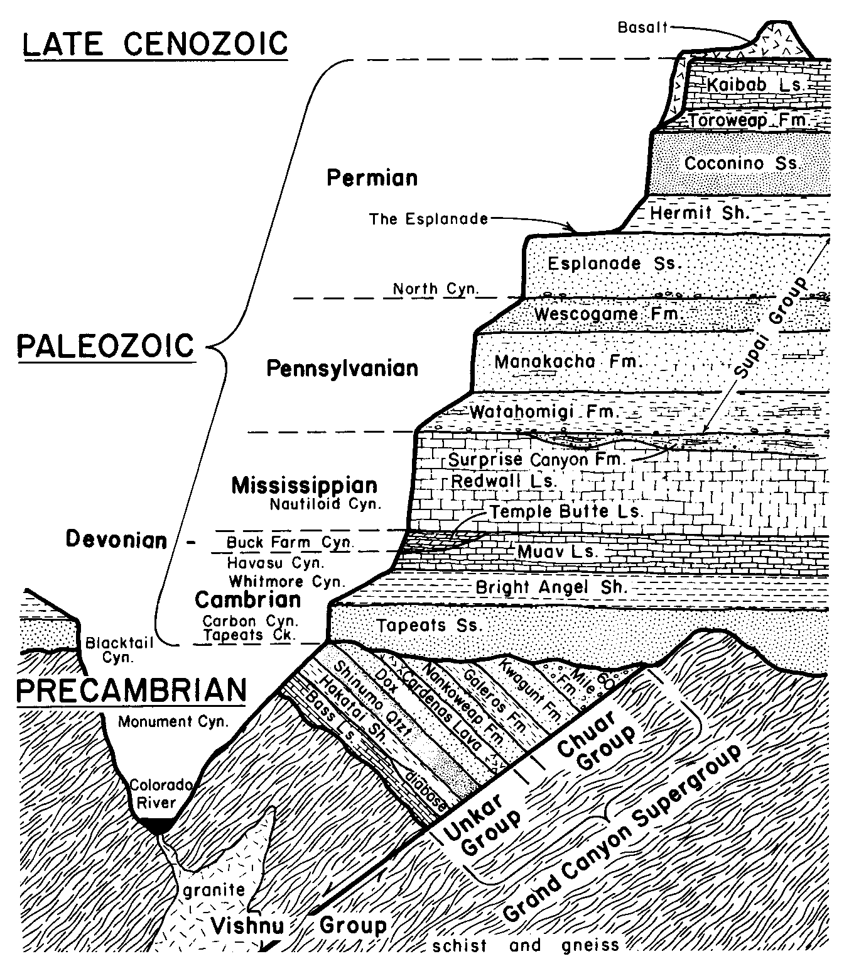
Grand Canyon Filled with Missing Time

Slide 52
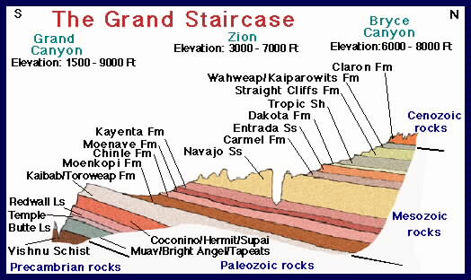
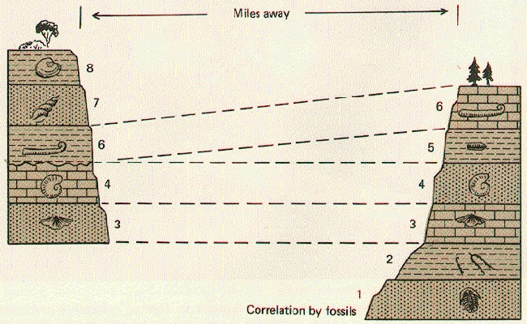
Correlation
Correlation is the matching of unique rock outcrops and/or fossils exposed
Must occur in several large geographic regions
Helps form a sequence of events to understand geologic history of a region

Slide 53
Key Bed and Lateral Succession
Keybeds are distinctive rock layers used as markers to compare rocks in different regions
Correlate one rock layer in a region to the same in another

Slide 54
Key Bed and Lateral Succession

Slide 55
Fossil Correlation
Use fossils to correlate (relate) different rocks in different geographic areas
Shows similar times of deposition even though the strata might be different

Slide 56
Fossil Correlation

Slide 57
Rules of Relative Dating
The oldest rocks are at the bottom and the youngest are at the top
If there are inclusions (rock fragments), they are older than the surrounding rock
If a fault or igneous intrusion cuts the surrounding rock, then it is younger than the rock it cuts
If a fault or igneous intrusion stops beneath a particular layer, then it older than the rock it doesn’t cut

Slide 58
Rules of Relative Dating
5. If there is an unconformity between rock layers, then the rocks above the squiggle unconformity line is considerably younger
6. Use key bed and fossil correlation to compare the relative ages of rock strata of two different regions

Slide 59
Daily Routine
Sit in your appropriate seat quietly
Make sure you are wearing your ID’s
Have all necessary materials out
All back packs on the floor
All cell phones on silent and away in backpacks
All IPods off and headphones out of your ears
Hats off
No food or drink except for water

Slide 60
Earth Science Announcements

Slide 61
Absolute Dating
How are minerals affected by the different stages of the rock cycle?

Slide 62
I will be able to…
Describe the process of absolute dating
Label parts of an atom
Perform the M&M activity pertaining to half-lives and radiometric dating
Explain how scientist radiometrically date rocks and organic material

Slide 63
Last week…we discussed
The Geologic Time Scale
Formation of Geology
History of an old Earth
Uniformitarianism = old Earth
Relative Dating = comparison without knowing exact ages
Principles:
Horizontality
Superposition
Inclusion
Cross-Cutting Relationships
Unconformity
Correlation

Slide 64
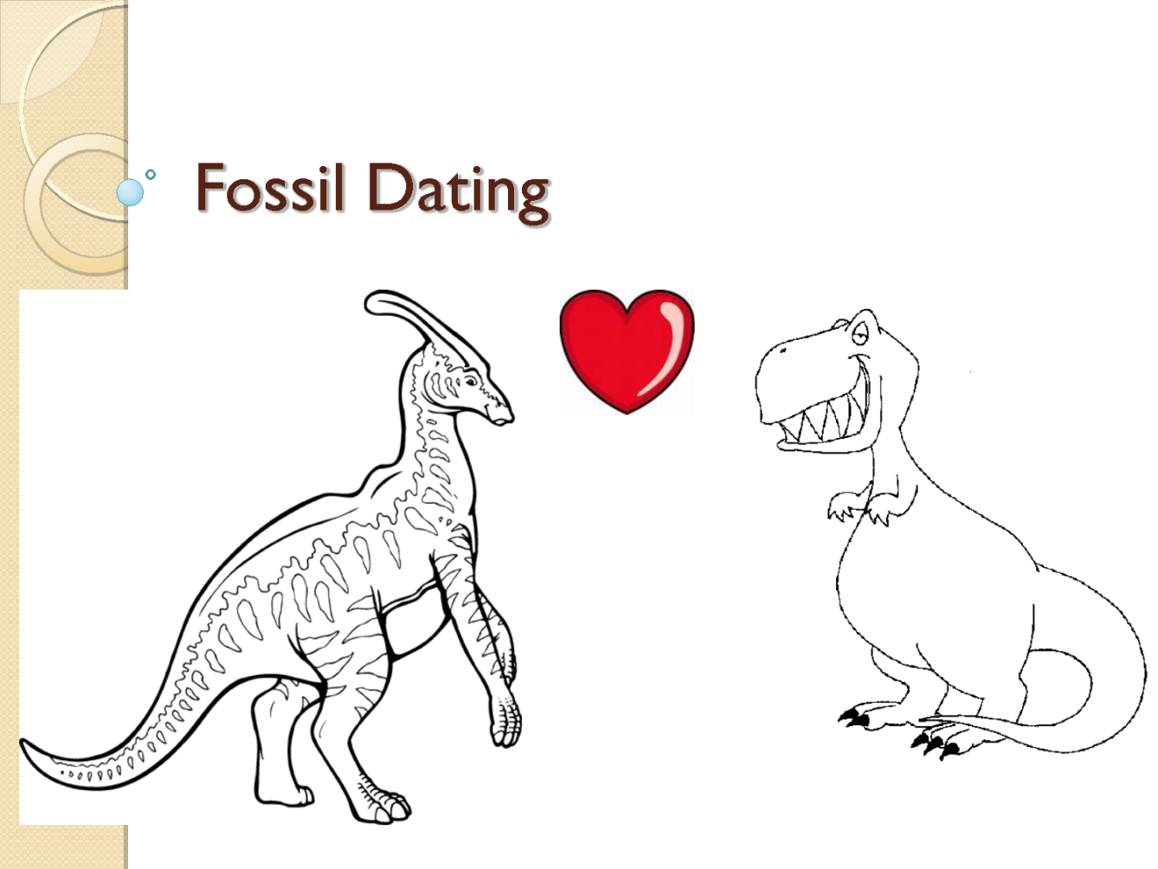
What is Absolute Dating?
The process of determining the numerical rocks and other objects

Slide 65
How do we determine the age of rocks?
We look at how atoms
radioactively decay

Slide 66
What is radioactivity?
Emission of radioactive particles which results in the change of an atom
Occurs at a constant rate with little to no variance
Occurs over long periods of time
Isotopes radioactively decay

Slide 67
What is an isotope?
But First….

Slide 68
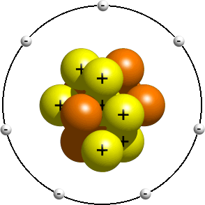
Label the parts of an atom…

Slide 69
What is an isotope and how does it pertain to radioactivity?
One of multiple forms of an element with differing numbers or neutrons
Radioactively decaying isotopes/atoms emit neutrons
This affects the atomic structure
Becomes a new element isotope

Slide 70
M&M Radioactive Lab

Slide 71
Directions
1. With a partner, count the number of M&Mium isotopes in your study and record this number in the data table under nondecayed isotopes (radioactive).
2. Place the isotopes in the container and mix. Pour out on a clean surface. Remove the “m” up isotopes. Count the remaining candies and record in your data table as the number of undecayed atoms.
3. Return the “m” down isotopes (undecayed) to the cup. Mix up and repeat step 2.
4. Continue the process until all isotopes have decayed.
5. You may then eat your candies when both trials are completed.
Using the graph paper provided, construct a graph by plotting the number of half-lives as the independent variable (x axis) and the number of undecayed atoms as the dependent variable (y-axis). Remember to label your x-axis, y-axis, and indicate a title for your graph.

Slide 72
Daily Routine
Sit in your appropriate seat quietly
Make sure you are wearing your ID’s
Have all necessary materials out
All back packs on the floor
All cell phones on silent and away in backpacks
All IPods off and headphones out of your ears
Hats off
No food or drink except for water

Slide 73
Bell work
How are isotopes and radioactive decay related?

Slide 74
Bell work
Isotopes are atoms of an element that vary in neutrons. Some isotopes are radioactive and emit or release/lose protons as they decay into different isotopes of other elements

Slide 75
Earth Science Announcements

Slide 76
Absolute Dating

Slide 77
Today we will
Describe the process of absolute dating
Perform the M&M activity pertaining to half-lives and radiometric dating by graphing our data
Explain how scientist radiometrically date rocks and organic material

Slide 78
What is an isotope and how does it pertain to radioactivity?
One of multiple forms of an element with differing numbers or neutrons
Radioactively decaying isotopes/atoms emit neutrons
This affects the atomic structure
Becomes a new element isotope

Slide 79
Recording Data
Trial | Undecayed (Radioactive) | Decayed Isotope
0 | 60 | 0
1 | 31 | 29
2 | 16 | 15
3 | 8 | 8
4 | 4 | 4
5 | 2 | 2
6 | 1 | 1
7 | 0 | 60
8
Trial | Undecayed (Radioactive) | Decayed Isotope
0 | 60 | 0
1 | 31 | 29
2 | 16
3 | 8
4 | 4
5 | 2
6 | 1
7 | 0
8

Slide 80
Graphing Review
An independent variable
is the variable you have control over, what you can choose and manipulate.
A dependent variable
A dependent variable is what you measure in the experiment and what is affected during the experiment.

Slide 81
Which is the IV and the DV
Trial | Undecayed (Radioactive) | Decayed Isotope
0
1
IV
Trial because we can control it and we change or manipulate it
DV
Undayed and Decayed Isotopes because they are affected each trial

Slide 82
Graphing
Using the graph paper provided, construct a graph by plotting the number of trials as the independent variable (x axis)
The number of undecayed atoms as the dependent variable (y-axis). Remember to label your x-axis, y-axis, and indicate a title for your graph.
Trial | Undecayed (Radioactive) | Decayed Isotope
0 | 60 | 0
1 | 31 | 29
2 | 16 | 44
3 | 8 | 52
4 | 4 | 56
5 | 2 | 58
6 | 1 | 59
7 | 0 | 60
8

Slide 83
What is radiometric dating and how do we use it?
Process of using counting and monitoring radioactive isotopes
Measure the rate of change between radioactive isotopes
Look at when things first formed (rocks) or died (fossils and other organic matter)

Slide 84
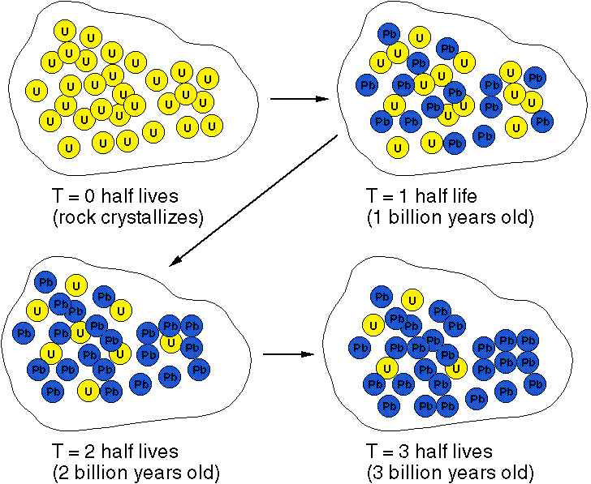
Half-Lives

Slide 85
Half-Lives
Length of time it takes for one half of the original isotope to decay
After each half life only half of the radioactive isotopes remain
Decayed and radioactive total remain constant

Slide 86
Parents and Daughters
Parents = original radioactive isotope
Daughter = decayed isotope
Determine radiometric ages and half-lives based on percentages
Look familiar?

Slide 87
Examples of Radioactive Isotope used for Radiometric Dating
*Zircons are small mineral crystals like quartz or diamonds

Slide 88
Exit Slip
A archeologist has exhumed a new tomb in Mexico. He wants to absolute date the material and cadavers he finds. Which absolute dating isotope should he use? Explain your answer
A Paleontologist wants to date a new fossilized species from the Cambrian Period (540 mya). Which absolute dating isotope should he use? Explain your answer
*Use your notes to help you explain your answers!

Slide 89
Exit Slip
A archeologist has exhumed a new tomb in Mexico. He wants to absolute date the material and cadavers he finds. Which absolute dating isotope should he use? Explain your answer

Slide 90
Exit Slip
A Paleontologist wants to date a new fossilized species from the Cambrian Period (540 mya). Which absolute dating isotope should he use? Explain your answer

Slide 91
Daily Routine
Sit in your appropriate seat quietly
Make sure you are wearing your ID’s
Have all necessary materials out
All back packs on the floor
All cell phones on silent and away in backpacks
All IPods off and headphones out of your ears
Hats off
No food or drink except for water

Slide 92
Bell work
A astronomer wants to date moon rocks to determine how old the moon is using radiometric dating. Which type of radioactive isotope would she want to use to determine the moon’s absolute age? Why?
Carbon/Nitrogen Half Life = 5,730 years
Potassim/Argon Half Life = 1.3 billion years
Uranium/Lead Half Life = 4.5 billion years

Slide 93
Bell work
Potassim/Argon Half Life = 1.3 billion years
Uranium/Lead Half Life = 4.5 billion years

Slide 94
Earth Science Announcements

Slide 95
Absolute Dating

Slide 96
Today we will
Describe the process of absolute dating using ice cores, tree rings and varves
Perform the varve dating activity
Explain how scientist radiometrically date rocks and organic material

Slide 97
Other ways of absolute dating
Three other natural ways to absolute date features on Earth:
Tree Rings
Ice Cores
Varves

Slide 98
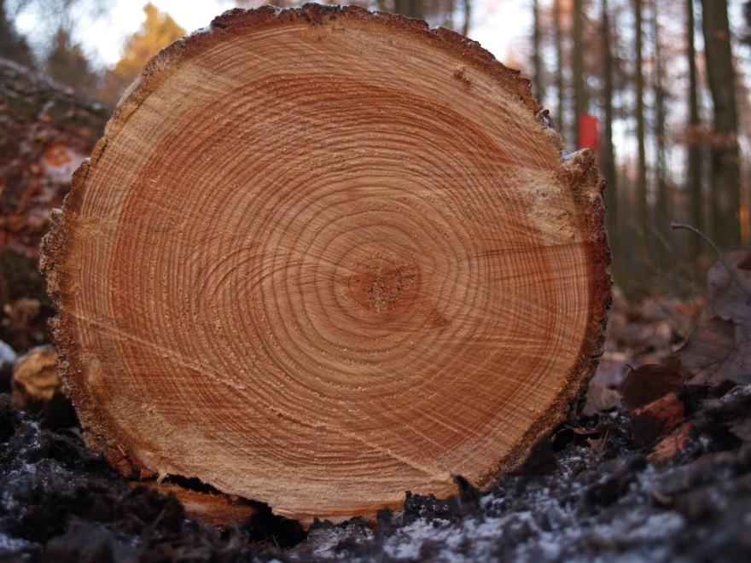
Tree Rings
Each ring around a tree = one yeargrowth
Tells us about the climate of an area
Distance between rings show precipitation levels
Thick = wet year
Thin = dry year
Compare years of different places

Slide 99
Ice Cores
Similar to tree rings but for colder/polar climates
Records years precipitation records and how it froze or thawed over a year
Each layer represents 1 year
Thick = lots of precipitation and thin = little precipitation
Records past climate situations in geologic history

Slide 100
Varves
Alternating light and dark colored sediments deposited from glaciers in lakes
Carried by melt-water from glaciers
Dark bands = winters
Light bands = summers
Summers are usually thick but winter band thickness depends on climate of the area

Slide 101
Daily Routine
Sit in your appropriate seat quietly
Make sure you are wearing your ID’s
Have all necessary materials out
All back packs on the floor
All cell phones on silent and away in backpacks
All IPods off and headphones out of your ears
Hats off
No food or drink except for water

Slide 102
Bell work
Discuss the link between uniformitarianism and absolute dating.

Slide 103
Earth Science Announcements

Slide 104
Fossils

Slide 105
Today we will
Identify the different types of fossils that exist and how fossil remain are preserved through different processes.
Relative and absolute date imaginary rock layers using different index fossils

Slide 106
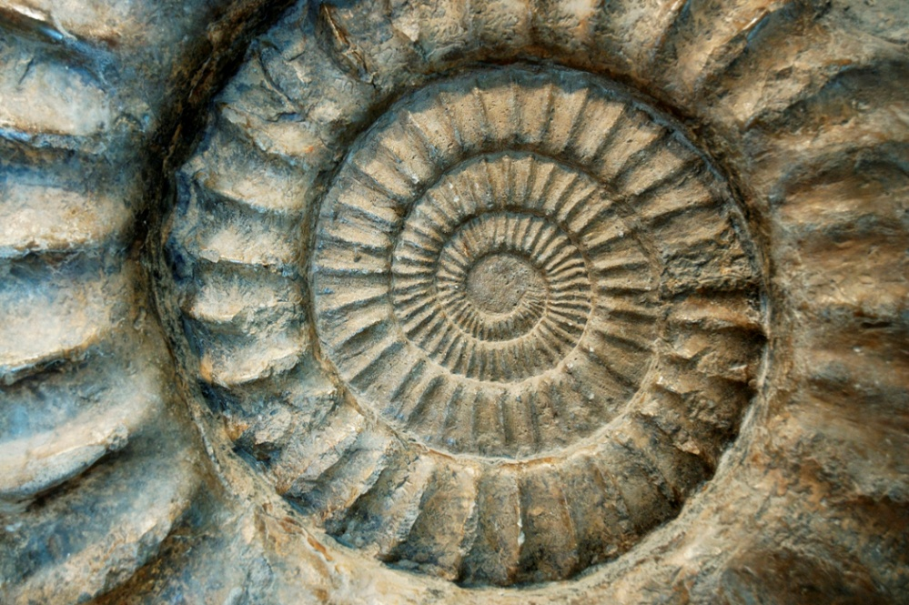
What is a fossil?
The remains or impression of a prehistoric organism preserved in petrified form or as a mold or cast in rock

Slide 107
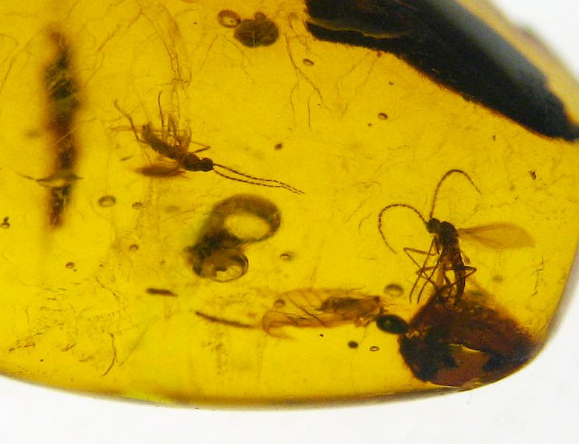
Original Preservation

Slide 108
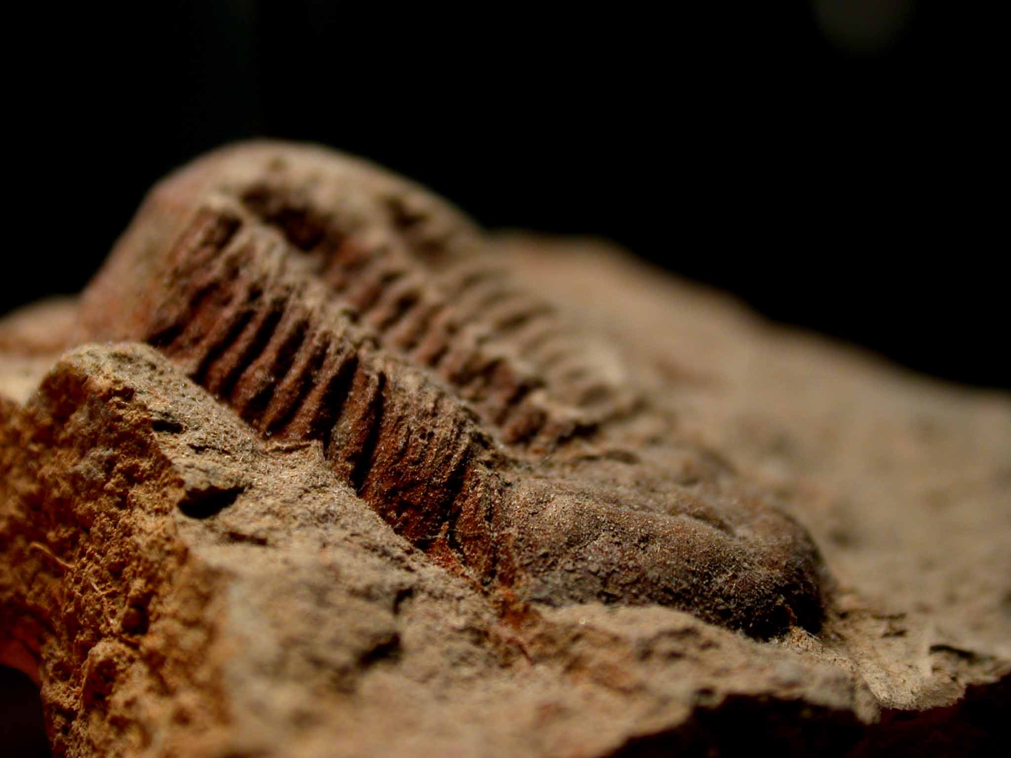
Mineral Replacement

Slide 109
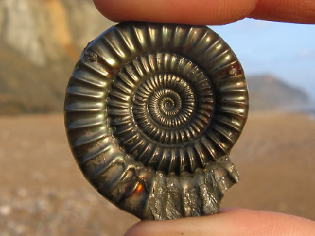
Recrystallization

Slide 110
Fossils Preservation
Original Preservation
Gets trapped in some substance that protects from environment
Examples: tar pits, ice, and amber (tree sap)
Mineral Replacement
Groundwater contact helps replace with new minerals
Often calcite replaces original organic material
Recrystallization
Heat and pressure changes organisms properties to form mineral remains
Petrified wood: organic material gets replaces with hard minerals, but shape and look remain the same

Slide 111
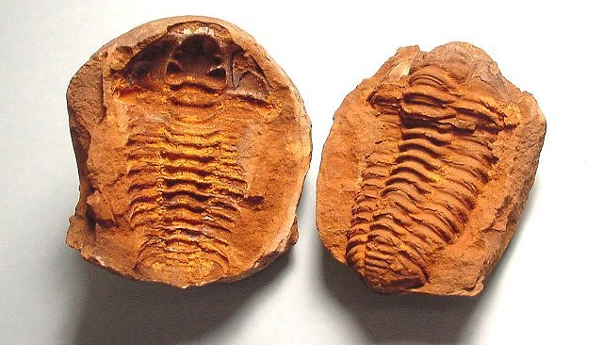
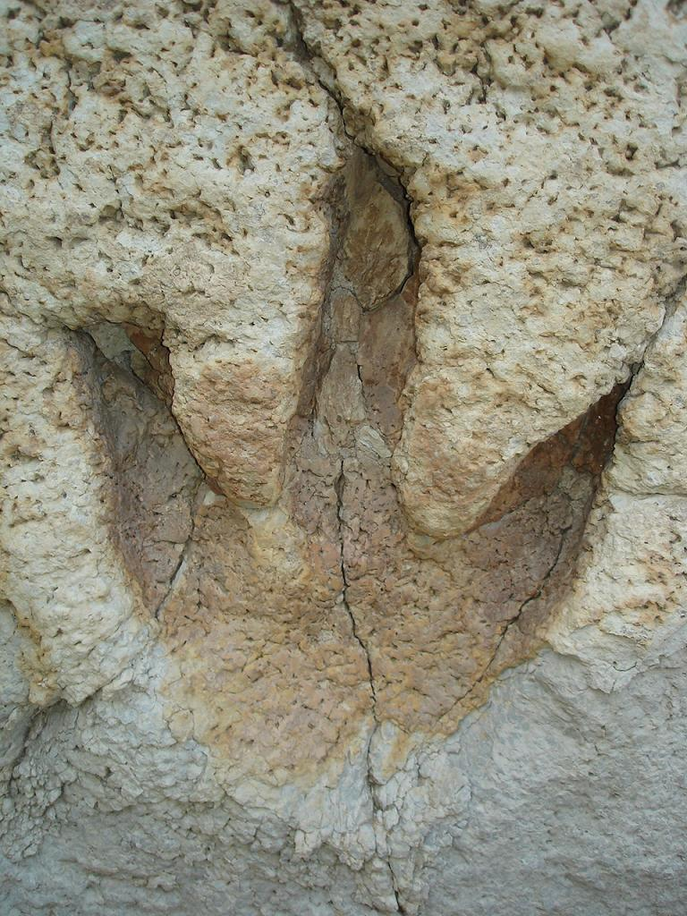
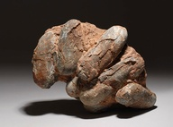
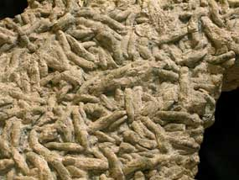
Types of Fossils
Cast and Mold
Molds form when sediments cover hard parts and weathering and erosion remove original hard body
Casts form when molds are filled in to form a 3D fossil
Trace Fossils
Impressions left behind by organisms
Footprints, poop, burrows

Slide 112
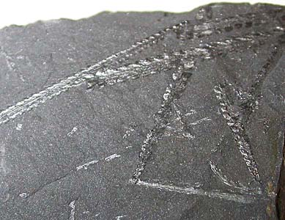
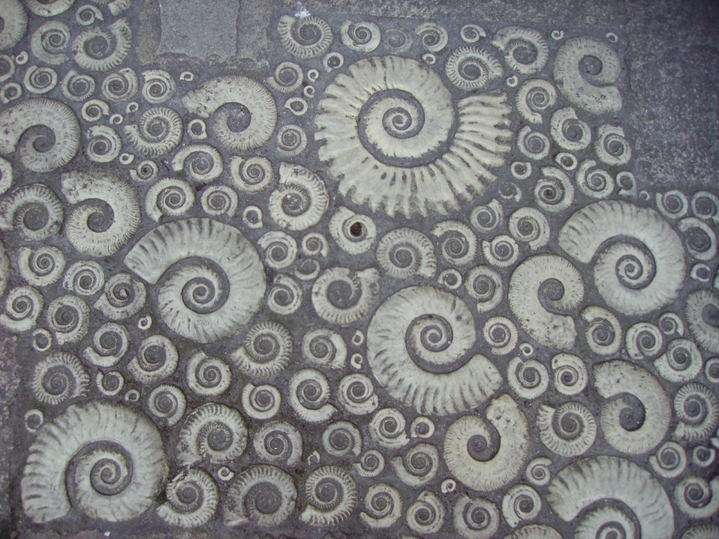
What are index fossils?
Fossils that are used to date rocks
Can be microscopic or large
Criteria for being a good index fossil
1. Evolved and adapted quickly
2. Lived in a specific short period of time
3. Lived in a large geographic area
4. Lived in water

Slide 113
Index Fossils

