Slide 1
Daily Routine
Sit in your appropriate seat quietly
Make sure you are wearing your ID’s
Have all necessary materials out
All back packs on the floor
All cell phones on silent and away in backpacks
All IPods off and headphones out of your ears
Hats off
No food or drink except for water

Slide 2
Biology Announcements
No Homework

Slide 3
Mendelian Genetics

Slide 4
I will be able to…
Describe the patterns of inheritance that Mendel’s data revealed
Summarize Mendel’s law of segragtion

Slide 5
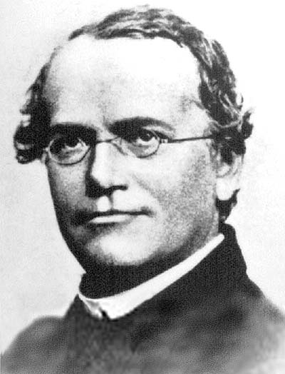
Who is Gregor Mendel?

Slide 6
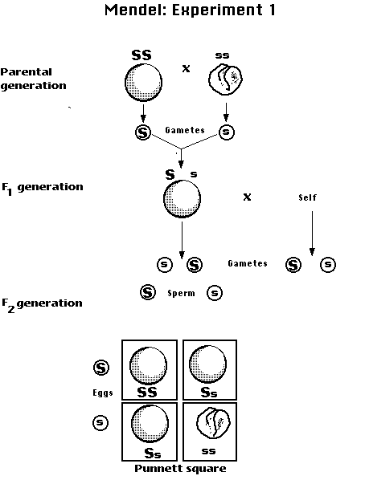
History to Mendel’s Experiments
Traits are distinguishing characteristics that are inherited, such as eye color
Genetics is the study of biological inheritance patterns and variation in organisms

Slide 7
History to Mendel’s Experiments
Principles of genetics were developed in the mid 19th century by Gregor Mendel an Austrian Monk
Experimented with pea plants, by crossing various strains and observing the characteristics of their offspring

Slide 8
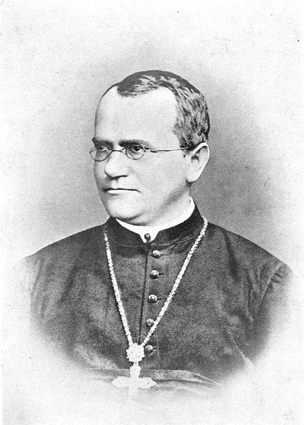
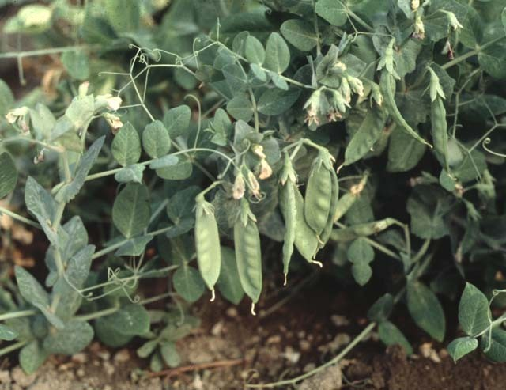
History to Mendel’s Experiments
Mendel spent his spare time breeding pea plants.
Three Key Choices of Breeding
Control over breeding
Use of purebred plants
Observation of either or traits that appeared in two forms
Repeated experiment and noticed patterns to the inheritance of traits, from one set of pea plants to the next.

Slide 9
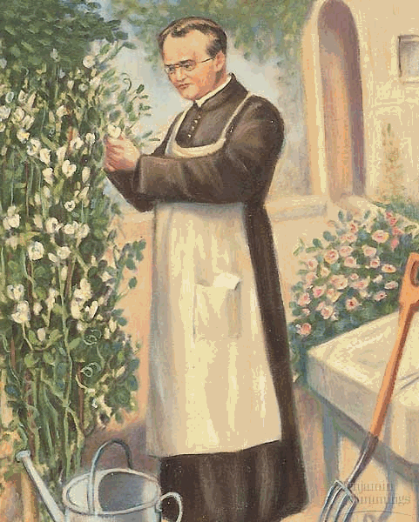
History to Mendel’s Experiment
Mendel crossed or mated purebred pea plants with purple flowers with purebred white flowers
Studied Pea Plant Characteristics
Pea shape (round vs. wrinkled)
Pea Color (yellow vs. green)
Flower Color (purple vs. white)
Pod Shape (smooth vs. constricted)
Pod Color (Green vs. yellow)
Flower Position
Plant height (tall vs. short)

Slide 10
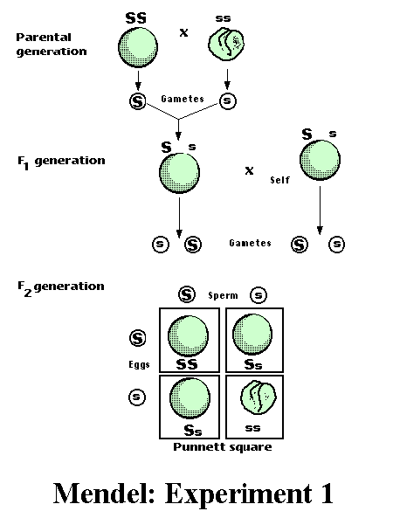
History of Mendel’s Experiment
P – parental generation: Forced pollenation with purebreds of different characteristics
F1 – First generation: self pollenated (all one characteristic)
F2 – Second generation
Results: Plants showed a 3:1 ration for studied traits

Slide 11
History of Mendel’s Experiment
Conclusion: Traits are inherited as discrete units (genes)
Law of Segregation
Organisms inherit two copies of each gene from parents
Organisms donate only one copy of gene
Two copies of each gene segregate or separate during meiosis (gamete formation)

Slide 12
Class Work
Using your textbook, define the following terms.
Starts on page 180
Gene
Allele
Homozygous
Heterozygous
Genome
Genotype
Phenotype
Dominate
Recessive

