Slide 1
Daily Routine
Sit in your appropriate seat quietly
All back packs on the floor
All cell phones away
ID’s on or out on the desk
All IPods off and headphones out of your ears
Have all necessary materials out
Hats off
No food or drink except for water

Slide 2
Announcements
Quiz on Friday about the material we cover this week
Bring in empty 2L bottles for extra credit by Friday

Slide 3
Can we predict the weather
Relative Humidity

Slide 4
Today we will
Demonstrate how to take relative humidity measurements using a handmade psychrometer
Calculate relative humidity and dew point
Describe what humidity is

Slide 5
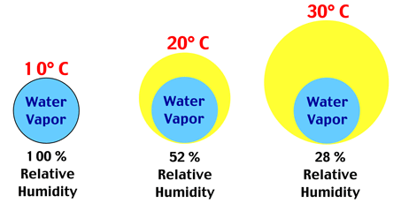
What is Humidity
The amount of water vapor in the atmosphere at any given location
Often given is percentages
Colder temperature can hold less water vapor
Warmer temperatures can hold more water vapor

Slide 6
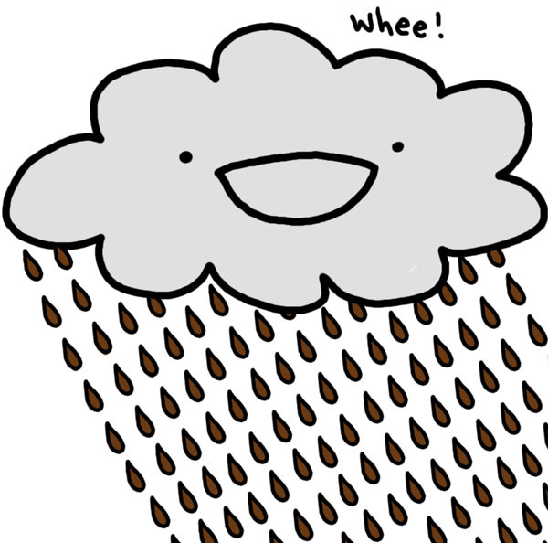
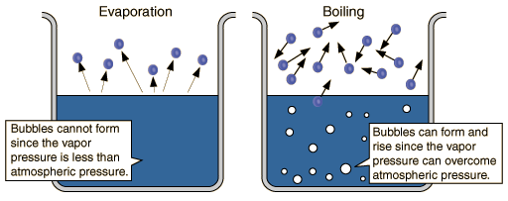
How does the atmosphere reach saturation of water vapor?
Water goes through different phase changes
Saturation = maximum capacity to hold moisture
Reached when evaporation > condensation
Volume of air and temperature have significant roles in atm. saturation levels

Slide 7
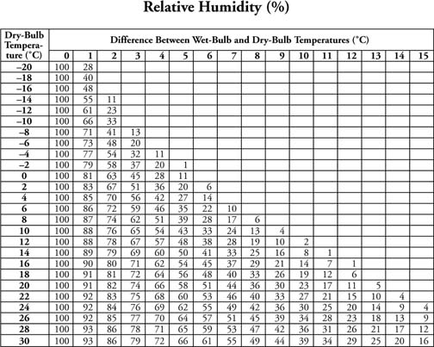
How does saturation affect relative humidity?
Relative humidity is the amount of water vapor in the air
Relative amount of water vapor needed for the volume of air to reach saturation

Slide 8
Describe what dew point is…
Amount of moisture content in the air
Measured by the temperature to which air is cooled at a constant pressure to reach saturation
If the dew point is close to the temperature outside = high relative humidity

Slide 9
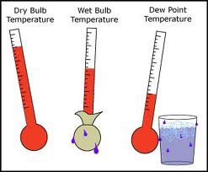
What device is used to measure relative humidity and dew point
Psychrometer!

