Slide 1
Daily Routine
Sit in your appropriate seat quietly
Have all necessary materials out
All back packs on the floor
All cell phones on silent and away in backpacks
All IPods off and headphones out of your ears
Hats off
No food or drink except for water

Slide 2
Bell Work
Compare and contrast rocks and minerals
Describe one other mineral property talked about on Friday

Slide 3
Earth Science Announcements
Mineral Quiz on Wednesday

Slide 4
Igneous Rocks
How are minerals affect by the different stages of the rock cycle?

Slide 5
I will be able to…
Describe how and where igneous rocks form
Explain how minerals form igneous rocks due to different cooling periods at different temperatures
Compare and contrast felsic, mafic, and intermediate groups of igneous rocks
Describe what igneous rock texture is

Slide 6
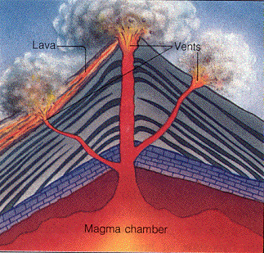
What are Igneous Rocks?
Igneous rocks form due to the solidification of magma or lava
Magma: is the molten or semi-molten form of rocks
High in Iron, Silicon, and Oxygen
Magma contains:
Minerals
Gases (CO₂ and Sulfur dioxide)
Water and Water vapor

Slide 7
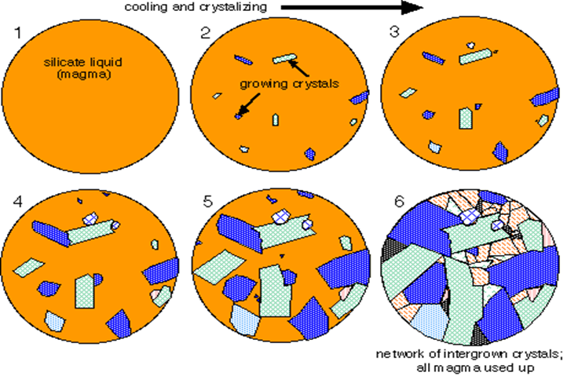
How do minerals condense to form rocks from magma?
Fractional crystallization: the removal and separation of a melt of different minerals at different temperatures and different periods of cooling based on chemical composition

Slide 8
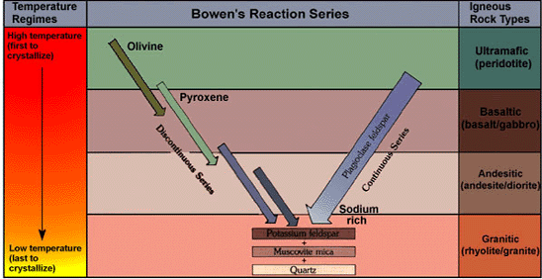
Bowen’s Reaction Series
Minerals first to form:
Form at high temperatures
Contains less silica (Si and O)
High in iron
Darker in color
Minerals last to form:
Form at lower temperatures
Contains lots of silica (Si and O)
Lighter in color

Slide 9
Felsic Vs. Mafic Igneous Rocks
Felsic | Intermediate | Mafic
Minerals have higher silica content Lighter in color usually need longer periods of time to cool Minerals often found in felsic rocks are quartz, micas, k-feldspar Examples: granite and rhyolite | Minerals have medium silica content Contain some minerals with higher iron content 50-50 mix in dark and light color Usually need longer periods of time to cool, but some minerals crystallize faster at hotter temperatures Common minerals: quartz, micas, k-feldspar, and amphibole Examples: diorite and andesite | Minerals have a lower content in silica Higher in iron (Fe) Cool quicker than the other minerals Often darker in color Common minerals: olivine plagioclase, amphibole, and pyroxene Examples: gabbro and basalt

Slide 10
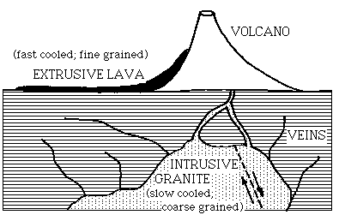
Where can Igneous Rock form?

Slide 11
Intrusive vs. Extrusive
Intrusive
Extrusive
Texture: Coarse (large visible crystals)
Conditions to form intrusive igneous rocks:
Deep below the surface
Cool magma temperatures (
Long and slowing during crystallization
Texture: Fine (microscopic crystals)
Conditions to form extrusive igneous rocks:
Forms on the surface
Hot lavas that cool rapidly
Short and rapid cooling which yields little crystal development

