Slide 1
Daily Routine
Sit in your appropriate seat quietly
Have all necessary materials out
All back packs on the floor
All cell phones on silent and away in backpacks
All IPods off and headphones out of your ears
No food or drink except for water

Slide 2
Bell Work
Compare and contrast the three types of volcanoes?
Are there any volcanoes on other planets or moons? Where?

Slide 3
Lava Properties

Slide 4
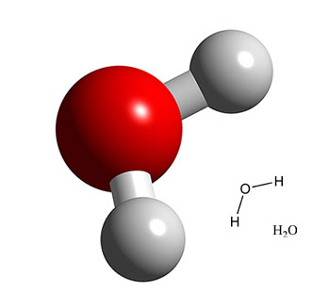
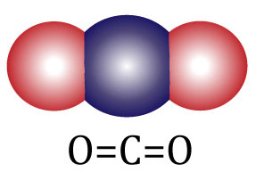
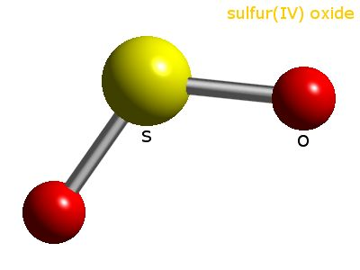
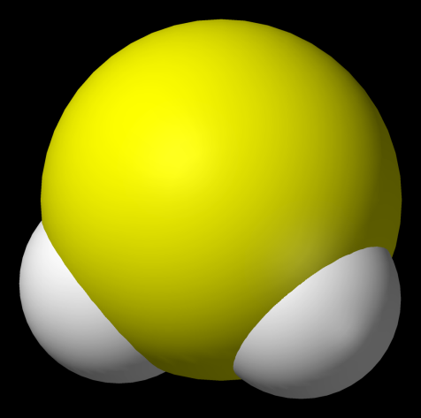
What gases are in lava
Four main gases in lava:
Water Vapor
Carbon Dioxide
Sulfur Dioxide
Hydrogen Sulfide

Slide 5
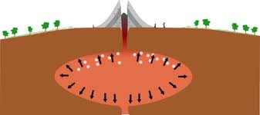
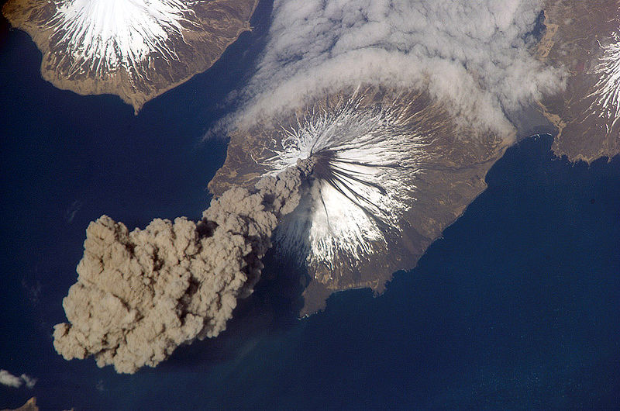
What is the Gas Relationships of Lava
Pressure increases due depths and confinement of space, which increase temperatures and explosive nature of eruption

Slide 6
What is viscosity?
The physical property that describes a materials resistance to flow

Slide 7
Viscosity is dependent on which chemicals?
Viscosity is dependent on many chemicals
The two main chemicals that affect viscosity…
Silica (Silicon and Oxygen)
Iron content

Slide 8
Lavas and Viscosity
Magma/lava that has a HIGH viscosity, moves SLOWLY and form EXPLOSIVE eruptions
BECAUSE THEY HAVE A HIGH SILICA CONTENT
SILICA IS STICKIER!
Magma/lava that has a LOW viscosity, moves QUICKLY and form QUIET eruptions
BECAUSE THEY HAVE A HIGH IRON CONTENT
IRON IS RUNNY!

Slide 9
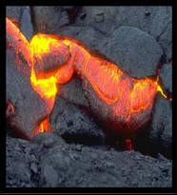
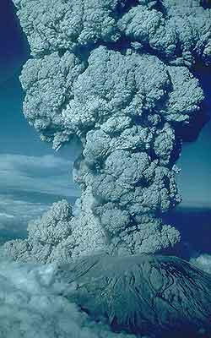
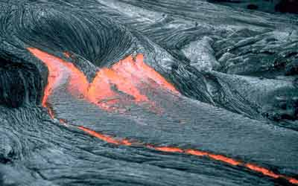
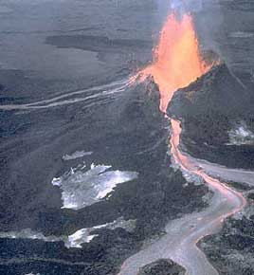
Magma Composition
Rhyolitic Magma = Explosive Eruptions
Rhyolitic Felsic magma
high in silica
has a high viscosity (thick)
traps gases
producing violent explosive eruptions
Basaltic Magma = Non-Explosive Eruptions

Slide 10
Magma Composition
Rhyolitic Magma = Explosive Eruptions
Basaltic Mafic (dark color)
magma is low in silica
low viscosity
releases gases producing quiet non-explosive eruptions
Basaltic Magma = Non-Explosive Eruptions

