Slide 1
Daily Routine
Sit in your appropriate seat quietly
Have all necessary materials out
All back packs on the floor
All cell phones on silent and away in backpacks
All IPods off and headphones out of your ears
Hats off
No food or drink except for water

Slide 2
Earth Science Announcements

Slide 3
Bell Work
Are rocks and minerals the same thing or two different things? Why or Why not?

Slide 4
Intro to Minerals and Mining
Should uranium ore mining be allowed in the area of the Grand Canyon National Park?

Slide 5
I will be able to…
Identify the five properties of all minerals
Compare and contrast the similarities and differences between minerals and rocks
Identify whether a sample is a rock, mineral or neither by using inferences
Evaluate and elaborate why some of our inferences were incorrect using described properties

Slide 6
Is it a rock, mineral, or neither?
There are several items around the classroom that are either a rock, mineral, or neither.
On the sheet, circle what your think the item is
Do not touch the materials unless instructed
Circulate around the classroom until you have all answered
After you are done, return to your seat

Slide 7
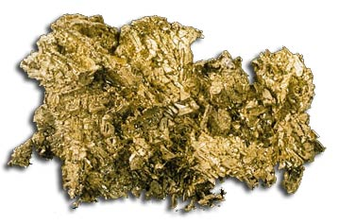
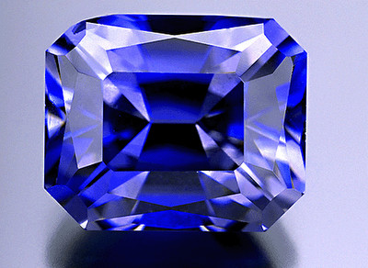
What constitutes as a mineral?
Naturally occurring = not man-made
Inorganic – not made from biotic matter
A solid object
Definite crystalline structure
Chemical make-up = made up of elements
Cali’s State Mineral:
Gold
Cali’s Gem: Benitoite

Slide 8
Going over: Is it a rock, mineral, or neither?

Slide 9
Are rocks and minerals the same thing?
Similarities
Differences
Naturally occurring
Solid objects
Definite chemical composition
Minerals are pure
Rocks are made of more than mineral
Rocks can be made of organic materials

Slide 10
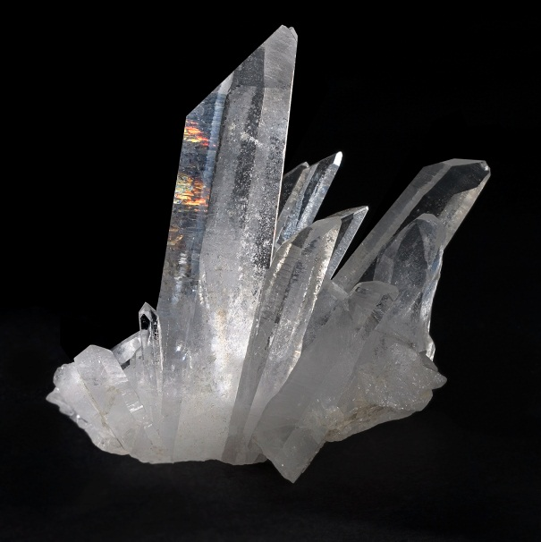
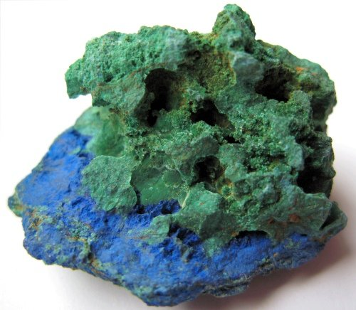
Chemical Composition
Minerals make up Earth’s Crust
Minerals are grouped by similarities in chemical make up
Silicon and Oxygen make up most of the crust
Silicates are the biggest group of minerals
Carbonates are the second biggest groups

Slide 11
Color
The type of light reflected off the mineral that you see
Caused by the trace elements that make up the mineral
Color is not the most useful mineral property

Slide 12
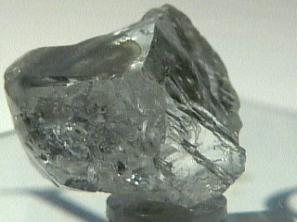
Color Paradox: Remember this?
Quartz
Diamond

Slide 13
Color
The type of light reflected off the mineral that you see
Caused by the trace elements that make up the mineral
Color is not the most useful mineral property
Many minerals have many different colors or share the same color with others

Slide 14
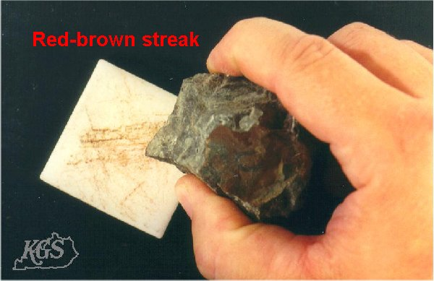
Luster and Streak
Luster: the way a mineral reflects light
Two main types:
Metallic = looks like a metal
Non-metallic = everything else
Streak: the color powdered scratch mark left on the surface

Slide 15
Daily Routine
Sit in your appropriate seat quietly
Have all necessary materials out
All back packs on the floor
All cell phones on silent and away in backpacks
All IPods off and headphones out of your ears
Hats off
No food or drink except for water

Slide 16
Earth Science Announcements

Slide 17
Bellwork
On the Mineral Bell Work, make two columns (Minerals and Non-Minerals). Which of the following items is a mineral? Which of the following items is not a mineral?
Salt Diamond Ice Steel
Coal Sugar Gold Silver
Cement Wood Copper Oxygen
Sulfur Glass Plastic Quartz

Slide 18
Bell Work
A mineral:
Forms in Nature
Is a solid
Has a definite chemical make up
Has a crystal structure
Cannot be made from organic material

Slide 19
Bell Work
A mineral:
Forms in Nature
Is a solid
Has a definite chemical make up
Has a crystal structure
Cannot be made from organic material
Salt Cement
Diamond Wood
Ice Copper
Steel Oxygen
Coal Sulfur
Sugar Glass
Gold Plastic
Silver Quartz

Slide 20
Bell Work
A mineral:
Forms in Nature
Is a solid
Has a definite chemical make up
Has a crystal structure
Cannot be made from organic material
Salt Cement
Diamond Wood
Ice Copper
Steel Oxygen
Coal Sulfur
Sugar Glass
Gold Plastic
Silver Quartz

Slide 21
Intro to Minerals and Mining
Should uranium ore mining be allowed in the area of the Grand Canyon National Park?

Slide 22
I will be able to…
Describe the mineral properties or color, streak, luster and hardness
Perform tests on a mineral kits to identify these properties
Explain why color is not a useful property

Slide 23
Luster and Streak
Luster: the way a mineral reflects light
Two main types:
Metallic = looks like a metal
Non-metallic = everything else
Streak: the color powdered scratch mark left on the surface

Slide 24
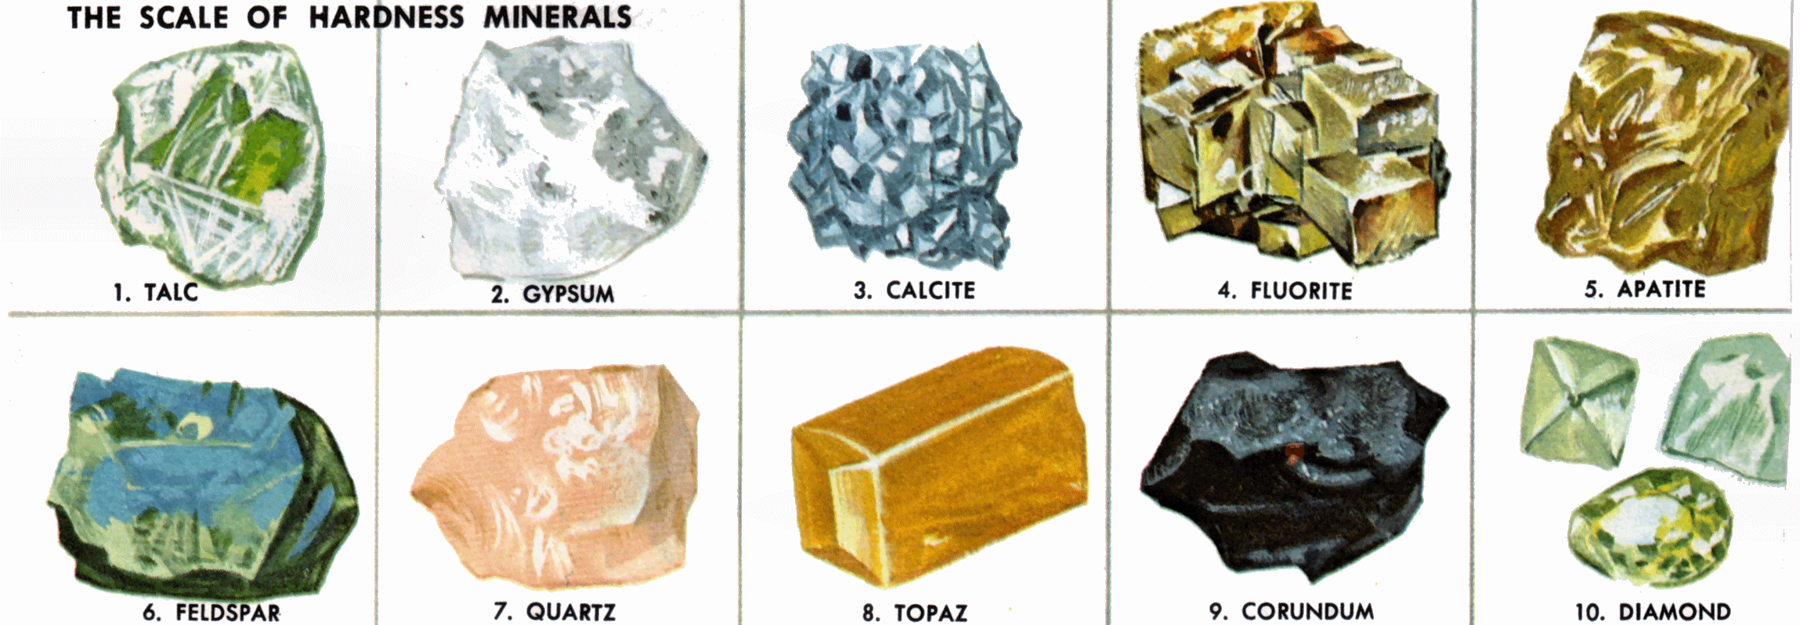
Mineral Hardness
Scaled created by Friedrich Mohs
The strength of the bonds in the crystal structure
Resistance to scratching or breaking
Tested using ordinary items

Slide 25
Mohs Hardness Scale
Mineral Specimen | Mineral Hardness
Diamond | 10
Corundum | 9
Topaz | 8
Quartz | 7
Feldspar (Orthoclase or Plagioclase) | 6
Apatite | 5
Fluorite | 4
Calcite | 3
Gypsum | 2
Talc | 1
Hardest Mineral
Softest Mineral

Slide 26
Mohs Hardness Scale
Mineral Specimen | Mineral Hardness
Diamond | 10
Corundum | 9
Topaz | 8
Quartz | 7
Feldspar (Orthoclase or Plagioclase) | 6 (glass 5.5)
Apatite | 5
Fluorite | 4 (penny 3.5)
Calcite | 3 (finger nail 2.5)
Gypsum | 2
Talc | 1
Hardest Mineral
Softest Mineral

Slide 27
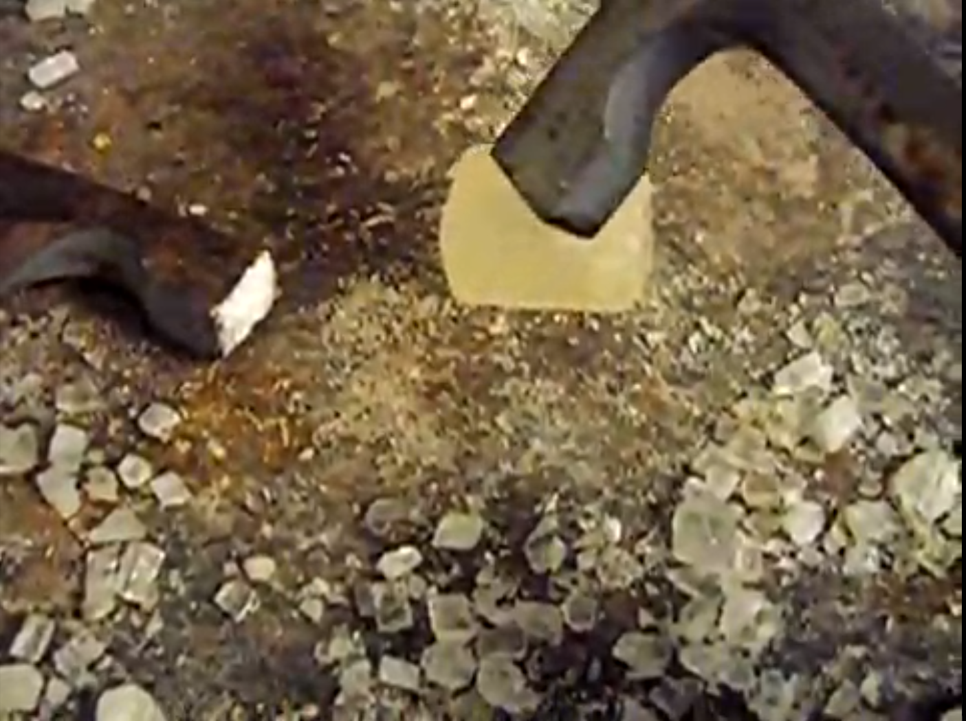
What will happen when the Calcite is smashed with the hammer?

Slide 28
http://www.youtube.com/watch?v=bYiT2qgD8zQ

Slide 29
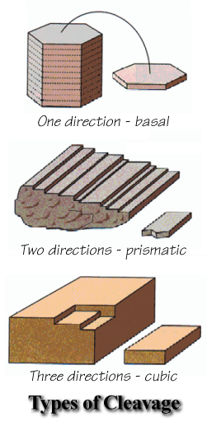
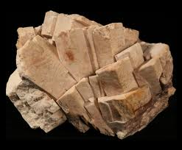
Mineral Properties - Cleavage
Is the way a mineral breaks on straight lines on parallel planes
Planes from chemical make-up
Break along weak bonds
Has different shapes
Flat/Basal
Rhombic
Cubic

Slide 30
Cleavage Planes

Slide 31
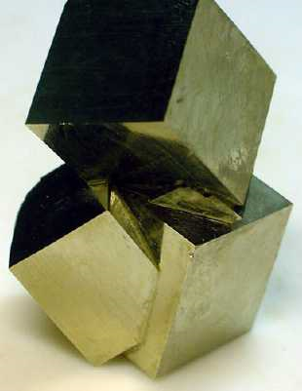
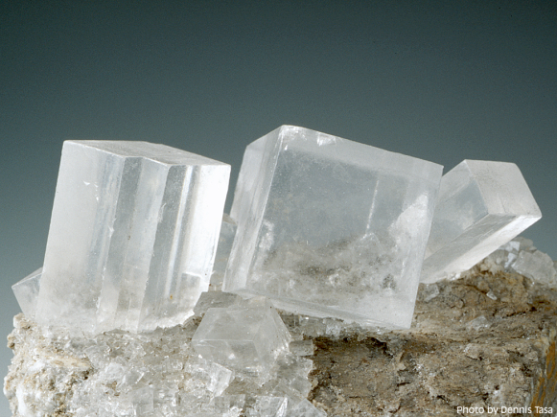
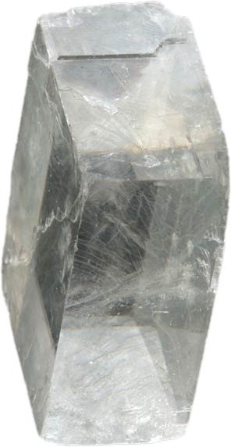
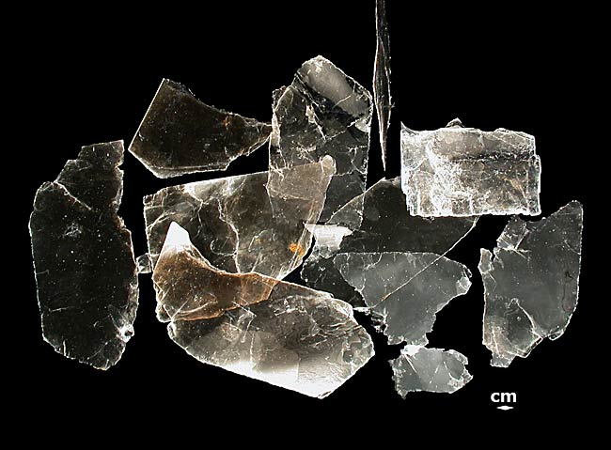
Common Minerals that Display Cleavage
Calcite
Micas (Muscovite and Biotite)
Halite (Salt)
Pyrite
Galena
Feldspars
Amphibole
Fluorite

Slide 32
Mineral Property – Fracture
Break into irregular pieces
Break into curved, splintered, and jagged pieces
Strong Bonds are equal in crystal structure
Quartz is a mineral the fractures in a curved pattern.

Slide 33
When am I ever going to need to know about mineral hardness?

Slide 34
Directions
You will work in groups of three and some groups of four
Each mineral is numbered
We are working with the first 20 specimen in each kit
If a mineral is missing, write missing in kit for that number
Identify the different properties of the minerals. We are focusing on color, luster and streak
For luster, you may abbreviate
i.e. M = Metallic and NM = Non-Metallic

Slide 35
Mineral Hardness Ranges
<2 (fingernail scratches)
2-3 (Scratches fingernail but not penny)
3-5 (Scratches penny but not glass)
>5 (Scratches glass)

Slide 36
Safety Reminder!
Be careful when handling the minerals
Be careful when handling the streak plate
If the plate breaks, do not touch! Tell the teacher
Contribute to the group or there will be an alternative assignment given

Slide 37
Questions?

Slide 38
Directions
You will work in groups of three and some groups of four
Each mineral is numbered
We are working with the first 20 specimen in each kit
If a mineral is missing, write missing in kit for that number
Identify the different properties of the minerals. We are focusing on color, luster and streak
For luster, you may abbreviate
i.e. M = Metallic and NM = Non-Metallic

Slide 39
Daily Routine
Sit in your appropriate seat quietly
Make sure you are wearing your ID’s
Have all necessary materials out
All back packs on the floor
All cell phones on silent and away in backpacks
All IPods off and headphones out of your ears
Hats off
No food or drink except for water

Slide 40
Bell Work
Why is using mineral color (the color you see when observing the mineral) not a useful property to use when trying to identify a mineral?
Compare and contrast cleavage and fracture.

Slide 41
Color Paradox: Remember this?
Quartz
Diamond

Slide 42
Earth Science Announcements
Other Mineral properties worksheet

Slide 43
Mineral Hardness Ranges
<2 (fingernail scratches)
2-3 (Scratches fingernail but not penny)
3-5 (Scratches penny but not glass)
>5 (Scratches glass)

Slide 44
Daily Routine
Sit in your appropriate seat quietly
Make sure you are wearing your ID’s
Have all necessary materials out
All back packs on the floor
All cell phones on silent and away in backpacks
All IPods off and headphones out of your ears
Hats off
No food or drink except for water

Slide 45
Bell Work
Describe how to use Mohs Hardness scale.
What are streak and luster?

Slide 46
Other Special Mineral Properties
Should uranium ore mining be allowed in the area of the Grand Canyon National Park?

Slide 47
I will be able to…
Explain how minerals display other different properties which makes them unique compared to other minerals

Slide 48
Magnetism
Due to chemical make up
Minerals contain Iron (Fe), Nickel (Ni), or Colbot (Co)
To test magnetism, use a magnet
Example: Magnetite

Slide 49
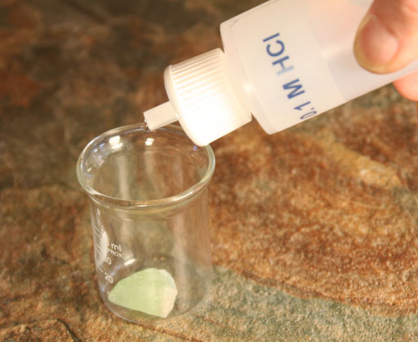
Reaction with Acids
Chemical reaction between a clean surface and another chemical such as an acid
Caused by chemical make up of mineral
Example: Calcite

Slide 50
Reaction with Acids Video
http://www.youtube.com/watch?v=cj5Wh_2v1xo

Slide 51
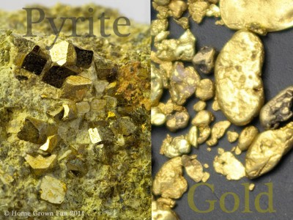
Density
Mass per a unit volume
Amount of stuff per a space occupied
Density=Mass/Volume
Example: Gold and Pyrite

Slide 52
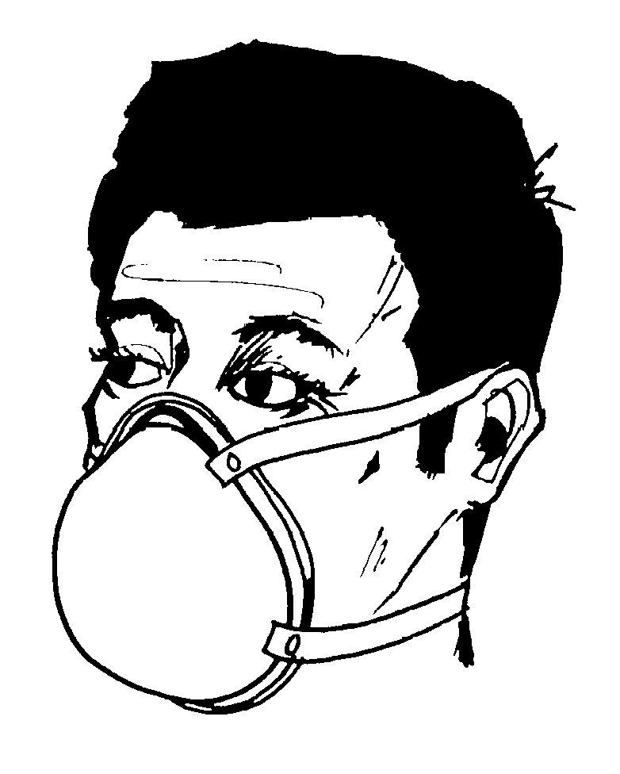
Odor
Refers to smell
Some minerals have a very distinctive smell
Example: Sulfur

Slide 53
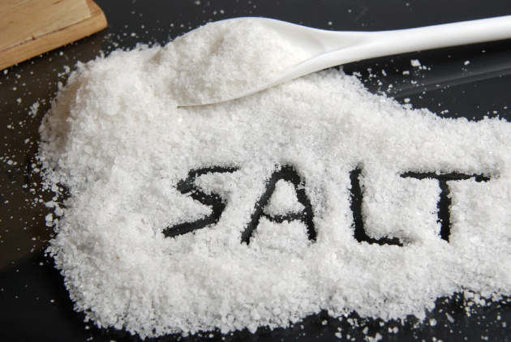
Taste
Some mineral have a specific taste
Some examples are salty, sweet, etc
Example: Halite

Slide 54
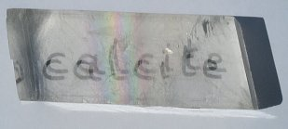
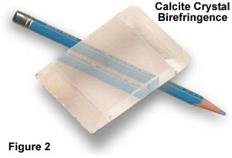
Double Refraction
How light refracts (bends) with in a crystal
Produces a double image
Seen in clear minerals
Example: Calcite

Slide 55
Fluorescence (Glow in the Dark)
Glows in dark light
Examples: Fluorite and Calcite

Slide 56
Radioactivity
Some elements decay or lose particle to change the properties
Use a Geiger counter to keep track of the decay

Slide 57
Today, we will test minerals in your mineral kits.

