Slide 1
Molecules in Motion
IAN page

Slide 2
Objective:
To be able to explain, on a molecular level, that heating and cooling affects molecular motion.

Slide 3
KEY CONCEPTS: we will come back to these after you do the activity.
Question to Investigate:
On BINDER page
Is the speed of water molecules different in hot and cold water?

Slide 4
Molecules in Motion
Read through the activity called “Molecules in Motion” through Procedure steps 1 and 2.
Should we use the same amount of hot and cold water in the experiment?
Should we use the same type of cup for the hot and cold water?
Should we use the same number of drops of food coloring in each cup?
Should we put the coloring in at the same time?
Do the activity. (15 minutes)

Slide 5
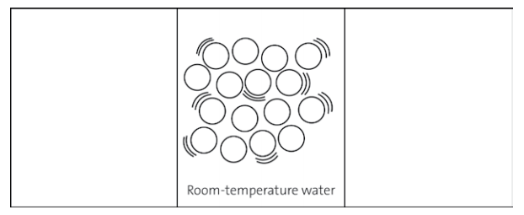
ANIMATION OF WATER MOLECULES BEING HEATED AND COOLED (IAN)
During the playing of the animation, begin your drawings in your interactive notebook.
Animation of Water Heating and Cooling

Slide 6
KEY CONCEPTS:
IAN PAGE
Heating a liquid increases the speed of the molecules.
An increase in the speed of the molecules competes with the attraction between molecules and causes molecules to move a little further apart.
Cooling a liquid decreases the speed of the molecules.
A decrease in the speed of the molecules allows attractions between molecules to bring them a little closer together.

