Slide 1
Daily Routine
Sit in your appropriate seat quietly
Make sure you are wearing your ID’s
Have all necessary materials out
All back packs on the floor
All cell phones on silent and away in backpacks
All IPods off and headphones out of your ears
Hats off
No food or drink except for water

Slide 2
Biology Announcements
Scientific Method Test – Friday
Lab Safety Posters – Sept. 6th
Sponge Capsule Lab Report – Due Sept. 4th

Slide 3
Bell Work
What is biology?

Slide 4
Qualitative vs. Quantitative Observations
Scientific Method

Slide 5
I will be able to…

Slide 9
Qualitative vs. Quantitative Observations
Qualitative Observations - describing the quality of a thing (e.g. round, blue, hot) without expressing numerical values
Quantitative - observations with numbers

Slide 10
Qualitative vs. Quantitative
Take out lab notebooks
On the first page, write Labs and Activities for the Title
Skip a couple of lines and write Qualitative vs. Quantitative Observations
Skip a couple of pages and write the title Qualitative vs. Quantitative Observations on the top of the page

Slide 11
Qualitative vs. Quantitative Observations
5. In your lab notebook, create a chart with 11 rows and 3 columns
6. In column 1, write object; in column 2 write qualitative, in column 3, write quantitative.
7. Choose 10 objects around the room, first take qualitative observation of the object (if it has words, you many not copy any of them!).
8. Afterwards, take quantitative data by taking measurement with a meter stick
9. When done, get back in your table group and try and have your partner guess what your items are by your observations

Slide 12
Daily Routine
Sit in your appropriate seat quietly
Make sure you are wearing your ID’s
Have all necessary materials out
All back packs on the floor
All cell phones on silent and away in backpacks
All IPods off and headphones out of your ears
Hats off
No food or drink except for water

Slide 13
Earth Science Announcements
Scientific Method Test – Friday
Earth Science Current Event – Due Tuesday Sept. 2nd
Gummy Bear Lab Report due Wednesday August 28th
Typed and Use the Guidelines Sheet to help you out
Size 12 font, single spaced, 1” margins, Times New Roman or Arial

Slide 14
Bell Work
What is Earth Science?

Slide 15
Introduction to Earth Science

Slide 16
I will be able to…
Describe what Earth Science is
Describe the different systems that operate on Earth

Slide 17
You will have 30 minutes to work on your lab safety posters

Slide 18
Safety Posters
Each person will create a poster that illustrates a different lab safety issue.
You should finish working on your posters during class.
No more than 12 words
Clearly shows the safety issue assigned
Easy to understand the issue
Looks good
School appropriate
Grabs your attention
Catchy slogan
Colorful design
Neatness

Slide 19
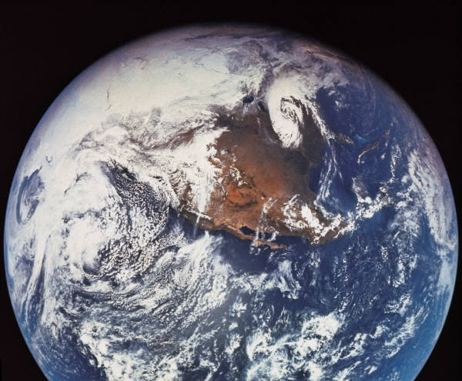
What is Earth Science?
Study of how Earth’s systems interact with one another
How systems impact our daily lives
Fields in Earth Science:
Astronomy
Environmental
Geology
Meteorology
Oceanography

Slide 20
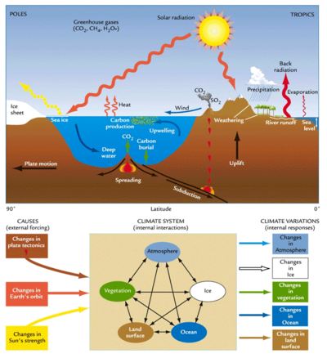
What is a System
How relationships within nature give rise to the collective behaviors
Lithosphere: rocks
Atmosphere: weather
Biosphere: living creatures
Hydrosphere: Water Cycle
Cryosphere: Ice

Slide 21
Earth Science Current Event Homework
The different areas of Earth Science affect our daily lives or others every day.
Find a current event of some type of Earth Science event that occurred during this week
Write a one page summary in typical English class format (12 font, 1” margin, double spaced, times new room font)
Good starting point…earthweek.com

