Slide 1
Daily Routine
Sit in your appropriate seat quietly
Have all necessary materials out
All back packs on the floor
All cell phones on silent and away in backpacks
All IPods off and headphones out of your ears
No food or drink except for water

Slide 2
Bellwork
How does earthquake depth show the relationship of subduction?
Describe subduction in your own words.

Slide 3
Plate Tectonics: Plate Boundaries

Slide 4
I will be able to…
Explain how the modern Theory of Plate Tectonics came about with Hess’ and Wegener’s lines of evidence
Elaborate about the similarities and differences of oceanic and continental crust
Describe the movement of each plate boundary
Diagram the three types of plate boundaries

Slide 5
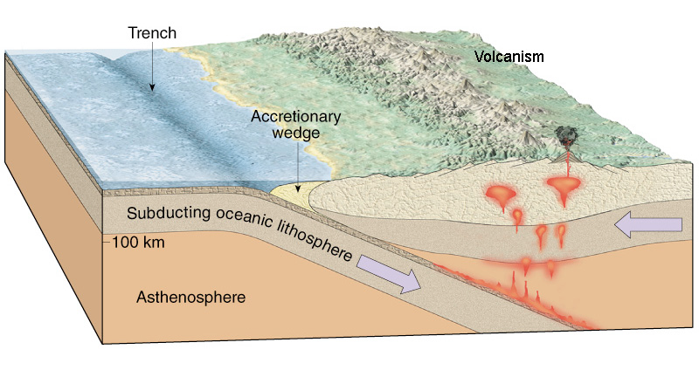
What is subduction?
Subduction is recycling of Earth’s crust
Known as slab pull
One tectonic plate slide under and down underneath another tectonic plate
Caused by density differences
Denser plate sinks or subducts under the less dense plate

Slide 6
Earth’s Crust
Oceanic
Continental
Makes up the land/continents on Earth
Composed of mostly Granites
Thick – 20-70 km thick
Density – 2.7 g/mL
Makes up the ocean floor
Composed of pillow basalts (rock type)
Thin – 5 km thick
Density – 3.0 g/mL

Slide 7
Important Layers for Plate Tectonics
Two sub-layers that drive plate tectonics:
Lithosphere
Asthenosphere
Lithosphere: Crust and rigid upper most part of the mantle = tectonic plate
Asthenosphere: plastic layer within the upper mantle that contains the mechanisms to cause plate movement

Slide 8
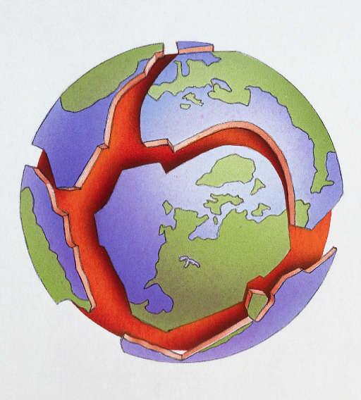
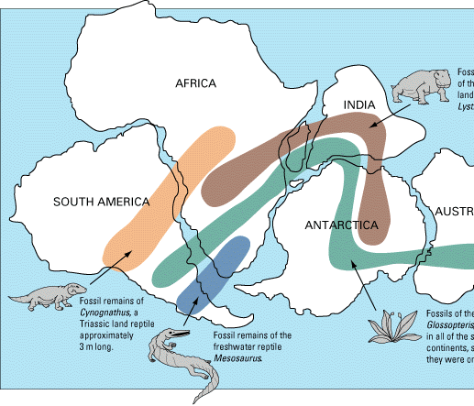
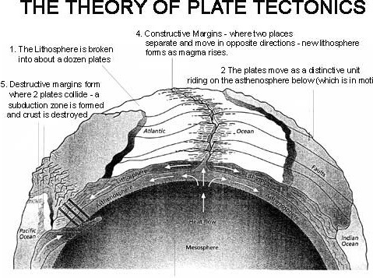
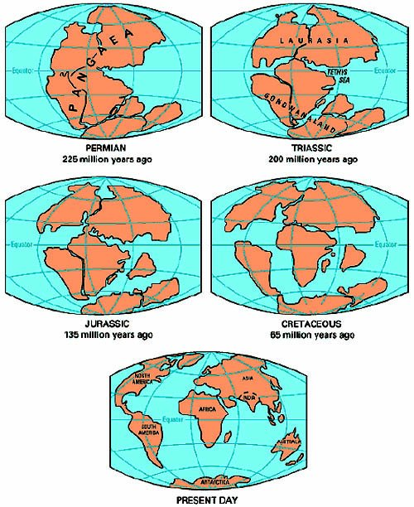
How did the Theory of Plate Tectonics come about?
Merger of all evidence:
Wegener’s continental drift hypothesis evidence
Hess’ sonar scans, core sample ages, paleomagentism to form sea floor spreading
Geographic evidence: mountain ranges, volcanoes, island arcs, trenches, MOR’s
Earthquake data

Slide 9
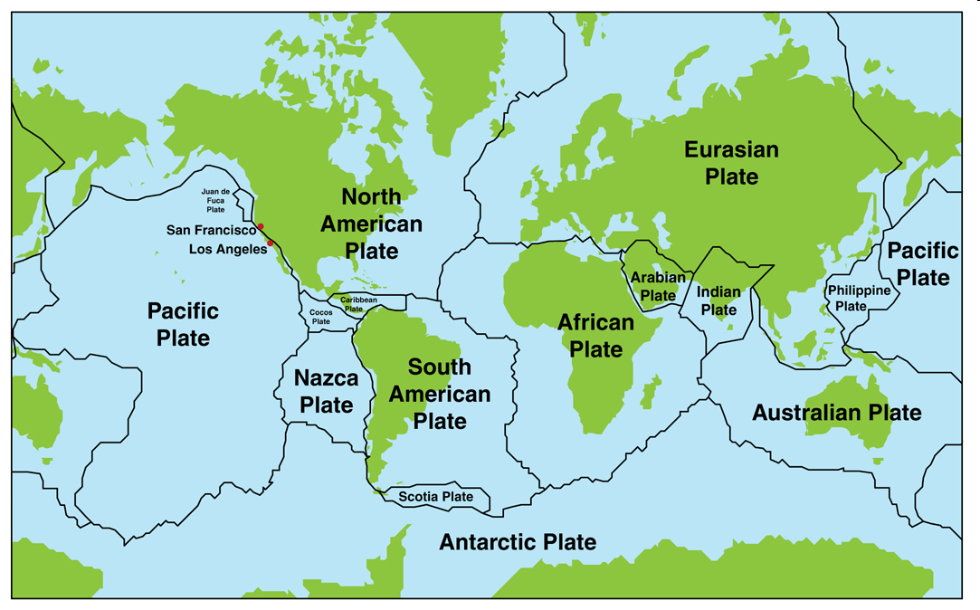
Scientists started plotting the location of earthquakes around the world
Next, Scientists began plotting the location of volcanoes around the world
As they did this, a pattern began to emerge that showed
cracks in the earth’s crust, revealing plate boundaries locations
Once again, a pattern emerged
= Earthquakes
= Volcanoes

Slide 10
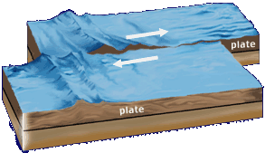
The 3 Plate Boundaries
Divergent-plates are pulled apart
Convergent-plates collide
Transform-plates slide past each other

Slide 11
Plate Boundary Types
On the worksheet perform the following tasks:
Diagram the types of plate boundaries
Describe the motion of the plate boundaries
Describe the types of crust involved with the plate boundaries
Identify what features (geographic) form due to the different plate boundaries
Identify at least two real-life examples of the plate boundaries

Slide 12
Convergent Boundary

Slide 13
Oceanic – Oceanic Subduction
Subduction of two oceanic plates
Denser older oceanic plate subducts under younger less dense
Lots of volcanism and earthquakes
Island Arc and deepest trenches are formed
Examples: Aleutian Islands and Japan

Slide 14
Continental – Continental Collision
When two continental plates/crust collide
Both plates have similar densities
Land buckles and pushes up
Push up motion of land = uplift
Lots of heat and pressure change the rocks
Forms mountain ranges and many Earthquakes
Example: Himalayas

