Slide 1
Daily Routine
Sit in your appropriate seat quietly
All back packs on the floor
All cell phones away
ID’s on or out on the desk
All IPods off and headphones out of your ears
Have all necessary materials out
Hats off
No food or drink except for water

Slide 2
Bell work
List the layers of the atmosphere in order and tell me one fact about each layer?
a
b
c
d
Earth

Slide 3
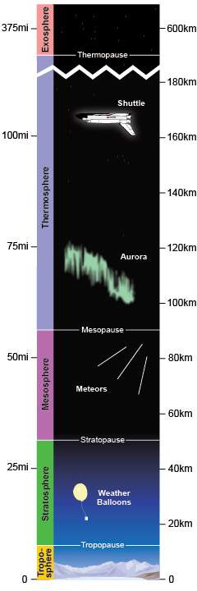
Layers of the atmosphere
Exosphere = lots of Helium and Hydrogen
Thermosphere = satellites orbit earth
Ionosphere = charge particles form Auroras and part of Thermosphere
Mesosphere = meteors burn up
Stratosphere = Ozone layer
Troposphere = where we live

Slide 4
Reminder
Quiz on Friday about the atmosphere
Last week to make up work
Example: Geologic Time Scale Quiz and Test and Geologic Time Online Interactive

Slide 5
Take out homework/class-work from Tuesday

Slide 6
Can We Predict the Weather?
Radiation, Conduction and Convection

Slide 7
Today we will
Identify the source of radiation that heats Earth’s atmosphere
Interpret how the process of conduction heats the Earth’s atmosphere
Demonstrate how convection currents form in the atmosphere
Diagram how radiation, conduction and convection operates in the atmosphere by completing the lesson activity

Slide 8
I need 3 volunteers to help with a demonstration…
The demonstration jobs are as follows:
Volunteer 1: Bag Holder – top of bag
Volunteer 2: Bag Holder – bottom of bag
Volunteer 3: Hair Dyer Runner – Hold the hair dryer 2 feet under the opening of the bag

Slide 9
What happened? Why did the bag rise and then fall?

Slide 10
Remember this from earlier this year…
http://www.youtube.com/watch?v=7xWWowXtuvA

Slide 11
So the demonstration represents convection current in the atmosphere, which works by:
Radiation - is the transfer of energy through space by electromagnetic waves
Conduction - is the transfer of heat between two parts of a stationary system, caused by a temperature difference between the parts.
Convection Currents -is the transfer of heat by the circulation or movement of the heated parts of a liquid or gas

Slide 12
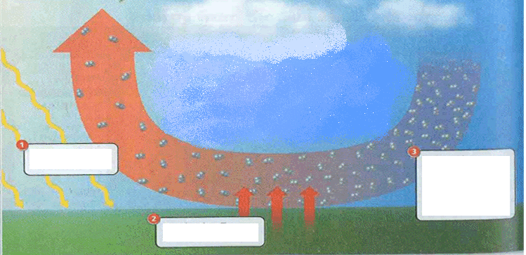
So here is a diagram of the heat transfer process in the atmosphere: Where do these three processes go on this model?

Slide 13
Atmospheric Heat Transfer Model
1. Radiation - The light and the electromagnetic energy from the Sun partially heat the atmosphere and mostly heat the Earth’s surface.

Slide 14
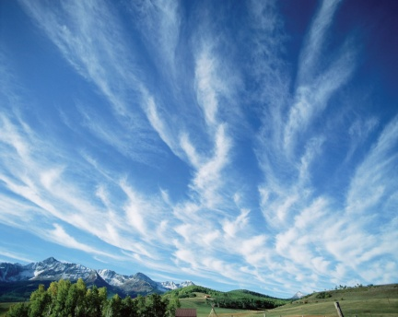
Where does our heat come from?
Sunlight!

Slide 15
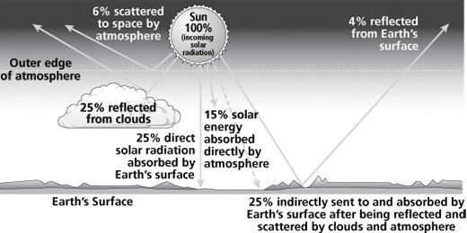
Sunlight Percentages….

Slide 16
Atmospheric Heat Transfer Model
2. Conduction - the heat energy is transferred from the warm surface to the cooler atmosphere.

Slide 17
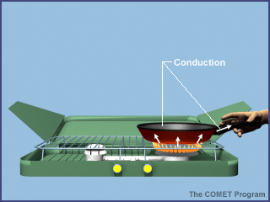
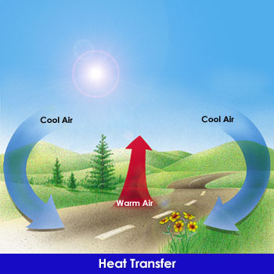
Where does Conduction Happen?
Conduction occurs here!
Why?
Absorbed sunlight on the surface releases heat energy which enters the atmosphere!

Slide 18
Atmospheric Heat Transfer Model
3. The heat transfer causes air molecules to rise. Once the air cools, air molecules grow closer and tend to subside.

Slide 19
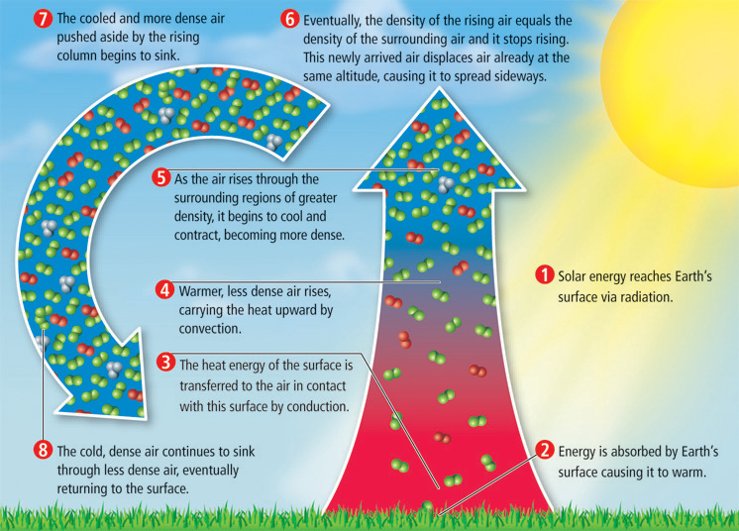
Convection in the Atmosphere

Slide 20
What we learned in today’s lesson
Identified the source of radiation that heats Earth’s atmosphere
Interpreted how the process of conduction heats the Earth’s atmosphere
Demonstrated how convection currents form in the atmosphere by completing the lab activity
Diagramed how radiation, conduction and convection operates in the atmosphere by completing the lesson activity

Slide 21
But wait!!!!!

Slide 22
Exit Slip
Diagram how heat transfer operates in the atmosphere. Identify where convection, conduction, and radiation occurs in your diagram and describe the process in your own words. Where else in nature or technology use currents and what is the heat source?

