Slide 1
Daily Routine
Sit in your appropriate seat quietly
All back packs on the floor
All cell phones away
All IPods off and headphones out of your ears
Have all necessary materials out
No food or drink except for water

Slide 2
Bell Work
What is a nebula?
Explain how the solar system formed.

Slide 3
Announcements
Solar System Test on Thursday

Slide 4
What is a planet?
The Solar System:
Is Pluto a planet or a dwarf planet?

Slide 5
Today we will
Graph relationships of different planet data
Analyze graphs about planetary data
Describe trends of graphs to determine locations of unknowns

Slide 6
Graphing our Solar System Planet Data
Name of Planet | Distance (AU) | Temperature (⁰C) | Orbital Period (Years) | Orbital Speed (km/sec)
Mercury | 0.4 | 167 | .2 | 48
Venus | 0.7 | 464 | .6 | 35
Earth | 1.0 | 15 | 1.0 | 30
Mars | 1.5 | -65 | 1.9 | 24
Jupiter | 5.2 | -110 | 12 | 13
Saturn | 9.5 | -140 | 30 | 10
Uranus | 19.2 | -195 | 165 | 7
Neptune | 30.7 | -200 | 248 | 6

Slide 7
Daily Routine
Sit in your appropriate seat quietly
Have all necessary materials out
All back packs on the floor
All cell phones away
All IPods off and headphones out of your ears
No food or drink except for water

Slide 8
Bell Work
Explain how planets are formed.

Slide 9
Announcements
Solar System Test on Friday 2/13

Slide 10
What is a planet?
The Solar System:
Is Pluto a planet or a dwarf planet?

Slide 11
Today we will
Categorize Solar System objects
Define the categories characteristics and observations
Discuss what defines a planet
Discuss whether Pluto is a planet

Slide 12
Categorizing Solar System Objects
Get into groups of 2 people
Categorize Solar System objects by prior knowledge, observations, and information on the cards
Define your category with criteria
Make sure that you write down the name of the category, the criteria for the objects in your category, and the objects in the category
Answer questions on the back side

Slide 13
What defines a planet?
Get into your groups at your lab stations.
Discuss in your groups for a couple of minutes about what a planet is
We will define what a planet as a class
Is Pluto a planet or something else? Why?

Slide 14
What is a planet? Reading
After reading answer the following questions:
What is the definition of a planet?
Why does or why doesn’t Pluto fulfill the definition of a planet?

Slide 15
Daily Routine
Sit in your appropriate seat quietly
Have all necessary materials out
All back packs on the floor
All cell phones away
All IPods off and headphones out of your ears
No food or drink except for water

Slide 16
Bell Work
What is a planet?
Why isn’t Pluto considered a planet?

Slide 17
Announcements
Solar System Test on Friday 2/13

Slide 18
What is a planet?
The Solar System:
Is Pluto a planet or a dwarf planet?

Slide 19
Today we will
Define the categories of Solar System objects based on characteristics and observations
Discuss what defines a planet
Discuss whether Pluto is a planet

Slide 20
Yesterday’s activity
How are creating categories of objects a useful way for organizing scientific information?
Is it acceptable that scientists use different personal categories or similar categories when performing observations or scientific studies?
In the case of new discoveries, do you think scientists should create a new category for an object, or revise and redefine current categories?

Slide 21
What are the different categories of Solar System Objects?
Planets
Dwarf Planets
Moons
Asteroids/Meteors/Meteorites
Comets
Stars – The Sun

Slide 22
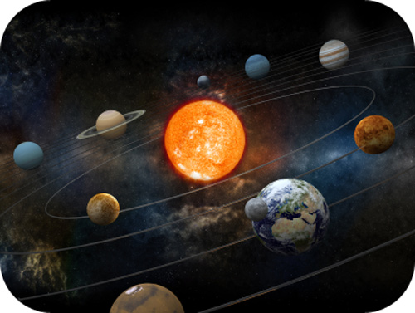
What are planets?
Orbit around a star like the Sun
Has enough mass to be nearly spherical in shape
Spherical shape created by equal distribution of gravity
Has cleared out the neighborhood around its orbit

Slide 23
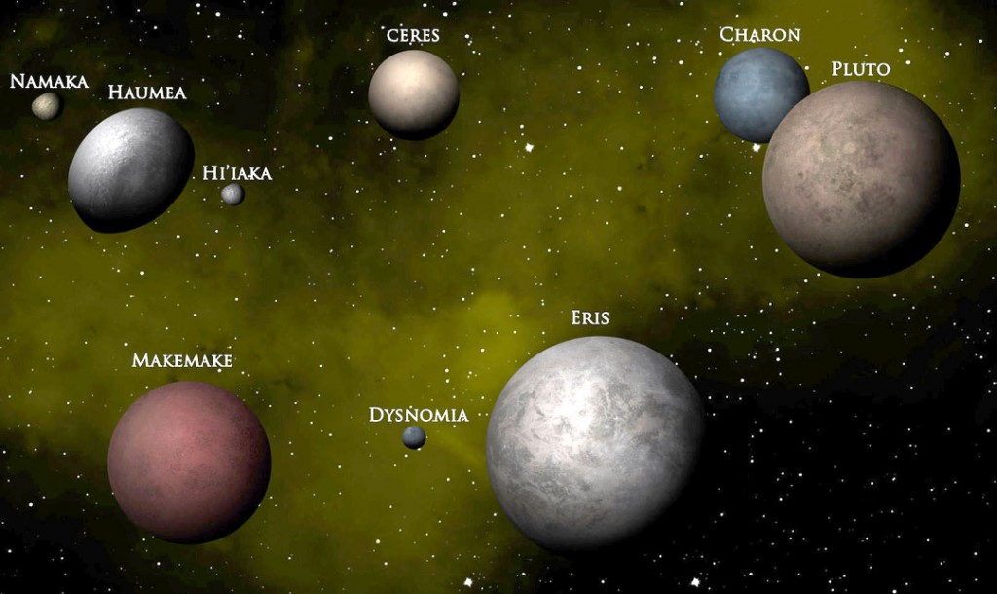
What is a dwarf planet
Orbits around a star like the Sun
Has enough mass to be nearly spherical
Has not cleared the neighborhood around its orbit
Shares orbital neighborhood with other objects like it

Slide 24
What are moons?
Known as satellites
Orbits another object that orbits the Sun
Orbits planets, dwarf planets, or asteroids

Slide 25
Moons of the Solar System

Slide 26
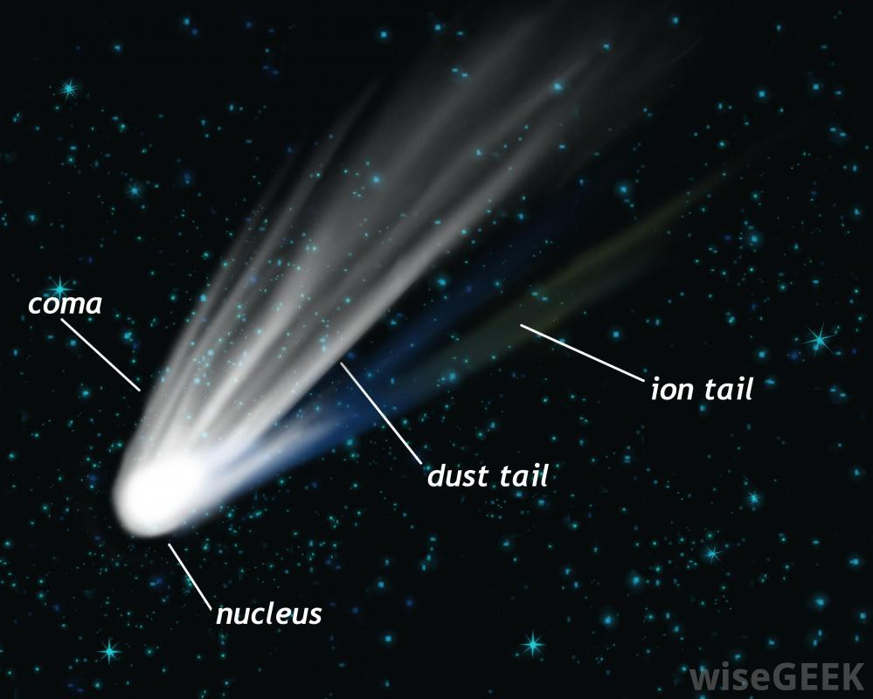
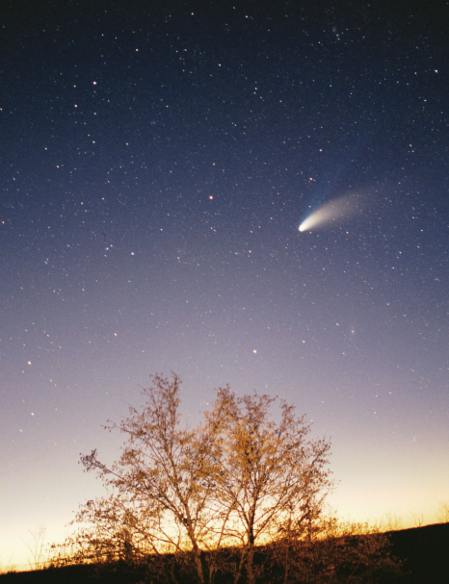
What are comets?
small body that orbits the Sun
Elliptical orbit
Orbit created by gravitational pull by planets and the Sun
Has a tail when gets closer to the Sun
Solar radiation causes tail to form
Made from rock, dust, and ice

Slide 27
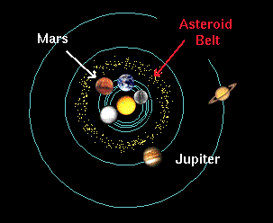
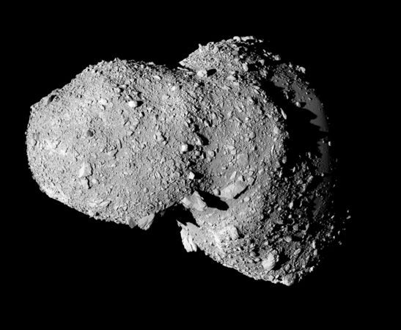
What are asteroids?
Small rocky or metal body that orbits the Sun
Can be part of the asteroid belt between Mars and Jupiter
When entering planet atmosphere, it becomes a meteor
When making an impact at the surface, it is known as a meteorite

Slide 28
Daily Routine
Sit in your appropriate seat quietly
Have all necessary materials out
All back packs on the floor
All cell phones away
All IPods off and headphones out of your ears
No food or drink except for water

Slide 29
Bell Work
What does it mean when a planet has “cleared its neighborhood around orbit”?
What are asteroids, meteors, and meteorites?

Slide 30
Announcements
Solar System Test on Friday 2/13

Slide 31
What is a planet?
The Solar System:
Is Pluto a planet or a dwarf planet?

Slide 32
Today we will
Define the categories of Solar System objects based on characteristics and observations
Discuss what defines a planet
Discuss whether Pluto is a planet

Slide 33
Solar System Planet Activity
Groups of four people
Need to take out a piece of paper…make sure to write your name, date, and period on the paper.
Make sure write the name of the planet of the station before answering the questions
Answer all questions in complete sentences
After 2-3 minutes I will ask you to switch stations to the next planet

Slide 34
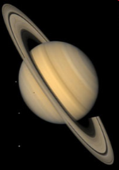
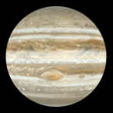
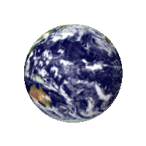
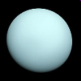
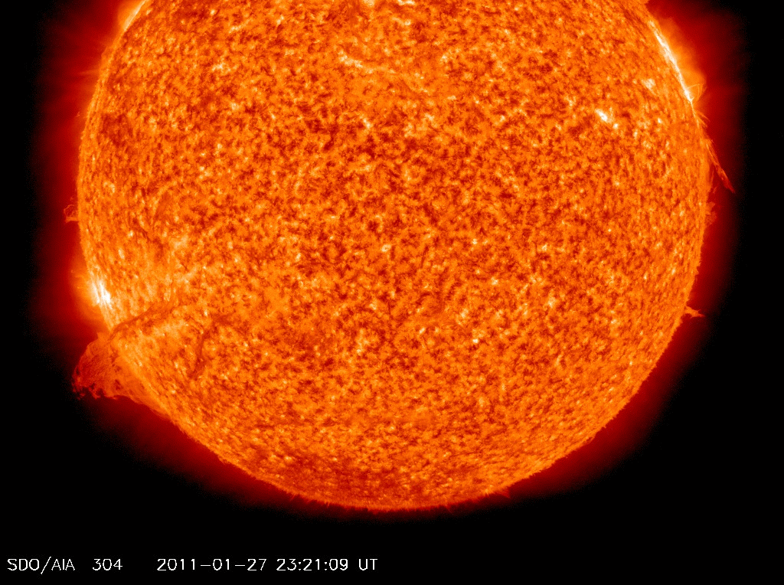
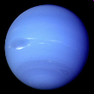
Motions of the Planets
Inner planets have high orbital velocities (go around the sun fast)
Outer planets have low orbital velocities (go around the sun slow)
Inner planets have
High Orbital Velocities
Outer Planets have
Low Orbital Velocities
11/15/99
Norm Herr (sample file)

Slide 35
Inner (Terrestrial) Planets vs. Outer (Gassy) Planets
The Inner (Terrestrial) planets are:
Mercury, Venus, Earth, and Mars
Smaller and Closest to the sun
Rocky, & therefore more dense
Orbit the sun faster
Made mostly of Iron and silica
The Outer (Gaseous Giants/Jovian) planets are:
Jupiter, Saturn, Uranus, and Neptune
larger & Farther from the sun
Made of gas, and therefore less dense
Orbit the sun slower
Made mostly of Hydrogen and Helium
11/15/99
Norm Herr (sample file)

Slide 36
Floating Debris Past Neptune…
Keiper Belt
Donut shaped cloud of material past Neptune
Contains short-period comets and dwarf planets
Icy material from early Solar System
Oort Cloud
Sphereical cloud of material surrounding the Solar System
Contains long-period comets
Icy material from early Solar System

