Slide 1
Daily Routine
Sit in your appropriate seat quietly
Make sure you are wearing your ID’s
Have all necessary materials out
All back packs on the floor
All cell phones on silent and away in backpacks
All IPods off and headphones out of your ears
Hats off
No food or drink except for water

Slide 2
Biology Announcements
Test on Wednesday September 25th
Tiny Particles (Atoms, Bond Types, Compounds)
Water Properties, Solutions, and pH Scale
Carbon macromolecules (carbs, proteins, lipids)

Slide 3
Chapter 2 Review
Chemistry in Biology
What are we made out of?

Slide 4
I will be able to…
Measure the pH of different household products
Explain the importance of carbs, proteins, lipids, and nucleic acids
Diagram and describe hydrogen bonds
Discuss the similarities and difference of polar and nonpolar covalent bonds
Explain the difference between a solute and solvent in solution
Explain the difference between acids and bases
Describe what an atom is
Diagram, label, and define the key parts of an atom
Describe the difference between an element and a compound
Create and describe ionic and covalent bonds

Slide 5
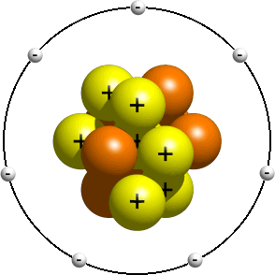
Diagram and label the parts of an atom.
Proton = positively charged particle in the nucleus of an atom
Neutron = neutrally (no) charged particle in the nucleus of an atom
Electron = negatively charged particle circling around the nucleus of an atom

Slide 6
How do ionic and covalent bonds form?
http://www.classzone.com/cz/books/bio_07/resources/htmls/animated_biology/unit1/bio_ch02_0059_ab_atombond.html

Slide 7
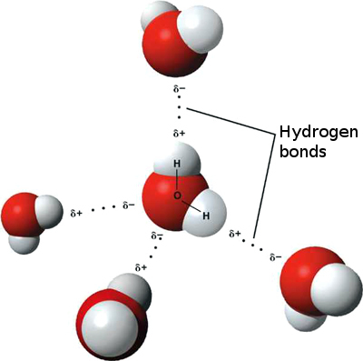
How do water molecules connect to one another
Think of water molecule like a magnet
The positive side has an attraction to the negative side of another molecule
Attraction between water molecule forms a linked chain
The attraction between the different slight atom charges forms a hydrogen bond

Slide 8
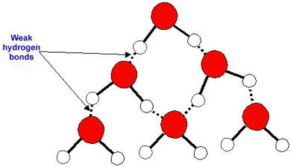
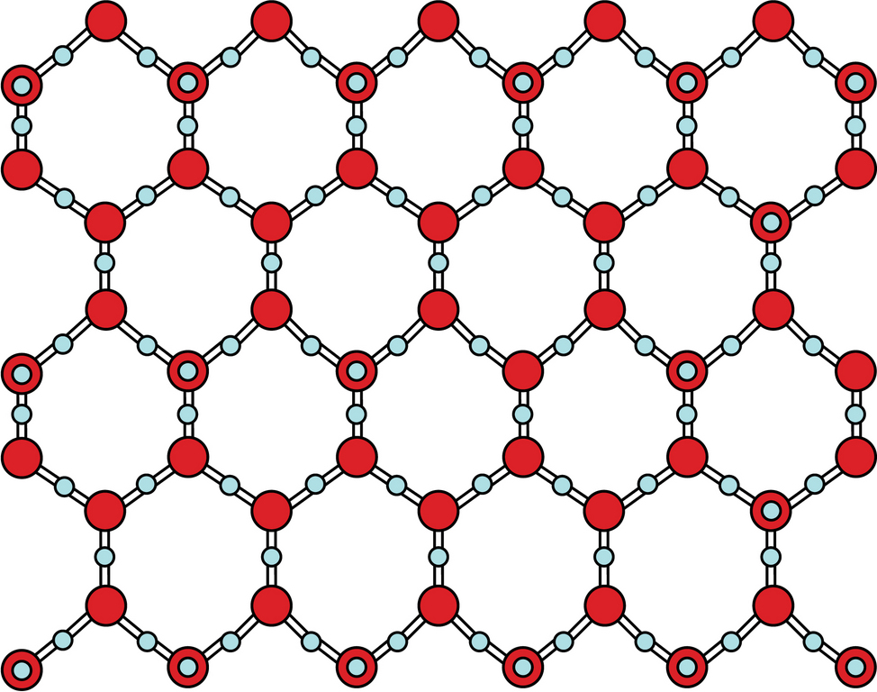
How do water molecules connect to one another
Slightly positive hydrogen is attracted to slightly negative oxygen

Slide 9
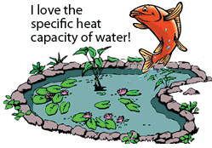
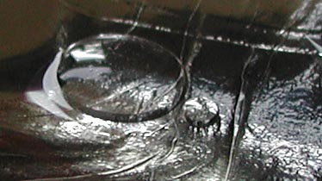
Special Properties of Water Due to Hydrogen Bonding
Specific Heat – ability to resist change in temperature
Cohesion – attraction between different water molecules: Convex shape
Examples – Dew in the morning
Beads of rain water on cars

Slide 10
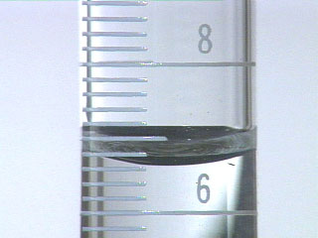
Special Properties of Water Due to Hydrogen Bonding
Specific Heat – ability to resist change in temperature
Cohesion – attraction between different water molecules
Adhesion – attraction between water molecules and another substance
: Concave shape
Example: meniscus in a graduated cylinder

Slide 11
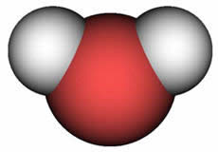
Penny Experiment Drawing
Cohesion: attraction between different water molecules
Adhesion: attraction between water molecules and another substance

Slide 12
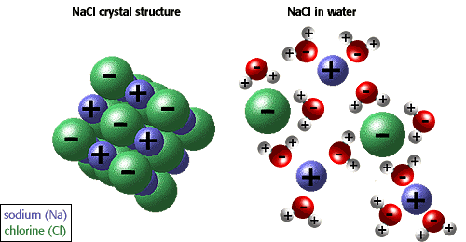
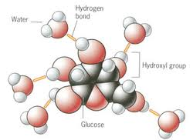
Why do things dissolve in water?
Water molecule is a polar molecule with weak charges
Ions break up and fill in the voids between hydrogen bonds
Other nonpolar molecules can take up the space between water molecules and held together by hydrogen bonds
This important in cells and blood so important ions and molecules can be transported

Slide 13
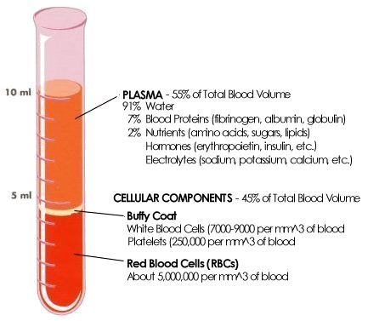
What does dissolve different materials make?
Solutions – a mixture of substances that is the same throughout
Has two parts:
Solvent is the substance that is present in greatest amount
Solute is the substance that dissolves in a solvent
Blood is a solution
Solvent: water
Solute: proteins, sugars, lipids

Slide 14
Solution Demonstration
Which item is the solvent?
Which item is the solute?

Slide 15
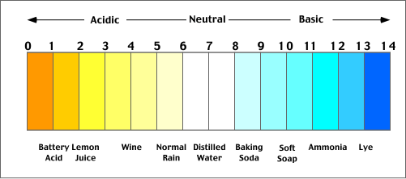
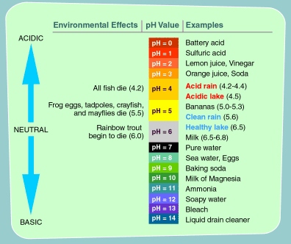
Why do some solutions burn and others don’t?
pH – the concentration of H⁺ ions in a solution
Acids – a solution that contains a high concentration of H⁺ ions
Bases – a solution low in concentration of H⁺ ions
Dependent on how items release or absorbs H⁺ ions in solution

Slide 16
Draw a pH scale in your notebooks

Slide 18
Macromolecule Demonstration
Monomer: A molecule that can attach to another molecule to form a complex chain molecule known as a macromolecule
Polymer: A complex chain of many monomers (sub-unit) that creates the macromolecule

Slide 19
Daily Routine
Sit in your appropriate seat quietly
Make sure you are wearing your ID’s
Have all necessary materials out
All back packs on the floor
All cell phones on silent and away in backpacks
All IPods off and headphones out of your ears
Hats off
No food or drink except for water

Slide 20
Biology Announcements
Test on Wednesday September 25th
Tiny Particles (Atoms, Bond Types, Compounds)
Water Properties, Solutions, and pH Scale
Carbon macromolecules (carbs, proteins, lipids)

Slide 21
Chapter 2 Review
Chemistry in Biology
What are we made out of?

Slide 22
I will be able to…
Measure the pH of different household products
Explain the importance of carbs, proteins, lipids, and nucleic acids
Diagram and describe hydrogen bonds
Discuss the similarities and difference of polar and nonpolar covalent bonds
Explain the difference between a solute and solvent in solution
Explain the difference between acids and bases
Describe what an atom is
Diagram, label, and define the key parts of an atom
Describe the difference between an element and a compound
Create and describe ionic and covalent bonds

Slide 23
The measurable factor in an experiment is known as the:
A. Control
B. Theory
C. Constant
D. Dependent Variable

Slide 24
The measurable factor in an experiment is known as the:
Control
Theory
Constant
Dependent Variable

Slide 25
A scientist makes several observations, develops a hypothesis, and performs a series of experiments to test her ideas. The results suggest that her hypothesis was incorrect. Which of the following statements must be true regarding this scenario?
A. The scientist has wasted her time on useless experiments
B. The scientist should hide the results of her experiment
C. The scientist has revealed flaws in several other theories
D. The scientist can use the data to make and test a new hypothesis.

Slide 26
A scientist makes several observations, develops a hypothesis, and performs a series of experiments to test her ideas. The results suggest that her hypothesis was incorrect. Which of the following statements must be true regarding this scenario?
The scientist has wasted her time on useless experiments
The scientist should hide the results of her experiment
The scientist has revealed flaws in several other theories
The scientist can use the data to make and test a new hypothesis.

Slide 27
What distinguishes one element from another?
A. The number of protons in the nuclei of the atoms
B. The number of atoms in a samples of each element
C. The number of electrons in the nuclei of their atoms
D. The number of nuclei in their atoms

Slide 28
What distinguishes one element from another?
The number of protons in the nuclei of the atoms
The number of atoms in a samples of each element
The number of electrons in the nuclei of their atoms
The number of nuclei in their atoms

Slide 29
What determines the properties of an element?
A. The element’s protons
B. The element’s electrons
C. The element’s neutrons
D. The element’s nucleus

Slide 30
What determines the properties of an element?
A. The element’s protons
B. The element’s electrons
C. The element’s neutrons
D. The element’s nucleus

Slide 31
How is an ionic bond formed between two atoms
A. A pair of electrons is shared between two atoms
B. The outer energy levels of the atoms are filled
C. An electrical force forms between pairs of electrons
D. An electrical force forms between oppositely charged ions

Slide 32
How is an ionic bond formed between two atoms
A. A pair of electrons is shared between two atoms
B. The outer energy levels of the atoms are filled
C. An electrical force forms between pairs of electrons
D. An electrical force forms between oppositely charged ions

Slide 33
What is formed when an atom gains or loses electrons?
A. An element
B. A compound
C. An ion
D. A molecule

Slide 34
What is formed when an atom gains or loses electrons?
A. An element
B. A compound
C. An ion
D. A molecule

Slide 35
Which of the following describes a hydrogen bond?
A. The bond between two hydrogen atoms within a molecule of water
B. The bond between hydrogen and oxygen within a water molecule
C. The bond between hydrogen in one water molecule and another hydrogen in a different water molecule
D. The bond between hydrogen in one water molecule and oxygen in a different water molecule

Slide 36
Which of the following describes a hydrogen bond?
A. The bond between two hydrogen atoms within a molecule of water
B. The bond between hydrogen and oxygen within a water molecule
C. The bond between hydrogen in one water molecule and another hydrogen in a different water molecule
D. The bond between hydrogen in one water molecule and oxygen in a different water molecule

Slide 37
What water property is demonstrated when water molecules are attracted to one another?
A. Adhesion
B. Cohesion
C. Inversion
D. Specific Heat

Slide 38
What water property is demonstrated when water molecules are attracted to one another?
A. Adhesion
B. Cohesion
C. Inversion
D. Specific Heat

Slide 39
When taking the volume of a liquid, like water, we measure the bottom of the meniscus in a graduated cylinder. Which water property enables the water to form a concave meniscus while touching another substance?
A. Specific Heat
B. Adhesion
C. Cohesion
D. Refraction

Slide 40
When taking the volume of a liquid, like water, we measure the bottom of the meniscus in a graduated cylinder. Which water property enables the water to form a concave meniscus while touching another substance?
A. Specific Heat
B. Adhesion
C. Cohesion
D. Refraction

Slide 41
In a solution, the substance that appears greatest in concentration is known as the:
A. Solute
B. Ion
C. Solvent
D. Covalent

Slide 42
In a solution, the substance that appears greatest in concentration is known as the:
A. Solute
B. Ion
C. Solvent
D. Covalent

Slide 43
Blood is considered to be a solution. Water appears in highest concentration, while platelets, red and white bloods cells and other nutrients and ions appear in less concentration. Water is the ______ of the solution while the other materials are the ________ of the solution.
A. Solvent and solute
B. Ionic and Covalent
C. Solute and Solvent
D. Covalent and Ionic

Slide 44
Blood is considered to be a solution. Water appears in highest concentration, while platelets, red and white bloods cells and other nutrients and ions appear in less concentration. Water is the ______ of the solution while the other materials are the ________ of the solution.
A. Solvent and solute
B. Ionic and Covalent
C. Solute and Solvent
D. Covalent and Ionic

Slide 45
Which of the following properties of water is not caused by hydrogen bonding?
A. pH
B. Cohesion
C. Adhesion
D. Specific heat

Slide 46
Which of the following properties of water is not caused by hydrogen bonding?
A. pH
B. Cohesion
C. Adhesion
D. Specific heat

Slide 47
The pH scale is used to determine whether a solution is acidic or basic. To determine pH of a solution, the value is dependent on which ion?
A. Hydrogen⁺
B. Chlorine⁻
C. Carbon
D. Sodium⁺

Slide 48
The pH scale is used to determine whether a solution is acidic or basic. To determine pH of a solution, the value is dependent on which ion?
A. Hydrogen⁺
B. Chlorine⁻
C. Carbon
D. Sodium⁺

Slide 49
Basic solution are characterized by:
A. A low pH
B. A pH of 7
C. A low concentration of hydrogen ions
D. A high concentration of hydrogen ions

Slide 50
Basic solution are characterized by:
A. A low pH
B. A pH of 7
C. A low concentration of hydrogen ions
D. A high concentration of hydrogen ions

Slide 51
Amino acids serves as building blocks for _____:
A. DNA and RNA
B. Proteins
C. Carbohydrates
D. Lipids

Slide 52
Amino acids serves as building blocks for _____:
A. DNA and RNA
B. Proteins
C. Carbohydrates
D. Lipids

Slide 53
Which of the following is a type of protein?
A. Enzyme
B. Triglyceride
C. Sodium Chloride
D. Sucrose

Slide 54
Which of the following is a type of protein?
A. Enzyme
B. Triglyceride
C. Sodium Chloride
D. Sucrose

Slide 55
Monosaccharide and polysaccharides are all:
A. Proteins
B. Monomers
C. Lipid
D. Carbohydrates

Slide 56
Monosaccharide and polysaccharides are all:
A. Proteins
B. Monomers
C. Lipid
D. Carbohydrates

Slide 57
What elements make up carbohydrates and lipids?
A. Carbon, nitrogen and hydrogen
B. Carbon, hydrogen, and oxygen
C. Starches and sugars
D. Carbon, hydrogen, nitrogen, and oxygen

Slide 58
What elements make up carbohydrates and lipids?
A. Carbon, nitrogen and hydrogen
B. Carbon, hydrogen, and oxygen
C. Starches and sugars
D. Carbon, hydrogen, nitrogen, and oxygen

Slide 59
What is the relationship between a monomer and a polymer?
A. Monomers are linked together to form a polymer
B. Polymers are linked together to form a monomer
C. Both monomers and polymers are made of the same subunits
D. A polymer is made of straight-chain units called monomers

Slide 60
What is the relationship between a monomer and a polymer?
A. Monomers are linked together to form a polymer
B. Polymers are linked together to form a monomer
C. Both monomers and polymers are made of the same subunits
D. A polymer is made of straight-chain units called monomers

Slide 61
In what kind of molecule are the instructions for building proteins stored?
A. Carbohydrates
B. Nucleic Acids
C. Proteins
D. Lipids

Slide 62
In what kind of molecule are the instructions for building proteins stored?
A. Carbohydrates
B. Nucleic Acids
C. Proteins
D. Lipids

Slide 63
The membranes of our cells are made mostly of ______.
A. Cholesterol
B. Proteins
C. Polysaccharides
D. Lipids

Slide 64
The membranes of our cells are made mostly of ______.
A. Cholesterol
B. Proteins
C. Polysaccharides
D. Lipids

Slide 65
Diagram and label the three part of an atom.

Slide 66
Diagram and label the three part of an atom.
Proton = positively charged particle in the nucleus of an atom
Neutron = neutrally (no) charged particle in the nucleus of an atom
Electron = negatively charged particle circling around the nucleus of an atom

Slide 67
A sodium ion (Na⁺) has a positive charge. What happens to a sodium atom’s electron when it becomes an ion?

Slide 68
Diagram and what a hydrogen bond may look like between water molecules. Describe how a hydrogen bond

Slide 69
Daily Routine
Sit in your appropriate seat quietly
Make sure you are wearing your ID’s
Have all necessary materials out
All back packs on the floor
All cell phones on silent and away in backpacks
All IPods off and headphones out of your ears
Hats off
No food or drink except for water

Slide 70
Biology Announcements
Test on Wednesday September 25th
Tiny Particles (Atoms, Bond Types, Compounds)
Water Properties, Solutions, and pH Scale
Carbon macromolecules (carbs, proteins, lipids)

Slide 71
Chapter 2 Adventure
Chemistry in Biology
What are we made out of?

Slide 72
I will be able to…
Measure the pH of different household products
Explain the importance of carbs, proteins, lipids, and nucleic acids
Diagram and describe hydrogen bonds
Discuss the similarities and difference of polar and nonpolar covalent bonds
Explain the difference between a solute and solvent in solution
Explain the difference between acids and bases
Describe what an atom is
Diagram, label, and define the key parts of an atom
Describe the difference between an element and a compound
Create and describe ionic and covalent bonds

Slide 73
Daily Routine
Sit in your appropriate seat quietly
Make sure you are wearing your ID’s
Have all necessary materials out
All back packs on the floor
All cell phones on silent and away in backpacks
All IPods off and headphones out of your ears
Hats off
No food or drink except for water

Slide 74
Biology Announcements

Slide 75
Intro to Cell Theory
Chemistry in Biology
What are we made out of?

Slide 76
I will be able to…

