Slide 1
Daily Routine
Sit in your appropriate seat quietly
Make sure you are wearing your ID’s
Have all necessary materials out
All back packs on the floor
All cell phones on silent and away in backpacks
All IPods off and headphones out of your ears
Hats off
No food or drink except for water

Slide 2
Biology Announcements
Sponge Capsule Lab Report – Due Sept. 4th

Slide 3
Tiny Little Particles
Chemistry in Biology
What are we made out of?

Slide 4
I will be able to…
Describe what an atom is
Diagram, label, and define the key parts of an atom
Describe the difference between an element and a compound
Create and describe ionic and covalent bonds

Slide 5
Correcting our Scientific Method Test

Slide 6
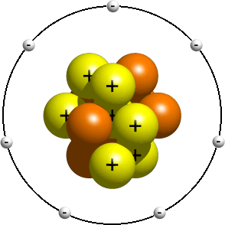
What are we made up of?
We are made of little particles known as atoms
Atoms are the smallest basic unit of matter
All atoms contain three parts
Proton
Neutron
Electron

Slide 7
Diagram and label the parts of an atom.
Proton = positively charged particle in the nucleus of an atom
Neutron = neutrally (no) charged particle in the nucleus of an atom
Electron = negatively charged particle circling around the nucleus of an atom

Slide 8
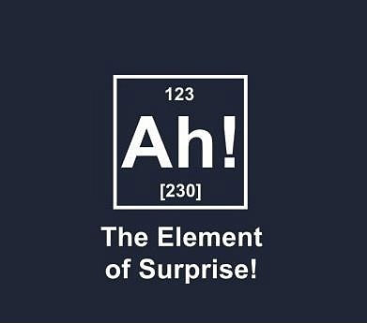
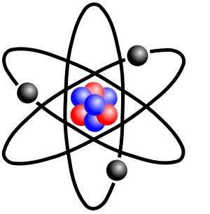
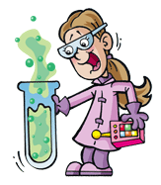
What do atoms make?
Atoms make up elements
Elements contain one particular atom
Cannot be broken down into a simpler particle
Have a particular amount of electrons and protons
92 naturally occurring element; 115 known elements

Slide 9
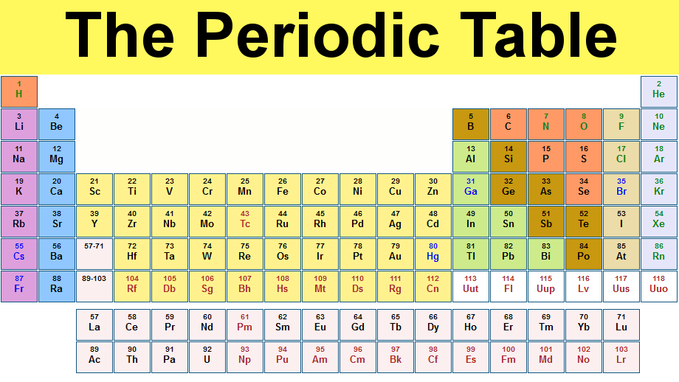
Periodic Table

Slide 10
Daily Routine
Sit in your appropriate seat quietly
Make sure you are wearing your ID’s
Have all necessary materials out
All back packs on the floor
All cell phones on silent and away in backpacks
All IPods off and headphones out of your ears
Hats off
No food or drink except for water

Slide 11
Biology Announcements
Sponge Capsule Lab Report – Due Today!
Quiz Friday!

Slide 12
Bell Work
What is the difference between an electron and a neutron?
Diagram and label the three parts of an atom

Slide 13
Putting Tiny Little Particles Together
Chemistry in Biology
What are we made out of?

Slide 14
I will be able to…
Describe what an atom is
Diagram, label, and define the key parts of an atom
Describe the difference between an element and a compound
Create and describe ionic and covalent bonds

Slide 15
Element Simulation
http://www.classzone.com/cz/books/bio_07/resources/htmls/animated_biology/unit1/bio_ch02_0059_ab_atombond.html

Slide 16
Periodic Table

Slide 17
Periodic Table
http://www.youtube.com/watch?v=zUDDiWtFtEM

Slide 18
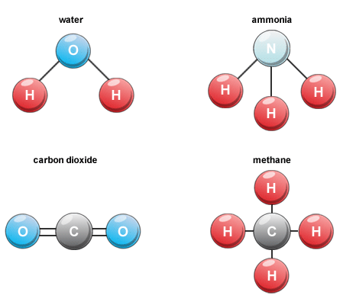
What happens when two elements join together?
When two or more atoms of a/an element join, they form a compound
Compound = substance made of atoms of different elements

Slide 19
Do all elements join the same way to form the compound?
NO!!!!

Slide 20
How are compounds form?
Ionic
Ion – atom that gains or losses electron(s)
Movement of electrons happens in the out shell of atom
Atoms that loss electrons become positive
Atoms that gain electrons become negative
Electrical attraction forms an ionic bond

Slide 21
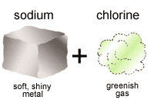
Famous Ionic Bond

Slide 22
How do ionic bonds form?
http://www.classzone.com/cz/books/bio_07/resources/htmls/animated_biology/unit1/bio_ch02_0059_ab_atombond.html
http://www.youtube.com/watch?v=WVonuBjCrNo

Slide 23
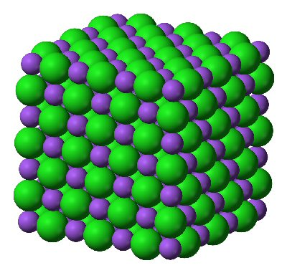
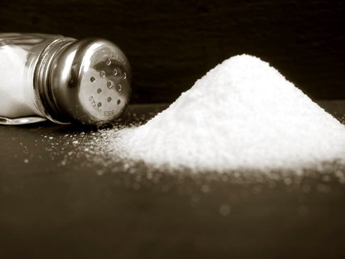
Famous Ionic Bond

Slide 24
How are compounds form?
Ionic
Covalent
Ion – atom that gains or losses electron(s)
Movement of electrons happens in the out shell of atom
Atoms that loss electrons become positive
Atoms that gain electrons become negative
Electrical attraction forms a strong/brittle ionic bond
Joining elements share electrons
Strong bond
Elements that share electrons form molecules
Molecules – two or more atoms held together by covalent bonds

Slide 25
How do covalent bonds form?
http://www.classzone.com/cz/books/bio_07/resources/htmls/animated_biology/unit1/bio_ch02_0059_ab_atombond.html

Slide 26
Daily Routine
Sit in your appropriate seat quietly
Make sure you are wearing your ID’s
Have all necessary materials out
All back packs on the floor
All cell phones on silent and away in backpacks
All IPods off and headphones out of your ears
Hats off
No food or drink except for water

Slide 27
Biology Announcements
Quiz Friday!

Slide 28
Bell Work
Compare and contrast ionic bonds and covalent bonds.

Slide 29
Finding Mass of an Object
Chemistry in Biology
What are we made out of?

Slide 30
I will be able to…
Mass an object using a triple beam balance
Calculate percent error between a triple beam balance and an electronic balance

Slide 31
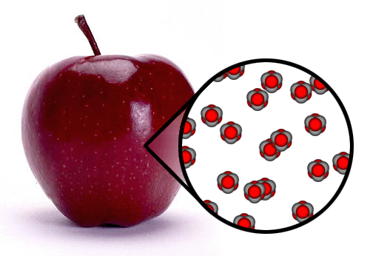
What is mass and why is it important?
Amount of matter in an object
Matter = # of atoms
All objects have mass which, intern, has volume
Helps us understand the chemical make up of biological and other objects

Slide 32
Are mass and weight the same thing?
NO!!!!

Slide 33
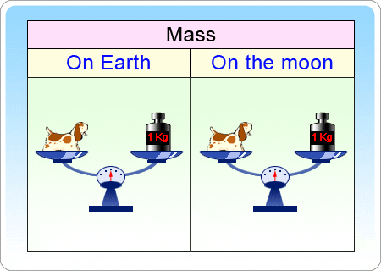
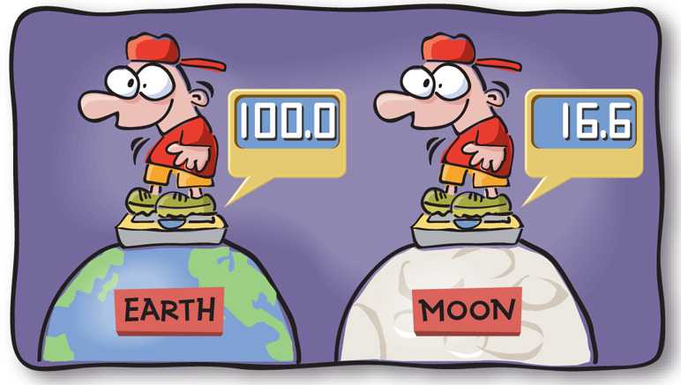
Are mass and weight the same thing?
Mass
Weight
Mass deals with the amount of matter an object has
Weight deals with how mass is affect by gravity’s pull

Slide 34
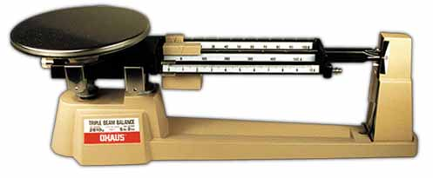
How do we measure mass
We use balances and scales to measure mass
Measure using grams and kilograms
Use a triple beam balance to mass an object
Zero and calibrate scale before using it

Slide 35
Daily Routine
Sit in your appropriate seat quietly
Make sure you are wearing your ID’s
Have all necessary materials out
All back packs on the floor
All cell phones on silent and away in backpacks
All IPods off and headphones out of your ears
Hats off
No food or drink except for water

Slide 36
Earth Science Announcements
Earth Science Current Event – Due Today!!!

Slide 37
Daily Routine
Sit in your appropriate seat quietly
Make sure you are wearing your ID’s
Have all necessary materials out
All back packs on the floor
All cell phones on silent and away in backpacks
All IPods off and headphones out of your ears
Hats off
No food or drink except for water

Slide 38
Earth Science Announcements
Density Worksheet due Friday Sept. 7th

Slide 39
Bell Work
Describe density in your own words.
What is the continental drift hypothesis?

Slide 40
Continental Drift
Geology: Plate Tectonics

Slide 41
I will be able to…
Explain who Alfred Wegner was and what his continental drift hypothesis was
State Wegner’s lines of evidence and elaborate about how they support his hypothesis
Explain why or why not Wegner’s hypothesis was(n’t) first supported by the scientific community

Slide 42
Continental Drift Article
Spend some time reading the Continental Drift Article
On another piece of paper answer the following questions in three complete paragraphs:
Who was Alfred Wegener?
Explain what the continental drift hypothesis is?
What evidence did he use to support his hypothesis? Explain how the evidence supports Wegener’s hypothesis
Was his hypothesis accepted at first? Why or why not?

Slide 43
Daily Routine
Sit in your appropriate seat quietly
Make sure you are wearing your ID’s
Have all necessary materials out
All back packs on the floor
All cell phones on silent and away in backpacks
All IPods off and headphones out of your ears
Hats off
No food or drink except for water

Slide 44
Earth Science Announcements
Density Worksheet due Friday Sept. 7th

Slide 45
Bell Work
Describe density in your own words.
What is the continental hypothesis?

Slide 46
Continental Drift
Geology: Plate Tectonics

Slide 47
I will be able to…
Explain who Alfred Wegner was and what his continental drift hypothesis was
State Wegner’s lines of evidence and elaborate about how they support his hypothesis
Explain why or why not Wegner’s hypothesis was(n’t) first supported by the scientific community

Slide 48
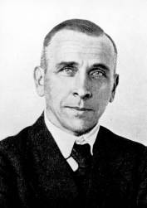
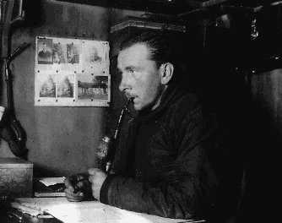
Who Was Alfred Wegener
German meteorologist (person who studies the weather)
Most research dealt with proving the existence of the jet stream
Became famous for his Continental Drift Hypothesis

Slide 49
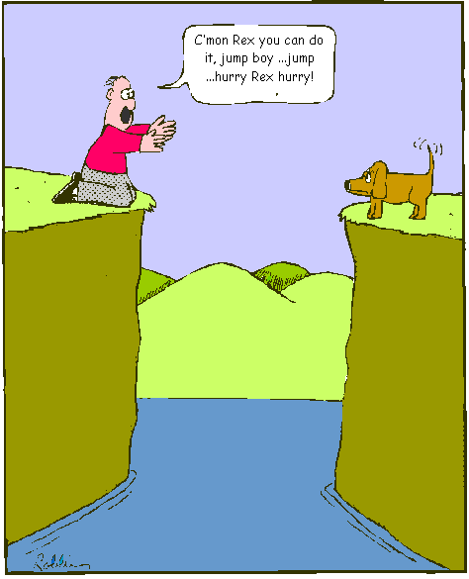
What is the Continental Drift Hypothesis
All continents were together in one landmass
Landmass was known as Pangaea
Some natural event happened and caused the continents to split
Continents drifted apart to their current day position

Slide 50
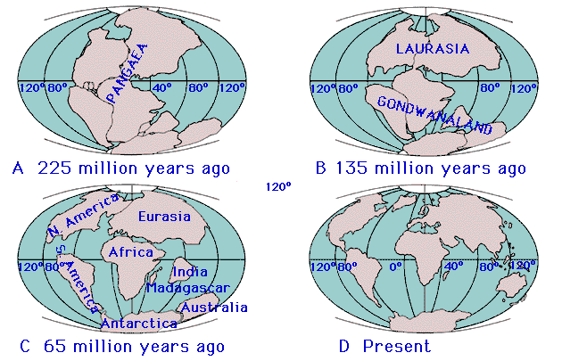
Continental Drift Hypothesis

Slide 51
Pangaea Animation
http://www.youtube.com/watch?v=hSdlQ8x7cuk

Slide 52
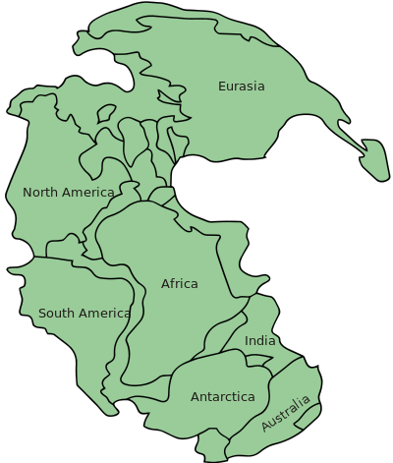
What type of evidence did he use to support his hypothesis?
The continents seems to fit together like a puzzle
One large land mass known as Pangaea
Lauratania – North America, Europe, Asia
Gondwana – South America, Australia, Africa, Antarctica, India

Slide 53
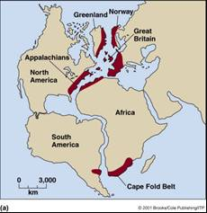
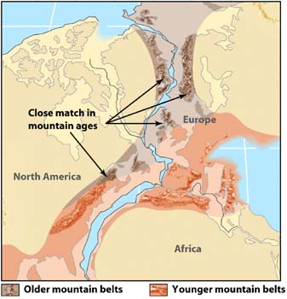
What type of evidence did he use to support his hypothesis?
Geologic Evidence:
Similar rock formations found on different continents
These formations were the same age
Different mountain ranges line up and have similarities

Slide 54
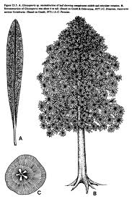
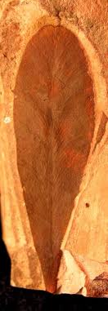
What type of evidence did he use to support his hypothesis?
Fossil Evidence:
Four index fossils were found throughout the five southern continents
Prime example: Glossopteris – type of tropical fern
Most animals were fresh water or land dwellers and couldn’t swim long distances

Slide 55
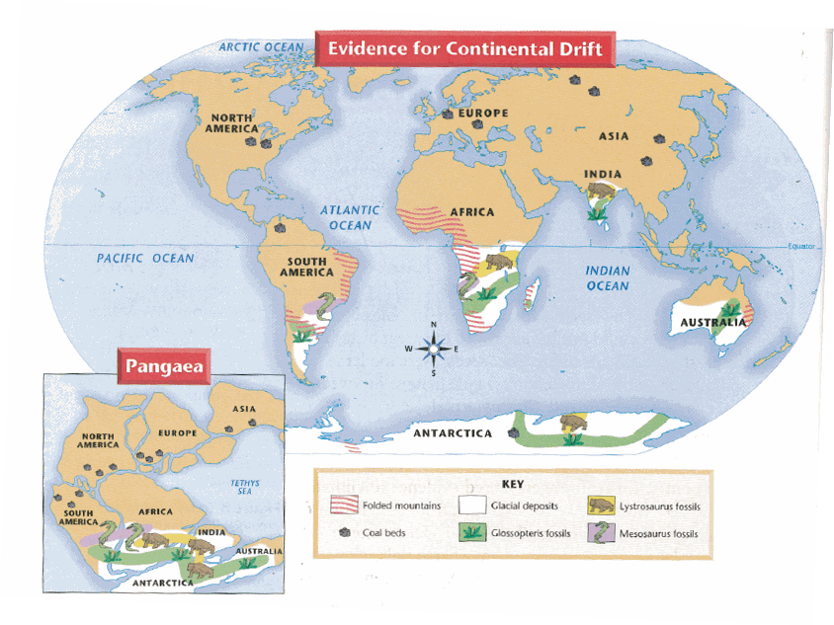
What type of evidence did he use to support his hypothesis?
Climatic Evidence
Coal Beds: indicate tropical climates and were found in Antarctica
Fossils indicate animals lived in tropical ecosystems
Glacial deposits (moraines) on different continents are similar by positioning and material
Glacial striations or scratch marks follow same trends on different continents

Slide 56
Climate Evidence

Slide 57
Was Wegner’s Hypothesis accepted?
NO!!!!

Slide 58
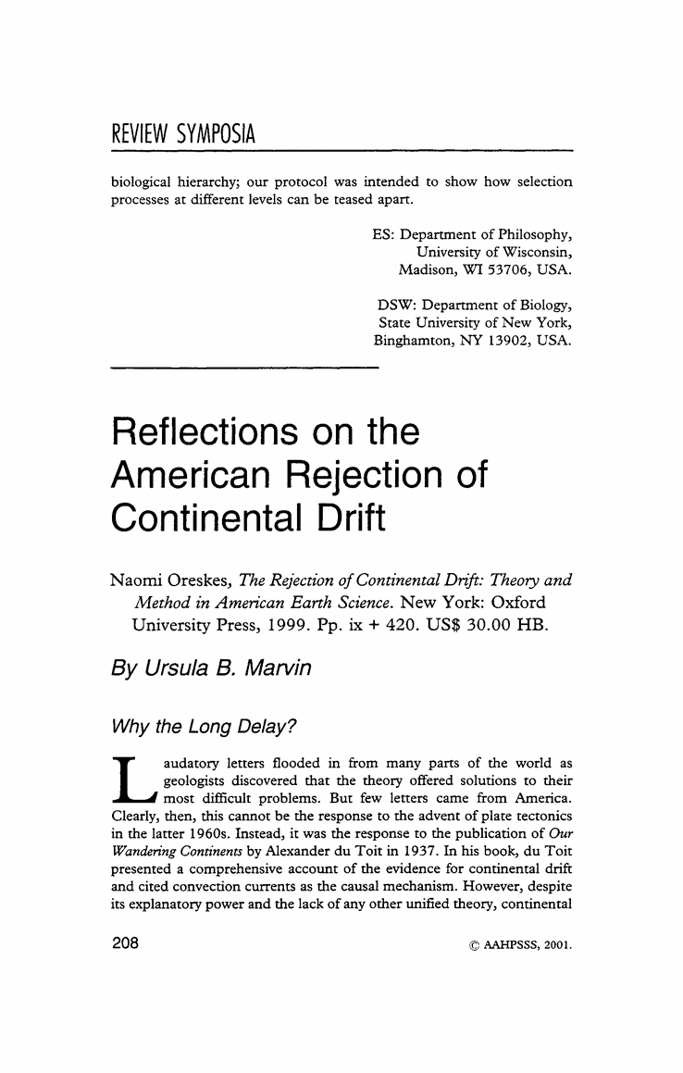
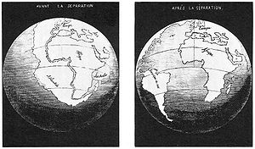
Why wasn’t Wegner’s Hypothesis accepted?
Wegner had an abundance of evidence to support his hypothesis
Didn’t have the mechanism to explain how the continents divided

