Slide 1
Daily Routine
Sit in your appropriate seat quietly
Have all necessary materials out
All back packs on the floor
All cell phones on silent and away in backpacks
All music devices off and headphones out of your ears
No food or drink except for water

Slide 2
Bell Work
What is topographic map? What is it used for in science?
What is a contour interval?

Slide 3
Earth Science Announcements
Quiz on Friday (Metric, Density, and Latitude and Longitude
Topographic Map Project Due January 23rd

Slide 4
Topographic Maps

Slide 5
Topic: Topographic maps
Unit: Maps
Objectives: I will be able to:
To learn about topographic maps
To learn mapping basics, such as contour lines and intervals
To learn contour rules
To draw a profile from contour lines on a topographic map

Slide 6
Going back to the Topo Maps: Answer in complete sentences!!!
Describe the topography of your mapped area? Is it steep or gradual sloped? Be detailed!!!
Describe the shape of the contour lines around rivers on the map.
Try to find the highest point on the map. What is the elevation. Is the land steep or flat? Explain using the contour lines.
What other symbols do you see on the map? What could these symbols represent?

Slide 7
Practice Drawing Contour Lines

Slide 8
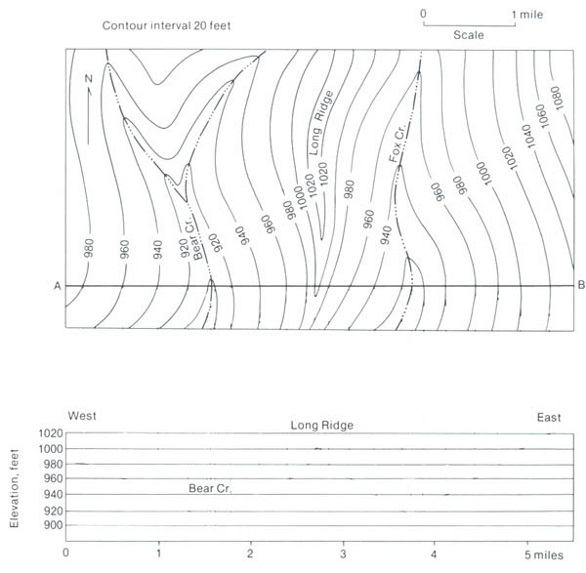
PROFILE
A profile shows a side view from a flat topographic map.
A
B

Slide 9
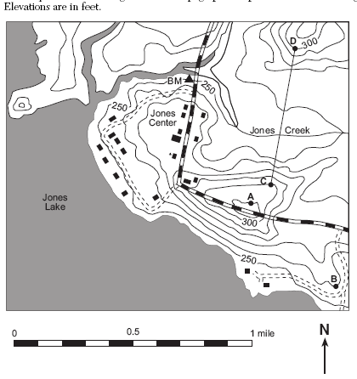
How To Make a Profile
Listen Carefully!!!!
300
290
280
Step 1: Draw a transect line. Sometimes the line will be drawn for you
Step 2: take a sheet of paper and make “tick” marks where each contour line intersects the map
Step 3: record elevation at each tick mark
270
260
260
270
280
290
300

Slide 10
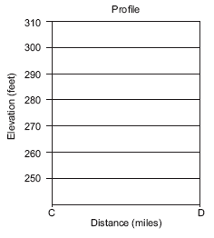
How To Make a Profile
Listen Carefully!!!!
Step 4: take your sheet of paper and plot your elevation points on a graph
Step 5: Draw a line through your points
260
260
300
270
270
300
280
290
290
280

Slide 11
Changing from top to side
The closer the lines,
the steeper the terrain
The farther apart the lines,
the flatter the terrain

Slide 12
Practice Drawing a Profile

Slide 13
Creating a Topographic Map and Profile of a Volcano
Thanks to CPO Science for making slides demonstrating the lab

Slide 14
Making a topographic map-Using the GeoBox
The GeoBox has a sticker on the side.
Each mark on this sticker represents one centimeter.
Pour water into the GeoBox up to the first centimeter line.
Notes:
Images like these can be used to make overheads, inserted into electronic documents, inserted into print documents, or projected directly onto a screen with a computer projection system. Every investigation has at least one image on the CD-ROM that is part of our teacher toolkit.

Slide 15
Making a topographic map-Using the GeoBox
The GeoBox has a sticker on the side.
Each mark on this sticker represents one centimeter.
Pour water into the GeoBox up to the second line. This will be our zero mark
0
Notes:
Images like these can be used to make overheads, inserted into electronic documents, inserted into print documents, or projected directly onto a screen with a computer projection system. Every investigation has at least one image on the CD-ROM that is part of our teacher toolkit.

Slide 16
Place the topo lid on the GeoBox.
Stand over the GeoBox so that you are looking down on the topo form.
With the overhead projector marker, outline the perimeter of the land surface onto the lid.
This will be considered “sea level,” or the 0 meter contour line.
Sea level
(coastline)
Water covering land surface
Uncovered land surface
Notes:
Images like these can be used to make overheads, inserted into electronic documents, inserted into print documents, or projected directly onto a screen with a computer projection system. Every investigation has at least one image on the CD-ROM that is part of our teacher toolkit.

Slide 17
Label the 0 cm line
Notes:
Images like these can be used to make overheads, inserted into electronic documents, inserted into print documents, or projected directly onto a screen with a computer projection system. Every investigation has at least one image on the CD-ROM that is part of our teacher toolkit.

Slide 18
Now, using your marker, number each centimeter above sea level.
Notes:
Images like these can be used to make overheads, inserted into electronic documents, inserted into print documents, or projected directly onto a screen with a computer projection system. Every investigation has at least one image on the CD-ROM that is part of our teacher toolkit.

Slide 19
Remove the topo lid and add water until the water level reaches the 1-centimeter mark.
Notes:
Images like these can be used to make overheads, inserted into electronic documents, inserted into print documents, or projected directly onto a screen with a computer projection system. Every investigation has at least one image on the CD-ROM that is part of our teacher toolkit.

Slide 20
Replace the lid. Trace the “coastline,” the line along which the water and land meet, onto the lid.
All points on this line are 1 cm above sea level. They form a contour line, a line of equal elevation.
Notes:
Images like these can be used to make overheads, inserted into electronic documents, inserted into print documents, or projected directly onto a screen with a computer projection system. Every investigation has at least one image on the CD-ROM that is part of our teacher toolkit.

Slide 21
Replace the lid. Trace the “coastline,” the line along which the water and land meet, onto the lid.
All points on this line are 1 cm above sea level. They form a contour line, a line of equal elevation.
Label the 1 cm contour line
Notes:
Images like these can be used to make overheads, inserted into electronic documents, inserted into print documents, or projected directly onto a screen with a computer projection system. Every investigation has at least one image on the CD-ROM that is part of our teacher toolkit.

Slide 22
Add water to the level of the 2 centimeter mark.
Notes:
Images like these can be used to make overheads, inserted into electronic documents, inserted into print documents, or projected directly onto a screen with a computer projection system. Every investigation has at least one image on the CD-ROM that is part of our teacher toolkit.

Slide 23
Add water to the level of the 2 centimeter mark.
Notes:
Images like these can be used to make overheads, inserted into electronic documents, inserted into print documents, or projected directly onto a screen with a computer projection system. Every investigation has at least one image on the CD-ROM that is part of our teacher toolkit.

Slide 24
Replace the lid and again, trace and label the “coastline.”
All points on this line are 2 centimeters above sea level.
Notes:
Images like these can be used to make overheads, inserted into electronic documents, inserted into print documents, or projected directly onto a screen with a computer projection system. Every investigation has at least one image on the CD-ROM that is part of our teacher toolkit.

