Slide 1
Daily Routine
Sit in your appropriate seat quietly
Have all necessary materials out
All back packs on the floor
All cell phones on silent and away in backpacks
All music devices off and headphones out of your ears
No food or drink except for water

Slide 2
Bell Work
Compare an contrast latitude and longitude.
What are the 0 degree lines of latitude and longitude called?

Slide 3
Earth Science Announcements
Latitude and Longitude Practice Sheet
Quiz on Friday (Metric, Density, and Latitude and Longitude

Slide 4
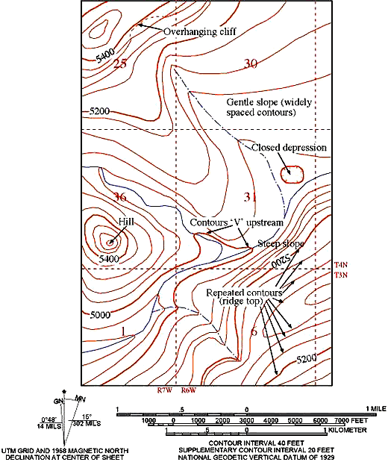
Topographic Maps

Slide 5
Topic: Topographic maps
Unit: Maps
Objectives: Day 2 of 3
To learn about topographic maps
To learn mapping basics, such as contour lines and intervals
To learn contour rules

Slide 6
Spend 5 minutes finishing yesterday’s Latitude and Longitude Worksheet Pass it in when you are done

Slide 7
How do you write the coordinates of latitude and longitude?
Each point must be labeled with degrees
Latitude is always the first point given in the coordinate
The latitude coordinate must state whether the location is in the Northern or Southern Hemisphere
The longitude coordinate must state whether the location is in the Eastern or Western Hemisphere
Example: Roseville – 38.7525° N, 121.2894° W

Slide 8
Topographic Map Activity
You will be in groups of 3-4 at a lab station…this is final
You and your group members will observe the map
You and your group members will answer the following questions on another sheet of paper

Slide 9
Questions
What location does your map depict?
What is the scale of the map?
What do the brown lines on the map represent?
Are all the brown lines an equal distance apart? If not, describe what this could mean?
Are there any physical features on you map? If so what are they?
What do the following colors represent: blue and green?

Slide 10
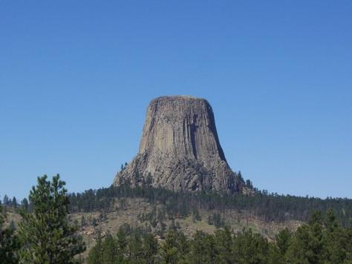
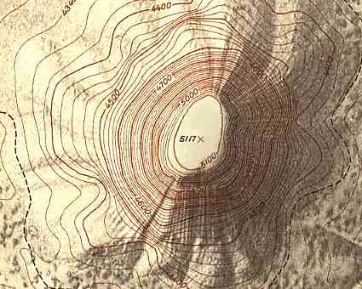
Topographic Maps
Topography is the shape of the land
A topographic map shows the shape of the Earth’s surface by using contour lines.

Slide 11
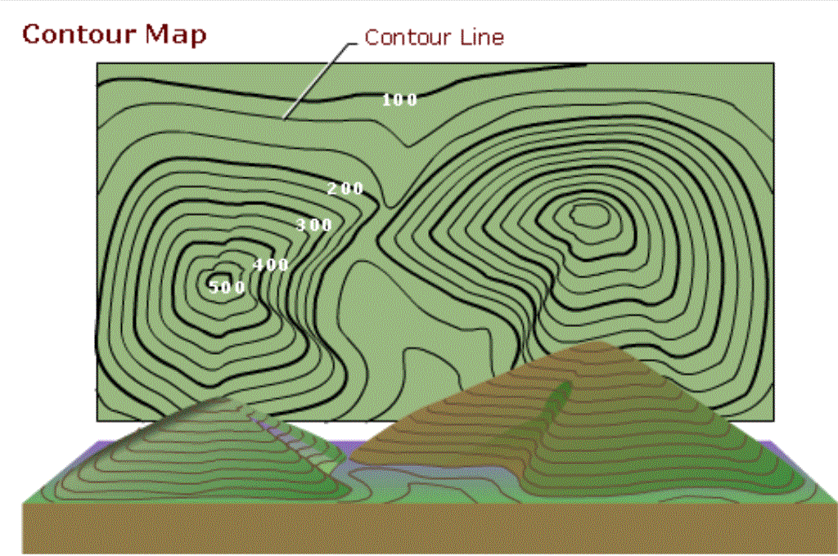
Contour Lines
Contour Lines are imaginary lines that join points of equal elevation above or below sea level.
Every Where on
the contour line,
The elevation
is 400 meters

Slide 12
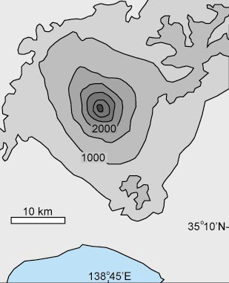
Contour Interval
The Contour Interval is the difference in elevation between one contour line and the next.
Can you figure out the contour interval on the map to the right?

Slide 13
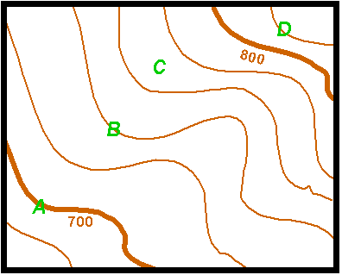
What are the elevations indicated by the letters on the map below?
Contour interval
20 meters (m)
20ft
Contour Interval =
A =
B =
C =
D =
700ft
740ft
770ft
820ft

Slide 14
Contour Mapping Rules
1. Hills and depressions are represented by circles. Hachure Lines are used to show depressions.
Hill Depression

Slide 15
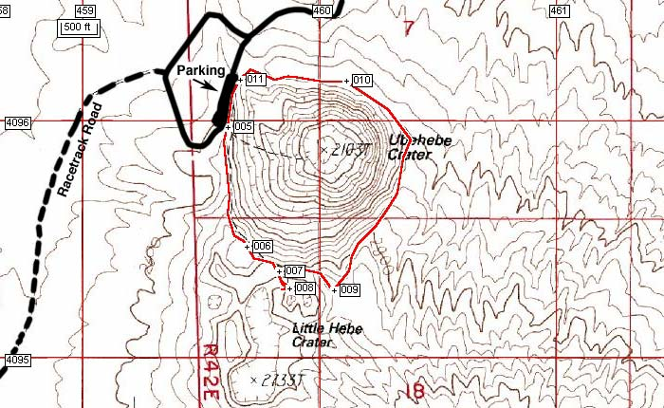

Slide 16
Contour Mapping Rules
2. Contour lines never cross.

Slide 17
Contour Mapping Rules
3. When contour lines meet a river or a stream they form a “V” that points upstream.

Slide 18
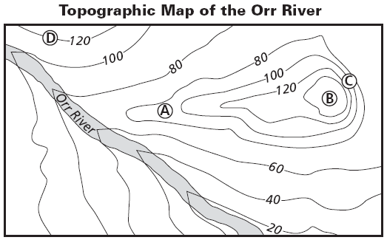
“V’s” Point upstream

Slide 19
Contour Mapping Rules
4. Contour Lines close together = steep slopes
Contour Lines far apart = flat gentle slopes
A
B
A
B

Slide 20
Going back to the Topo Maps: Answer in complete sentences!!!
Describe the topography of your mapped area? Is it steep or gradual sloped? Be detailed!!!
Describe the shape of the contour lines around rivers on the map.
Try to find the highest point on the map. What is the elevation. Is the land steep or flat? Explain using the contour lines.
What other symbols do you see on the map? What could these symbols represent?

