Slide 1
Daily Routine
Sit in your appropriate seat quietly
Make sure you are wearing your ID’s
Have all necessary materials out
All back packs on the floor
All cell phones on silent and away in backpacks
All IPods off and headphones out of your ears
Hats off
No food or drink except for water

Slide 2
Biology Announcements
DNA replication project due Wed. Jan 15th

Slide 3
Protein Synthesis - Transcription

Slide 4
I will be able to…
Describe and Identify the three components of the Central Dogma
Describe the relationship between RNA and DNA
Identify the three kinds of RNA and their functions
Compare transcription to replication

Slide 5
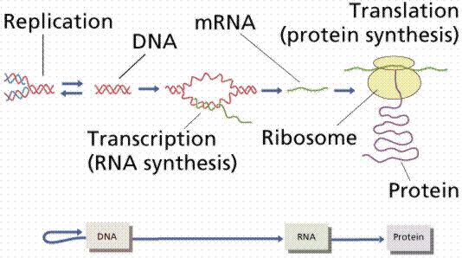
What is Central Dogma
Described by Francis Crick (describe DNA molecule)
Information flows in one directions using DNA as a template
DNA unwinds
Transcription
RNA formed
Translation processes RNA
Proteins formed by linking amino acids

Slide 6
DNA vs. RNA
DNA
RNA
Double Stranded
Codes for genetic information
Has deoxyribose sugar
Nitrogen bases: adenine, thymine, cytosine, and guanine
Single Stranded
Coded from DNA to make proteins
Has ribose sugar
Nitrogen bases: adenine, uracil, cytosine, and guanine

Slide 7
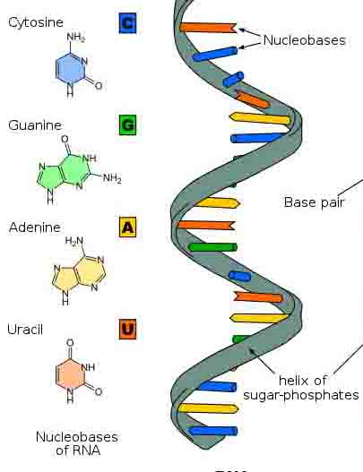
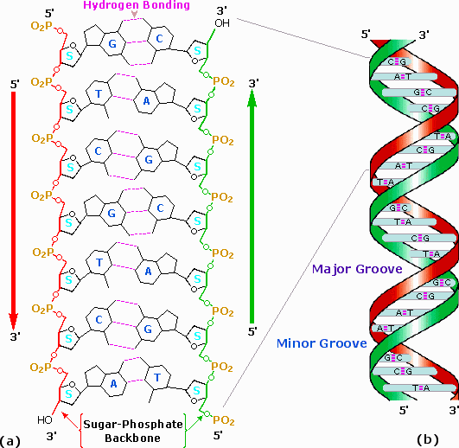
DNA vs. RNA
DNA
RNA

Slide 8
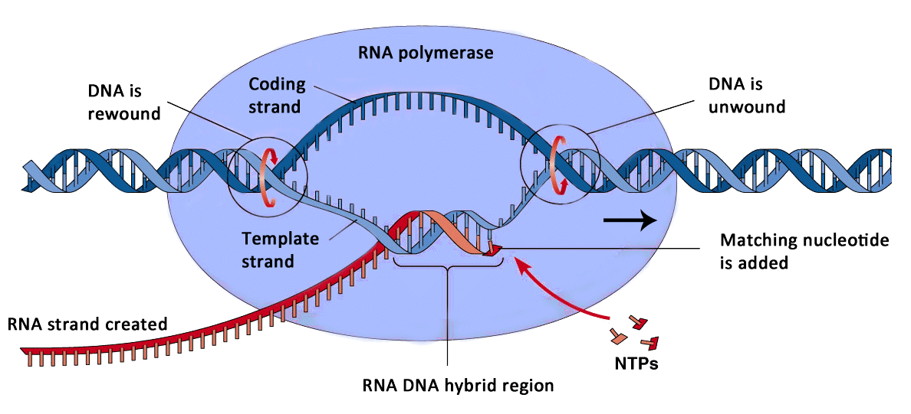
How does transcription work in the Central Dogma in protein synthesis?
1. RNA polymerase (transcription complex) and other proteins recognizes the start site of a gene and begins to unwind the DNA

Slide 9
How does transcription work in the Central Dogma in protein synthesis?
2. RNA polymerase reads one side of the DNA template and strings together a complementary strand of a RNA molecule

Slide 10
How does transcription work in the Central Dogma in protein synthesis?
3. The growing RNA strand hangs freely as it is transcribed (decoded) and detaches completely once the entire gene is transcribed

Slide 11
How does transcription work in the Central Dogma in protein synthesis?
4. New RNA strand leaves the nucleus through the nuclear membrane and enters the cytoplasm to be translated to form proteins.

Slide 12
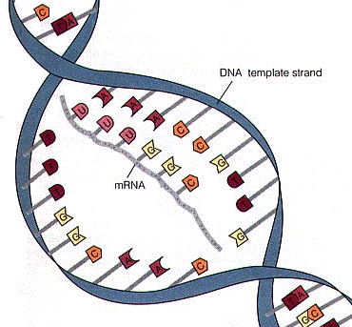
What types of RNA exist?
Messenger RNA (mRNA)
Intermediate message that is translated to form protein

Slide 13
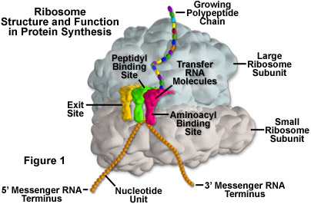
What types of RNA exist?
Ribosomal RNA (rRNA)
Forms part of a ribosome to help process information to make proteins

Slide 14
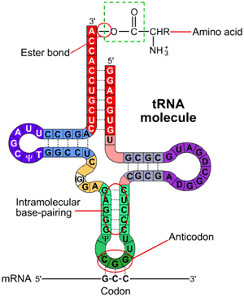
What types of RNA exist?
Transfer RNA (tRNA)
Brings amino acids from the cytoplasm to a ribosome to help make the growing protein

