Slide 1
Daily Routine
Sit in your appropriate seat quietly
Make sure you are wearing your ID’s
Have all necessary materials out
All back packs on the floor
All cell phones on silent and away in backpacks
All IPods off and headphones out of your ears
Hats off
No food or drink except for water

Slide 2
Biology Announcements
DNA replication project due Wed. Jan 15th

Slide 3
Protein Synthesis - Translation

Slide 4
I will be able to…
Describe how mRNA codons are translated into amino acids
Summarize the process of protein synthesis

Slide 5
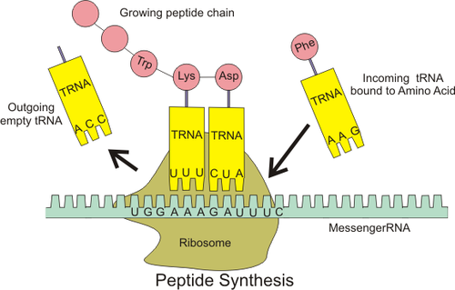
What is translation?
The process that converts, or translates, an mRNA message into a peptide bind
Need RNA and a ribosome
Peptide bonds connect amino acids
A polypeptide bond connects many amino acids to form proteins

Slide 6
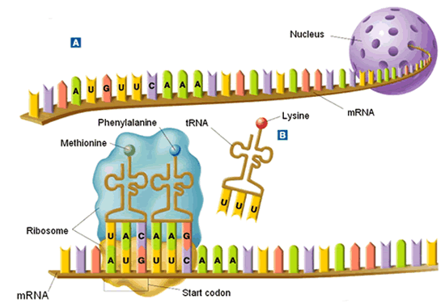
How does translation work?
1. Messenger RNA enters the cytoplasm while two parts of a ribosome assembly to form the ribosomal RNA complex.

Slide 7
How does translation work?
2. Messenger RNA enters ribosomes three base pairs at a time
3. Codon: a three-nucleotide sequence that codes for an amino acid

Slide 8
How does translation work?
4. The first codon is always a start codon which codes for the amino acid methionine
5. The exposed codon attracts the complimentary tRNA bearing an amino acid

Slide 9
How does translation work?
5. The transfer RNA anticodon pairs with mRNA codon, bringing it close to another tRNA
6. Ribosome forms a peptide bond between amino acids and break aa bond with the tRNA

Slide 10
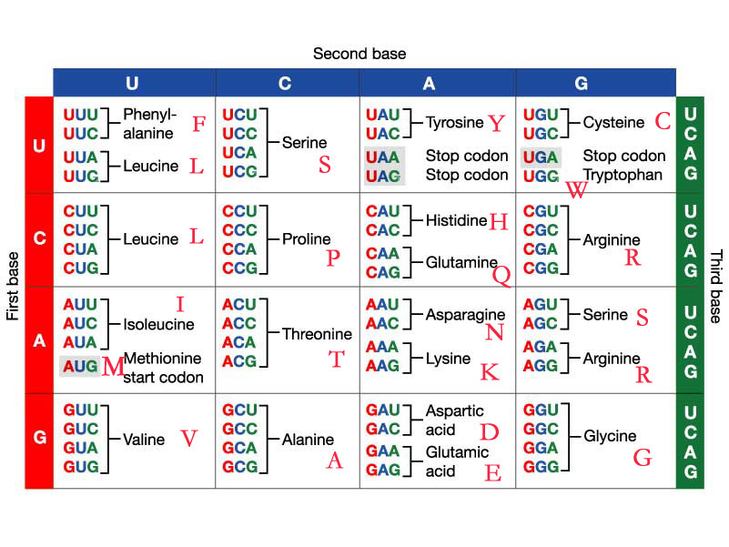
Transform RNA and Matching Amino Acid

Slide 11
How does translation work?
7. Ribosome pulls in one more codon to repeat process as used tRNA leaves ribosome
8. Process continues to translate the codons until it reaches a stop codon.

