Slide 1
Daily Routine
Sit in your appropriate seat quietly
All back packs on the floor
All cell phones away
ID’s on or out on the desk
All IPods off and headphones out of your ears
Have all necessary materials out
Hats off
No food or drink except for water

Slide 2
Bell Work
What type of pressure system are we experiencing today?
What are the four types of fronts? Draw the symbols that represent them on a map.
Compare and contrast a warm front and a cold front.

Slide 3
Announcements
No homework

Slide 4
Can we predict the weather
Weather Maps and Weather Stations

Slide 5
Today we will
Distinguish between a weather map and weather station model
Label different symbols for a weather map and weather station model
Describe current conditions using a weather map and weather station model

Slide 6
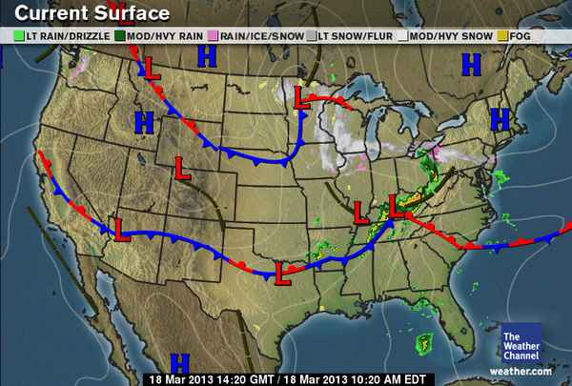
What is the Purpose of Weather Maps?
Weather Maps show current weather conditions and the trends of how storms move across and area

Slide 7
How can you read a weather map?
Weather Maps contains numerous symbols. Draw and label what these symbols means
Cold Front
Warm Front
Stationary Front
High Pressure
Low Pressure
Isobars – lines of equal atmospheric pressure
Occluded Front –
Weather Intensity/ and Type

Slide 8
How to interpret a weather map?
http://www.youtube.com/watch?v=_LZChlsROwA

Slide 9
Interpreting a weather map
http://www.sercc.com/education_files/wxmap/wxmap.html

Slide 10
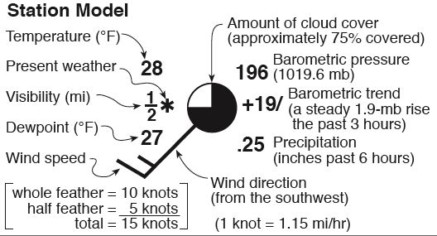
What is a station model and do we read one?

Slide 11
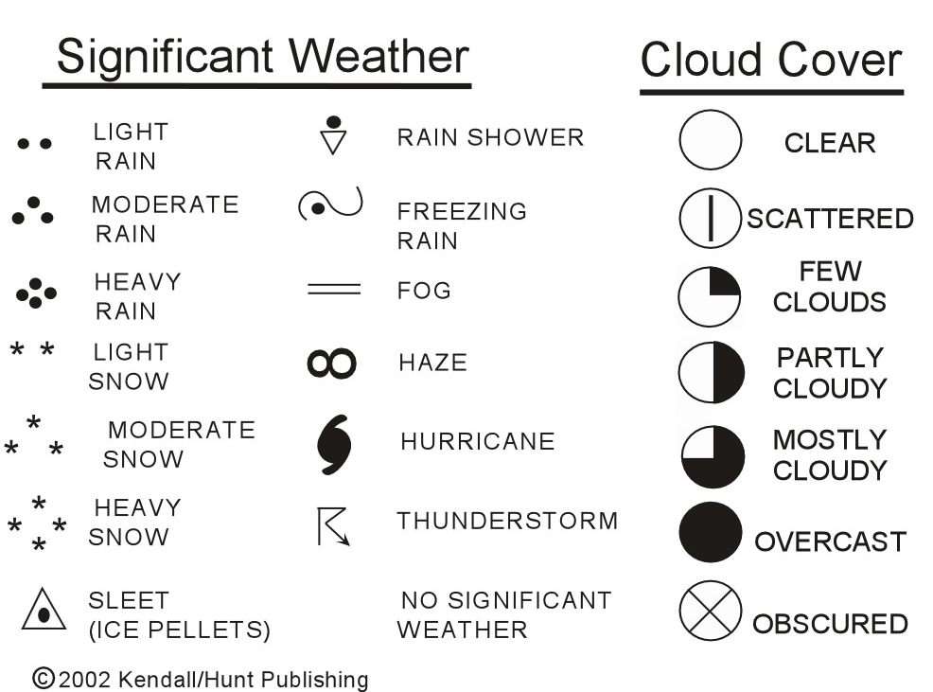
Station Model Symbols to know!

Slide 12
Practice making station models

Slide 13
Exit Slip
Based on the weather map, forecast the weather for Phoenix and Detroit for tomorrow.

