Slide 1
Welcome to CP Earth Science
Grant Hamilton
Room # 904
Email: ghamilton@rjuhsd.us
hamiltonearthscience.weebly.com

Slide 2
Today’s Schedule
Daily Schedule
Class Website
Content Covered
Rules and Expectations
Materials Needed for Class
Grades
Questions

Slide 3
Daily Schedule
Daily Routine – Classroom Expectations
Bell work – Usually a couple questions about unit
Announcements: Homework, Projects, Test Quizzes
Instruction: Various Teaching Strategies and Activities
  Note Taking
  Labs
  Project Work Time
  Classwork
  Movie
  Tests and quizzes
Conclusion

Slide 4
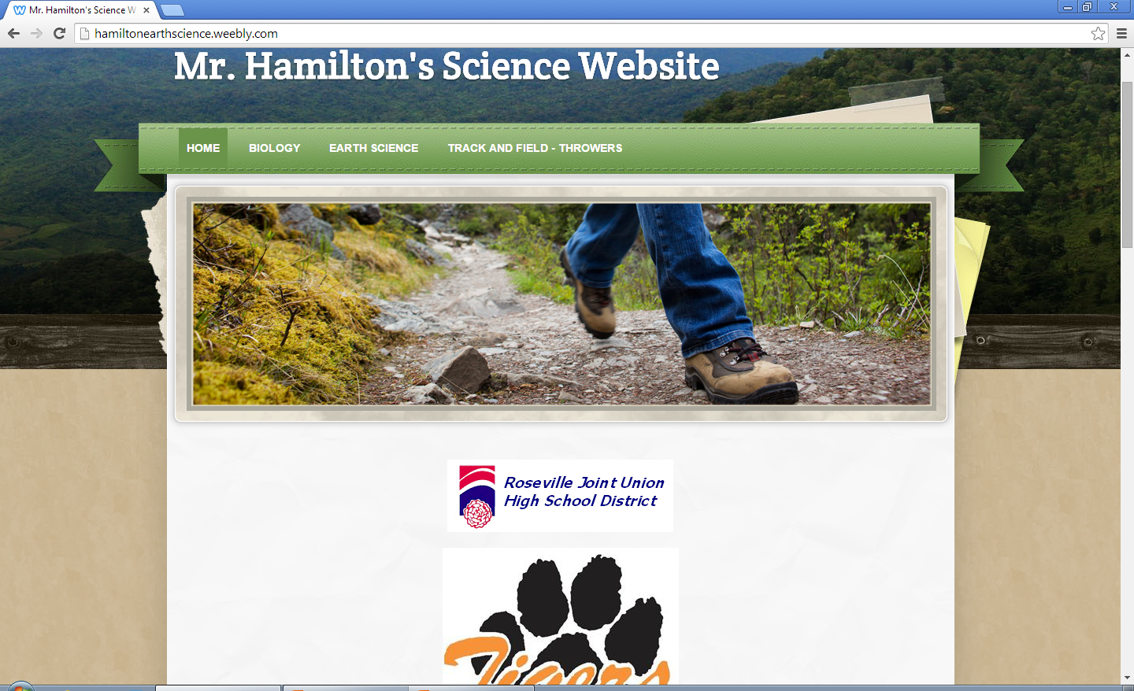
Hamiltonearthscience.weebly.com

Slide 5
Content Covered
Intro
  Metric
  Mass, Volume and Density
  Maps (Lat/Long and Topographic)
Astronomy
  Sun, Moon, and Earth Relationships
  Solar System
  Galaxies and Stars
Geology
  Plate Tectonics
  Earthquakes and Volcanoes
  Rocks and Minerals
  Geologic History
Meteorology
  Atmosphere
  Weather
  Climate
Oceanography

Slide 6
Class Rules
Demonstrate respect to classmates, teachers, and equipment
Take accountibility and responsibility in one’s learning
Positively listen to class discussion, demonstrations, and explanations
Take a chance and contribute to class discussions. Don’t be afraid of asking questions or being wrong.
Turnoff all other electronic gadgets before class begins and store them in backpacks, purses, etc.
Students must be seated when and until the bell rings or when asked to move around the classroom

Slide 7
Materials Needed for Class
pencils/pens
plenty of lined paper
paper notebook
colored pencils
Other useful materials: flash drive, notecards, markers, highlighter, white out, ruler, three ring binder, or white board marker

Slide 8
Grading Breakdown
Grading scale: | Assignment Type Grade Distributions:
A – 90-100 | Tests and Quizzes = 50% of grade
B – 80-89 | Labs and Projects = 20 % of grade
C – 70-79 | Classwork (worksheets, bellwork, etc) = 20%
D – 60-69 | Homework = 10%
F - <59 | Extra Credit is Offered

Slide 9
Questions?

